Slide 1
Canterbury North PCN
Version 2
Public Health PCN profile
Life course indicators
East Kent HCP
Created by Medway Council Public Health Intelligence Team and Kent Public Health Observatory

Slide 2
Summary part 1: Canterbury North
2
Indicator | Compared to England
Job Seekers Allowance rate (16-64 years) | Similar
Fuel poverty | Not compared
Life expectancy (Female) | Similar
Life expectancy (Male) | Worse
Estimated smoking prevalence (QOF) | Higher
Year 6: Prevalence of overweight (including obesity) | Similar
Admission episodes for alcohol-specific conditions | Similar
Total number of prescribed antibiotic items per STAR-PU | Lower
Breast cancer screening coverage (females aged 50-70) | Similar
Cervical cancer screening coverage (females aged 25-49) | Worse
Bowel cancer screening coverage (persons aged 60-74) | Similar
A&E attendances (0-4 years) | Worse
Emergency hospital admissions for asthma (< 19 yrs) | Similar
Hospital admissions as a result of self-harm (10-24 years) | Similar
CHD prevalence | Lower
Stroke prevalence | Lower
PAD prevalence | Similar
Heart failure prevalence | Lower

Slide 3
Summary part 2: Canterbury North
2
Indicator | Compared to England
AF prevalence | Similar
Hypertension prevalence | Lower
Cancer prevalence | Similar
Diabetes prevalence | Lower
COPD prevalence | Lower
Serious mental illness prevalence | Higher
Depression prevalence | Higher
Dementia prevalence | Lower
Premature mortality from all causes | Worse
Cancer mortality U75 | Similar
CVD mortality U75 | Similar
Osteoporosis prevalence 50+ | Similar
Hip fracture adm 65+ | Worse

Slide 4
Contact details
3
If you have any questions or would like further information about these profiles, please contact either:
Dr Natalie Goldring
Senior Public Health Intelligence Manager
Public Health
Medway Council
natalie.goldring@medway.gov.uk
01634 337271
Mark Chambers
Head of Health Intelligence
Kent Public Health Observatory
Kent County Council
mark.chambers@kent.gov.uk
03000 422 794

Slide 5
Introduction
4

Slide 6
Purpose and rationale
5
Profiles have been created for each of the Primary Care Networks (PCNs) in the Kent and Medway Integrated Care System (ICS).
There are 41 PCNs in Kent and Medway.
The aim of the PCN profiles is to identify the health and social care needs of an area. In addition to identifying priority areas to explore further, contextual information about the population characteristics is presented to help PCNs understand the underlying causes for these differences.
Key stakeholders were consulted to identify the indicators that should be included.

Slide 7
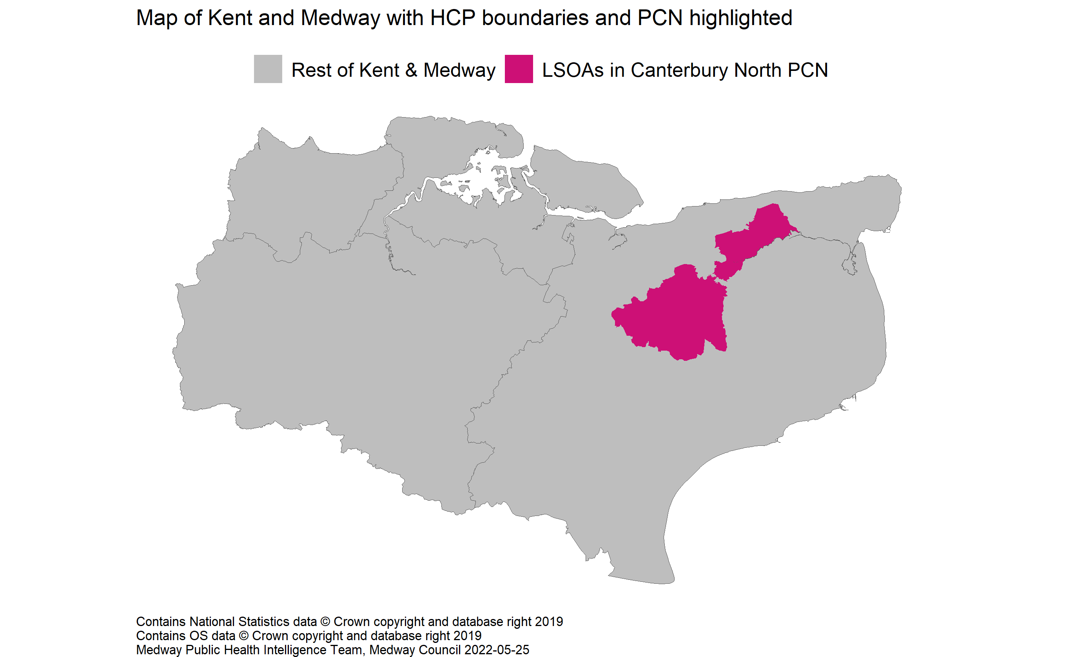
Location of the PCN
6

Slide 8
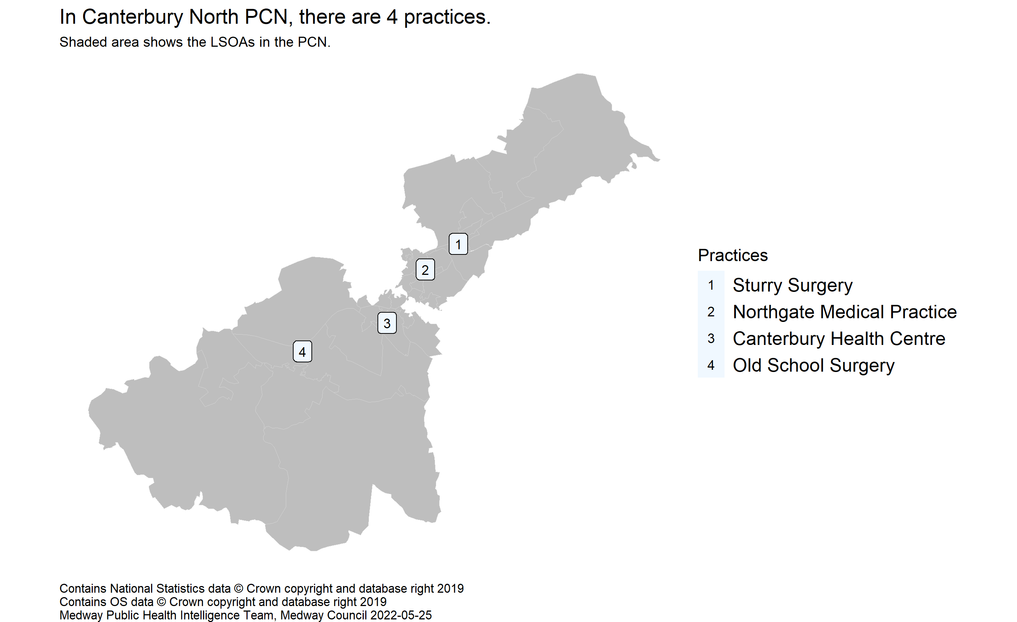
Practices in the PCN
7
Source: NHS Digital. GP and GP practice related data. GP Practices (epraccur).

Slide 9
Small areas
8
Data at several small area levels has been used as building blocks to calculate the PCN values: Lower layer Super Output Area (LSOA), ward, general practice and school.
LSOAs have a defined geographical boundary. On average the population is about 1,700 people so they can be thought of as representing a neighbourhood. There are 1,065 LSOAs within Kent and Medway.
LSOAs and wards were assigned to PCNs on a first passed the post basis, e.g. LSOAs or wards were mapped to PCNs based on which PCN has the highest count of registered patients living in that LSOA/ward.
School level data was assigned to PCNs based on the ward the school was located in. Only primary and nursery school data was used as this more likely reflects the child profile of the local area due to the larger catchment areas of secondary schools.

Slide 10
PCN value and RAG rating
9
The PCN values have been calculated from LSOA, ward, practice or school level data using one of two methods:
1) Aggregated data: PCN values are created from aggregated counts and denominators, where data is available.
2) Small areas averaged: Where count and/or denominator data is not available, the PCN value is the median of the small area values.
A RAG rating (red, amber, green) has been applied to the majority of indicators to show how well an area is performing compared to a benchmark (England). The RAG rating is assigned by comparing an area's value to a reference range, which was created using either confidence intervals (CIs) or a 5% range around the England average. Green corresponds to a value that is better than England, red to a value that is worse, and amber indicates that there is no difference. An indicator is shaded grey where it is inappropriate to apply a RAG rating due to the methods used in the calculation.
Where it is inappropriate to label high or low values as 'better' or 'worse', for example osteoporosis prevalence, the terms 'higher' and 'lower' have been used with neutral colouring such as shades of blue, from light to dark. Such labelling does not imply that high values of these indicators, for example, are 'worse'.

Slide 11
Peer groups
10
Peer groups were created to enable the comparison of PCNs with similar characteristics.
Cluster analysis was used to determine the PCN peer groups. Clustering divides the population into a number of groups with similar traits.
Two clustering algorithms were used to explore the data: K-means and hierarchical clustering.
The characteristics input into the cluster analysis were:
1) Total PCN population
2) Percentage aged 0 to 4 years
3) Percentage aged 5 to 18 years
4) Percentage aged 65 to 84 years
5) Percentage aged 85 years and over
6) Index of Multiple Deprivation (IMD) score
7) Total QOF points
The cluster analysis indicates that the optimum number of distinct groups is two, based on these inputs.
This methodology is being developed and additional characteristics may be added in the future, which may alter the peer groups.

Slide 12
Indicator slides explained
11

Slide 13
Demographics
12

Slide 14
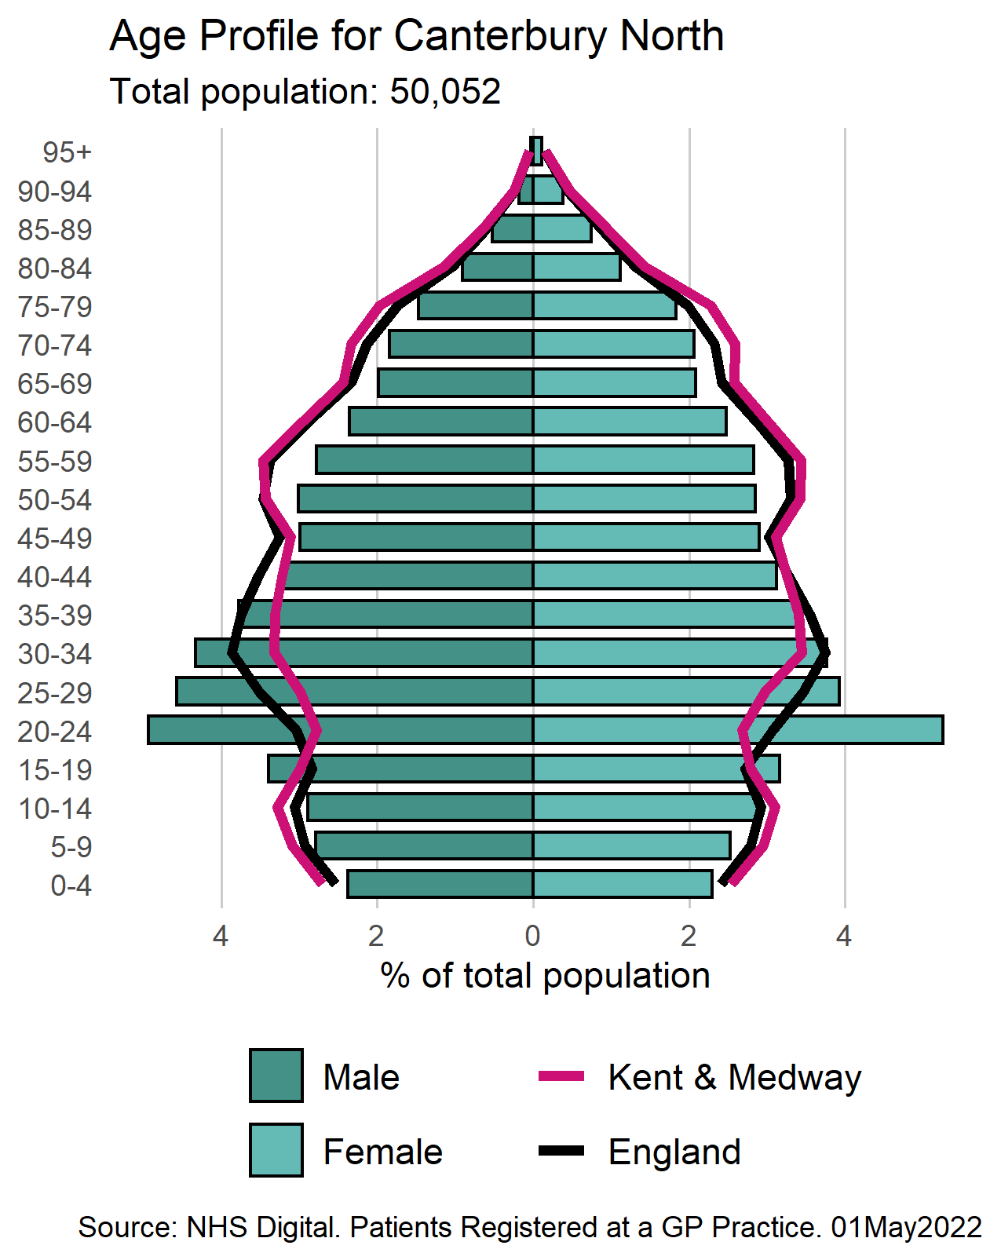
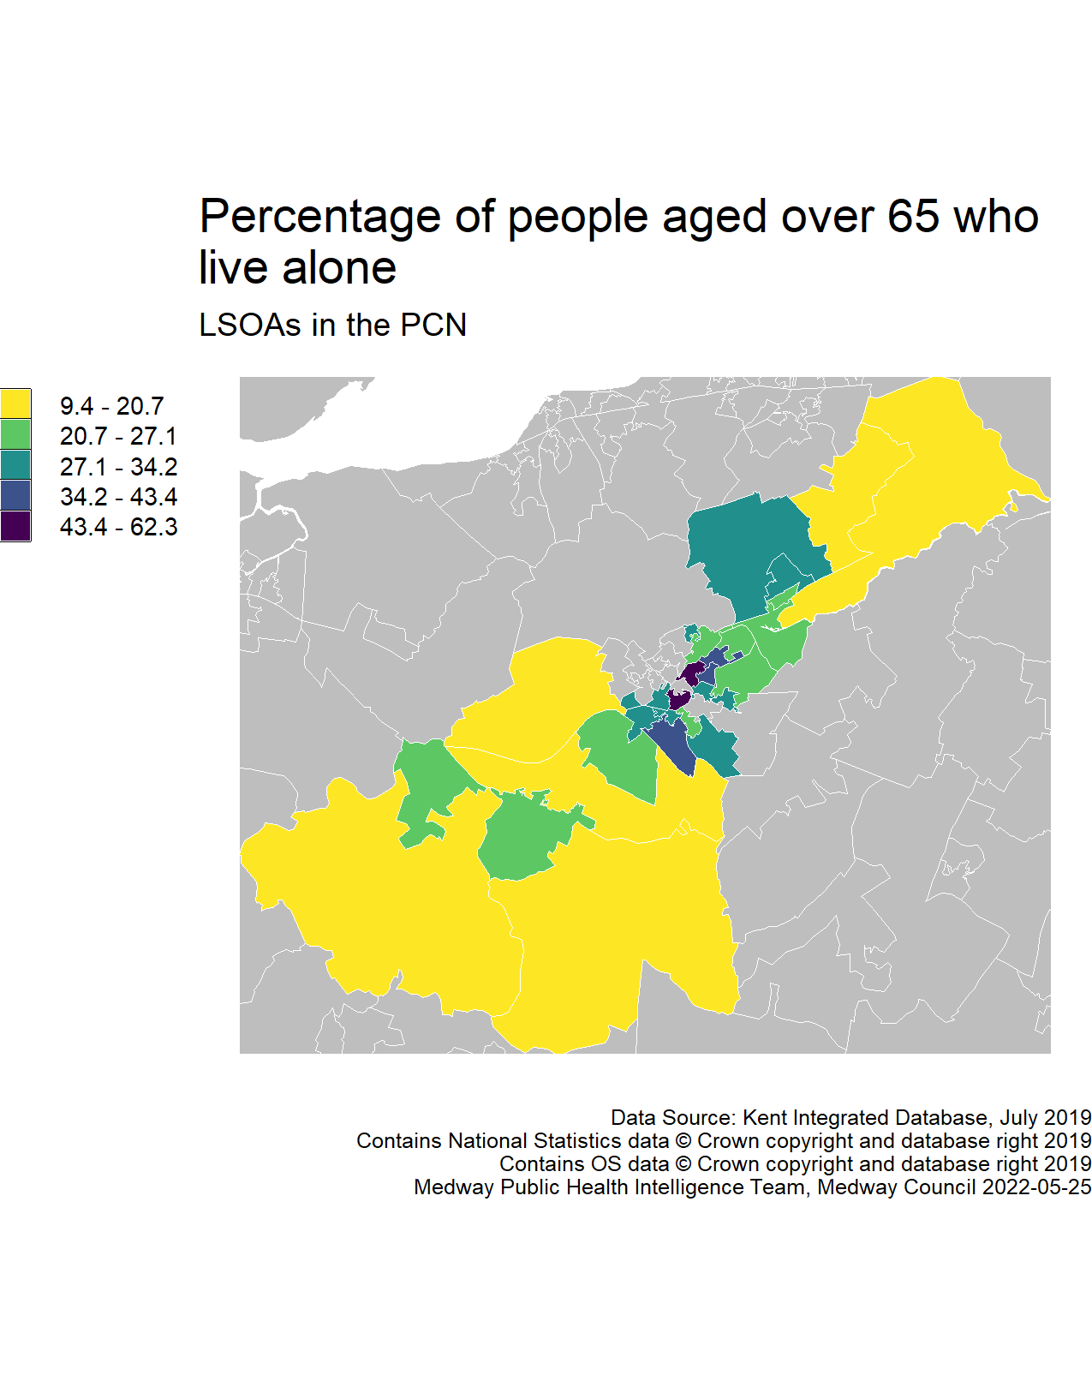
Population
13

Slide 15
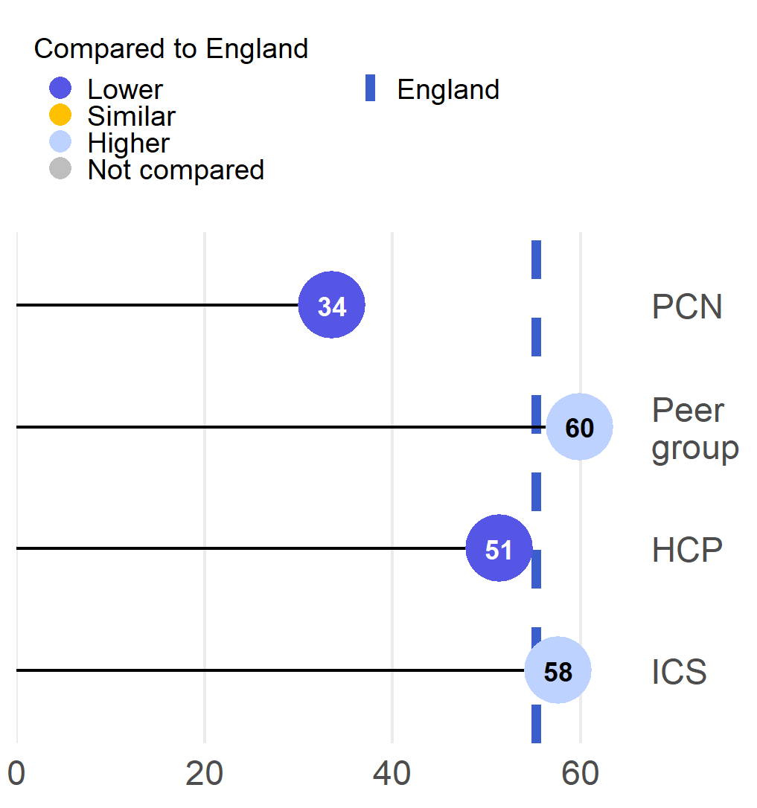
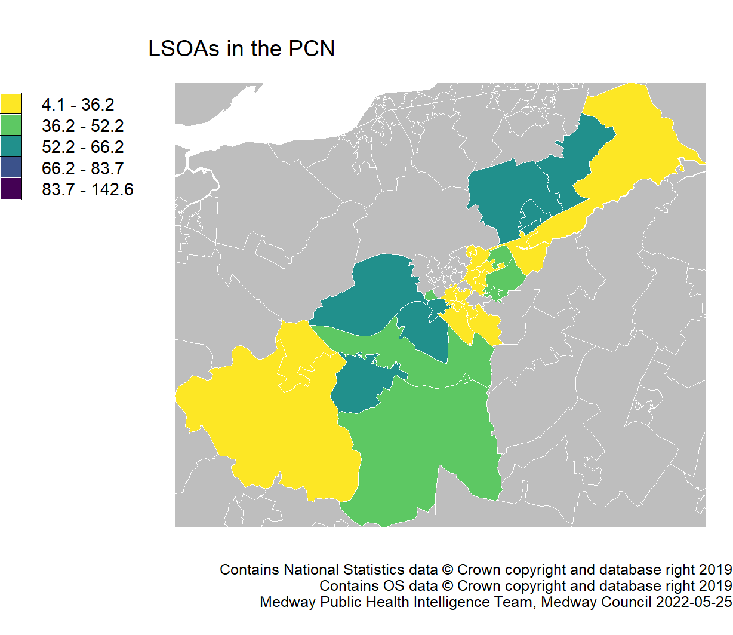
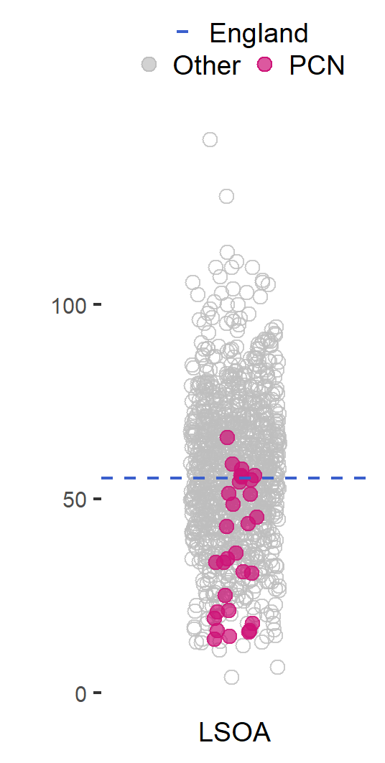
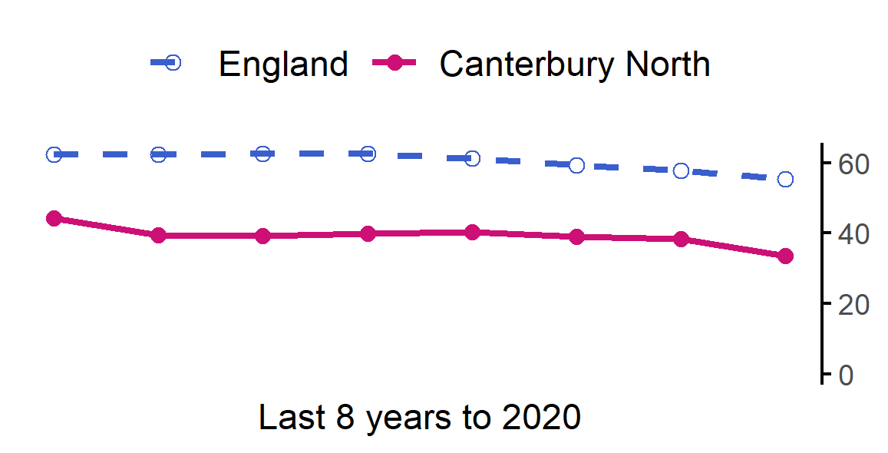
General fertility rate
14
The rate in Canterbury North PCN is lower than England.
Value type: Live births per 1,000 women aged 15-44.
Latest time period: 2020.
Source: Nomis, Office for National Statistics.
PCN average type: Mean.
PCN RAG method: Confidence interval (95%) - Byar's method.
Small area type: LSOA.

Slide 16
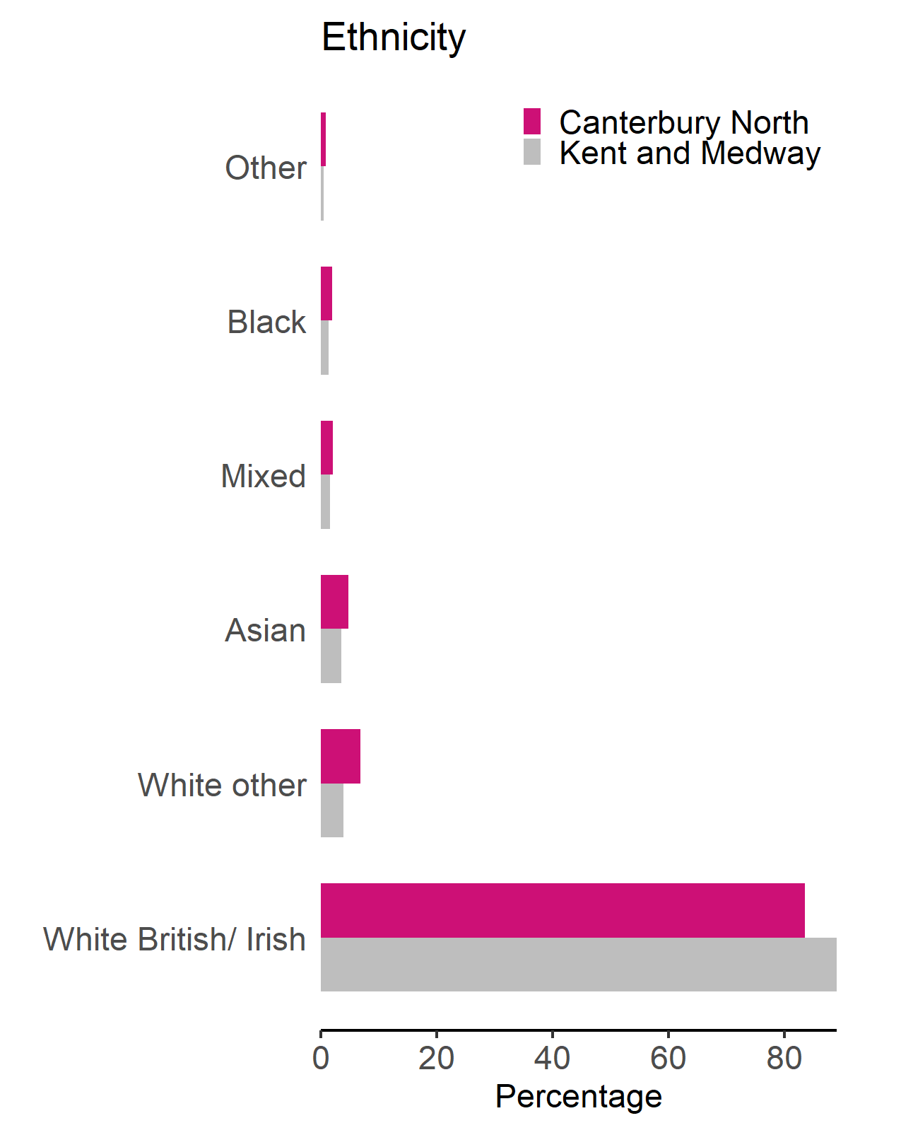
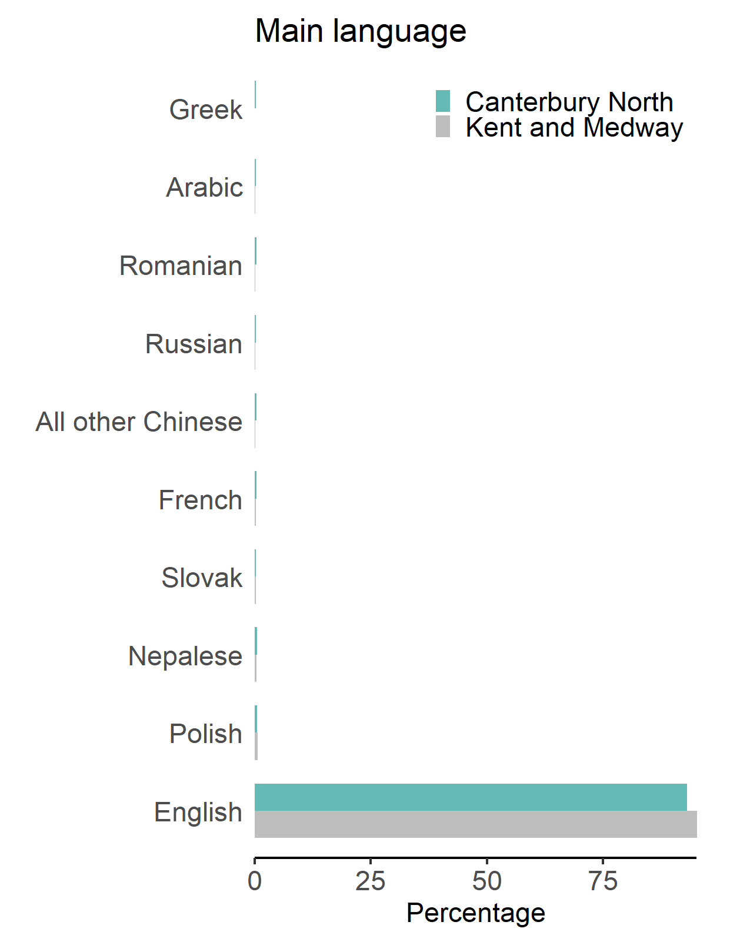
Ethnicity and main language
15
Census 2011 (Office for National Statistics), 2011 ethnicity and main language

Slide 17
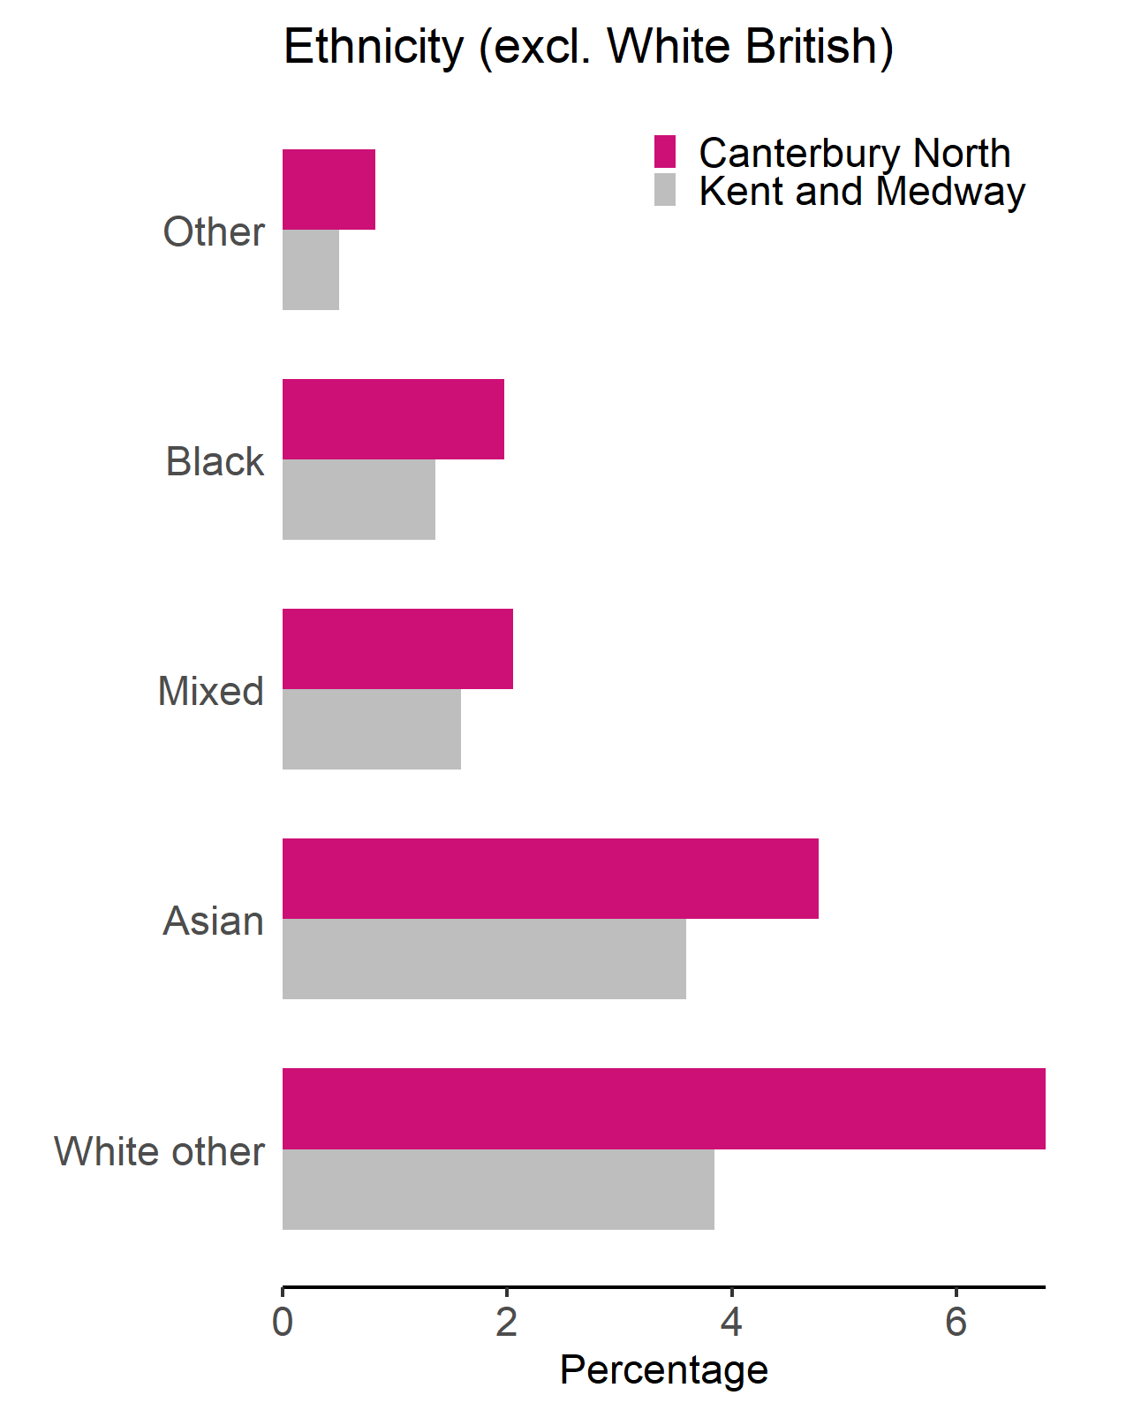
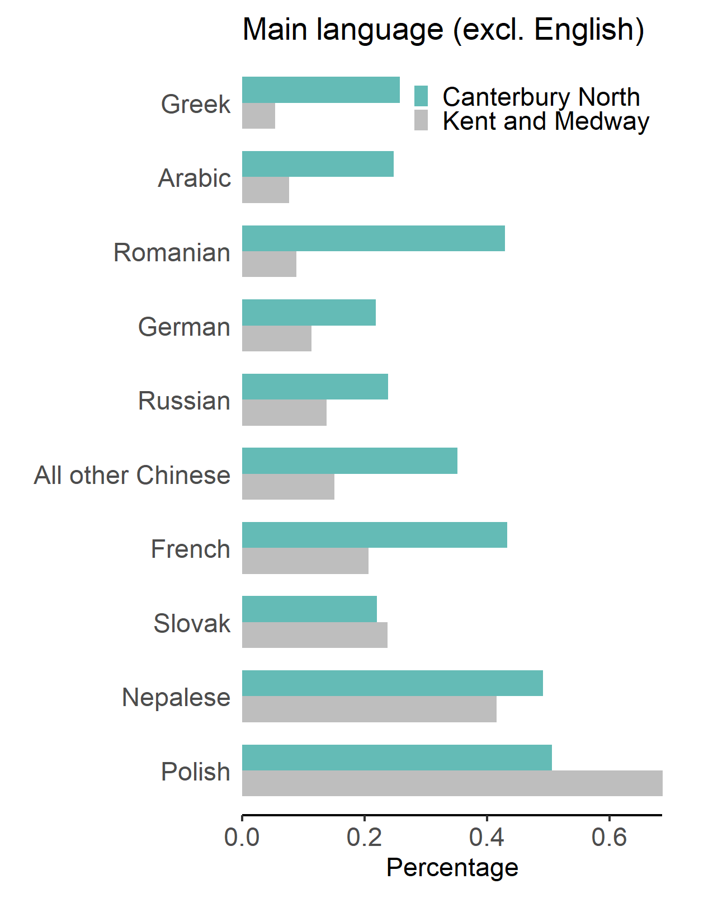
Ethnicity and main language (excluding White British and English)
16
Census 2011 (Office for National Statistics), 2011 ethnicity and main language

Slide 18
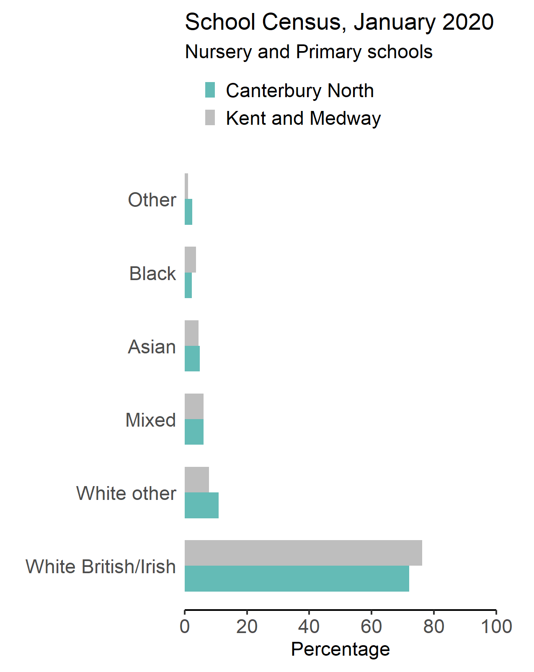
School ethnicity
17
English as first language:
- 81.7% of pupils in Canterbury North.
- 86.9% of pupils in Kent and Medway.
Other than English as first language:
- 18.2% of pupils in Canterbury North.
- 13% of pupils in Kent and Medway.
School Census source: GOV.UK. Department for Education. (2020). Schools, pupils and their characteristics: January 2020.

Slide 19
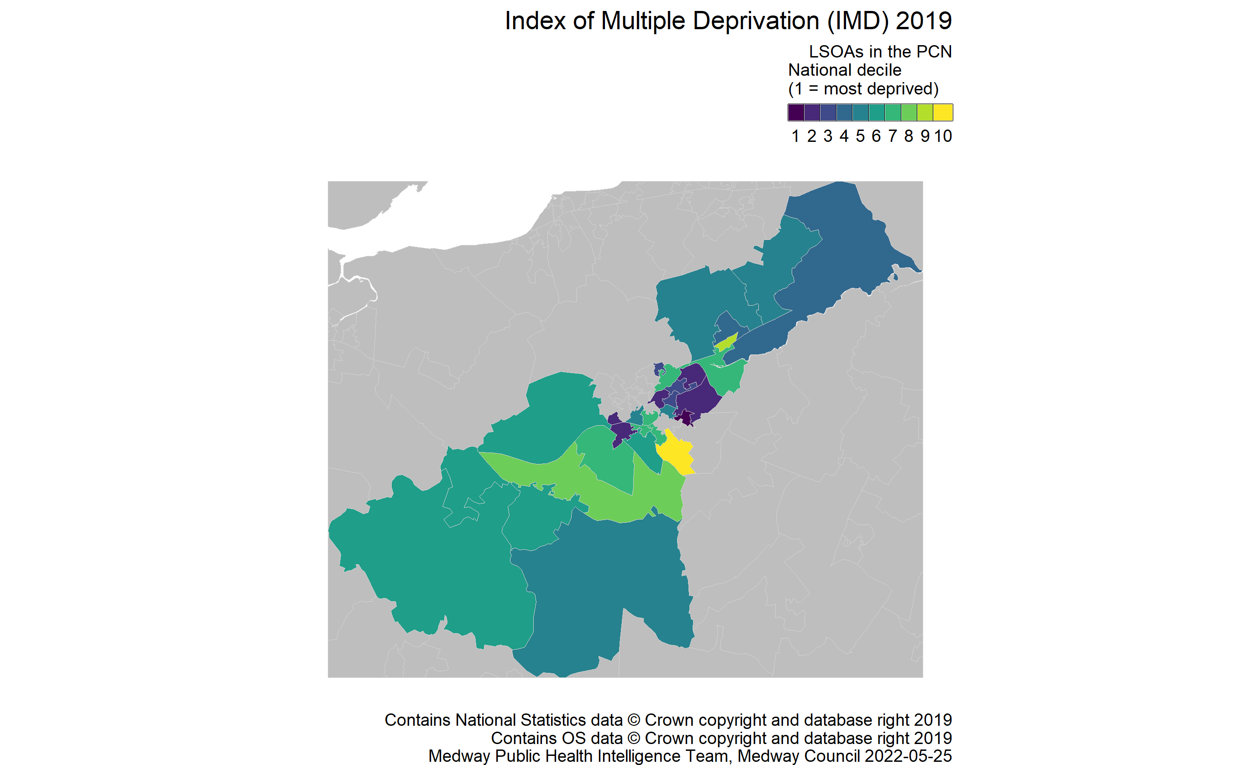
Deprivation
18
Source: GOV.UK. Ministry of Housing, Communities & Local Government. English Indices of Deprivation 2019.

Slide 20
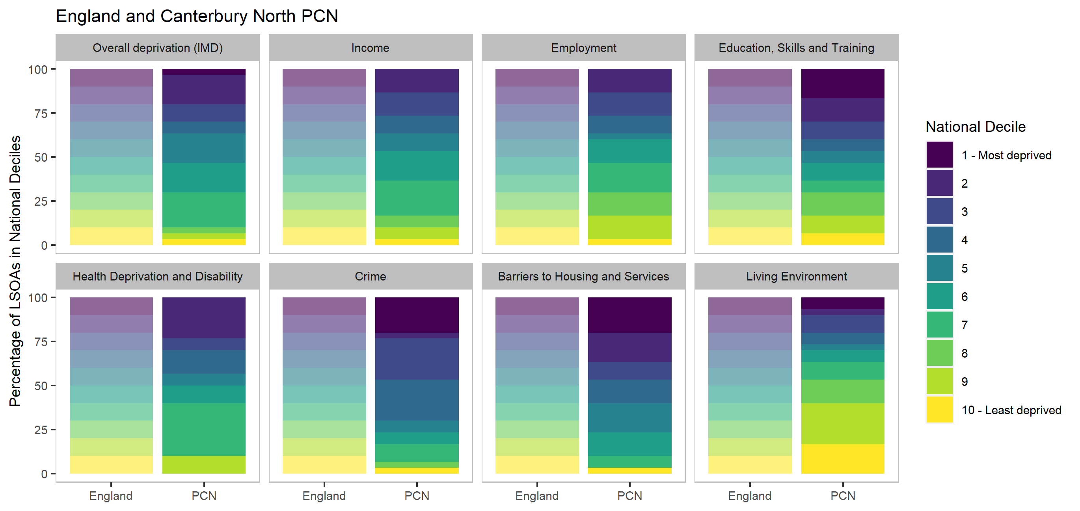
Domains of deprivation
19
Source: GOV.UK. Ministry of Housing, Communities & Local Government. English Indices of Deprivation 2019.
There are seven domains of deprivation, which combine to create the Index of Multiple Deprivation (IMD2019). Each of these domains describe different aspects of deprivation. The graphic shows the proportion of the PCN population ranked in one of 10 groups across all lower super output areas in England for each of these domains. The darker colours indicate the most deprived groups or 'deciles'.

Slide 21
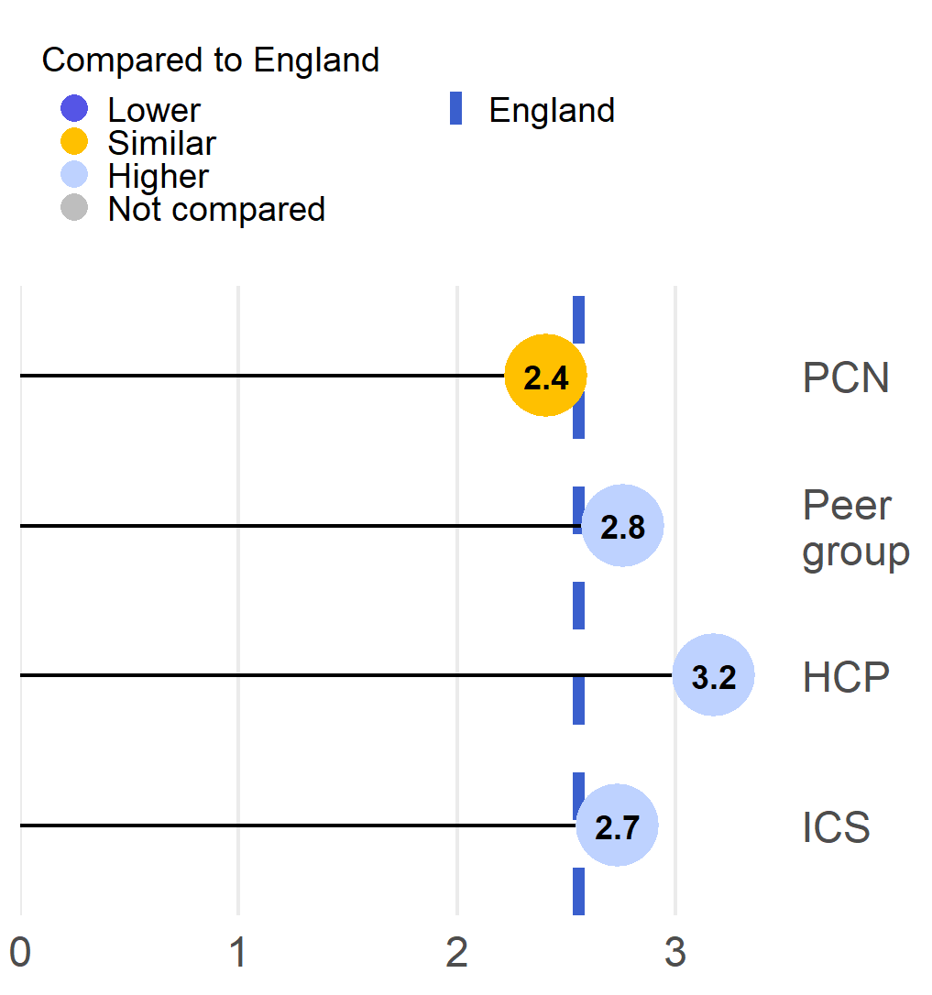
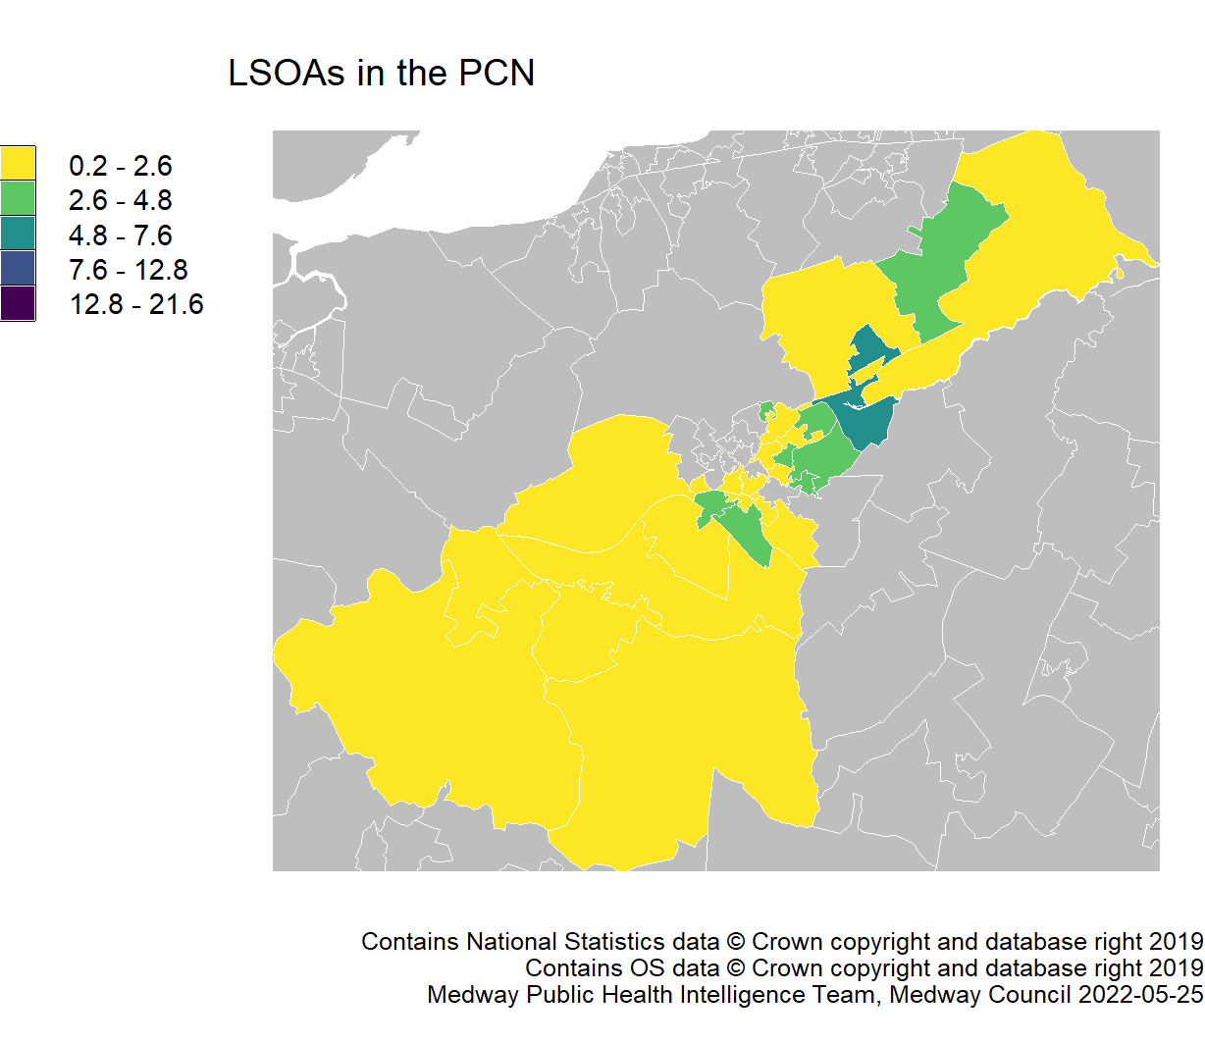
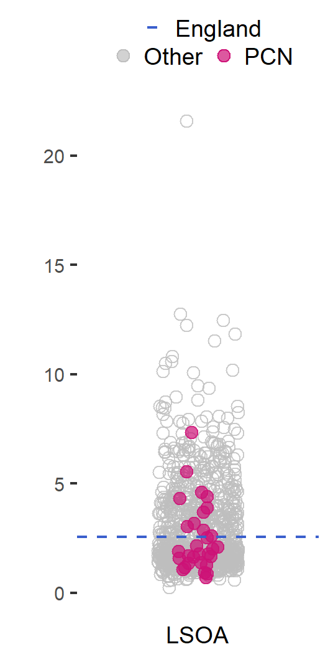
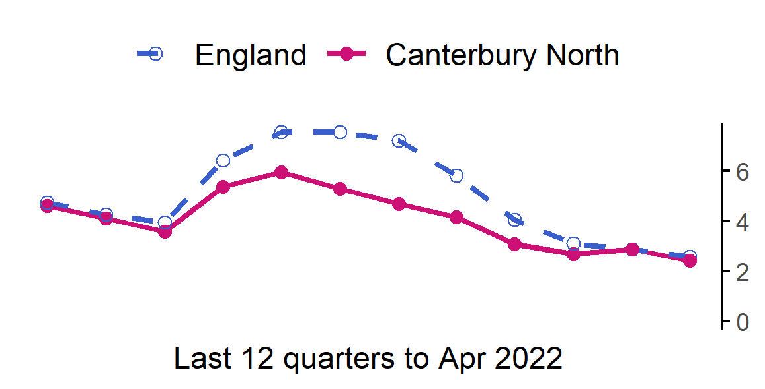
Job Seekers Allowance rate (16-64 years)
20
The rate in Canterbury North PCN is similar to England.
Value type: Rate per 1,000 residents aged 16-64.
Latest time period: Apr 2022.
Source: Nomis, Office for National Statistics.
PCN average type: Mean.
PCN RAG method: Confidence interval (95%) - Byar's method.
Small area type: LSOA.

Slide 22
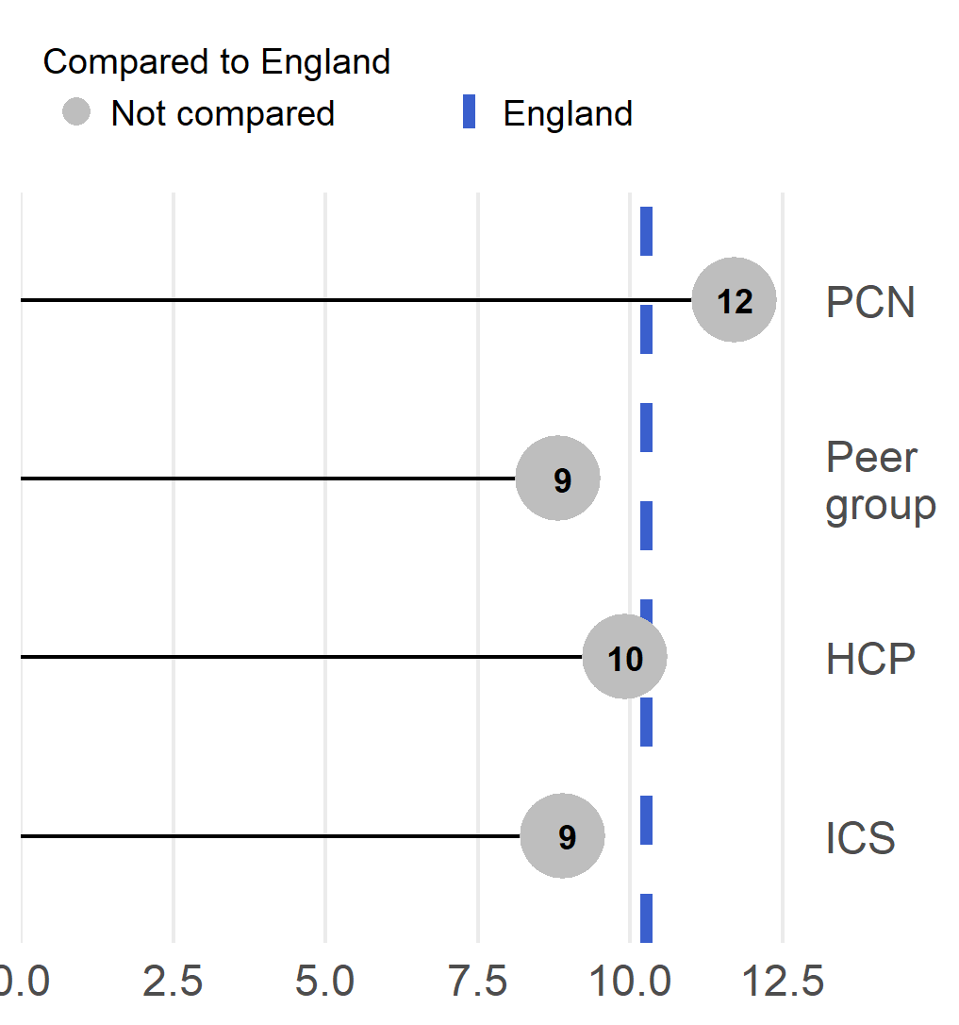
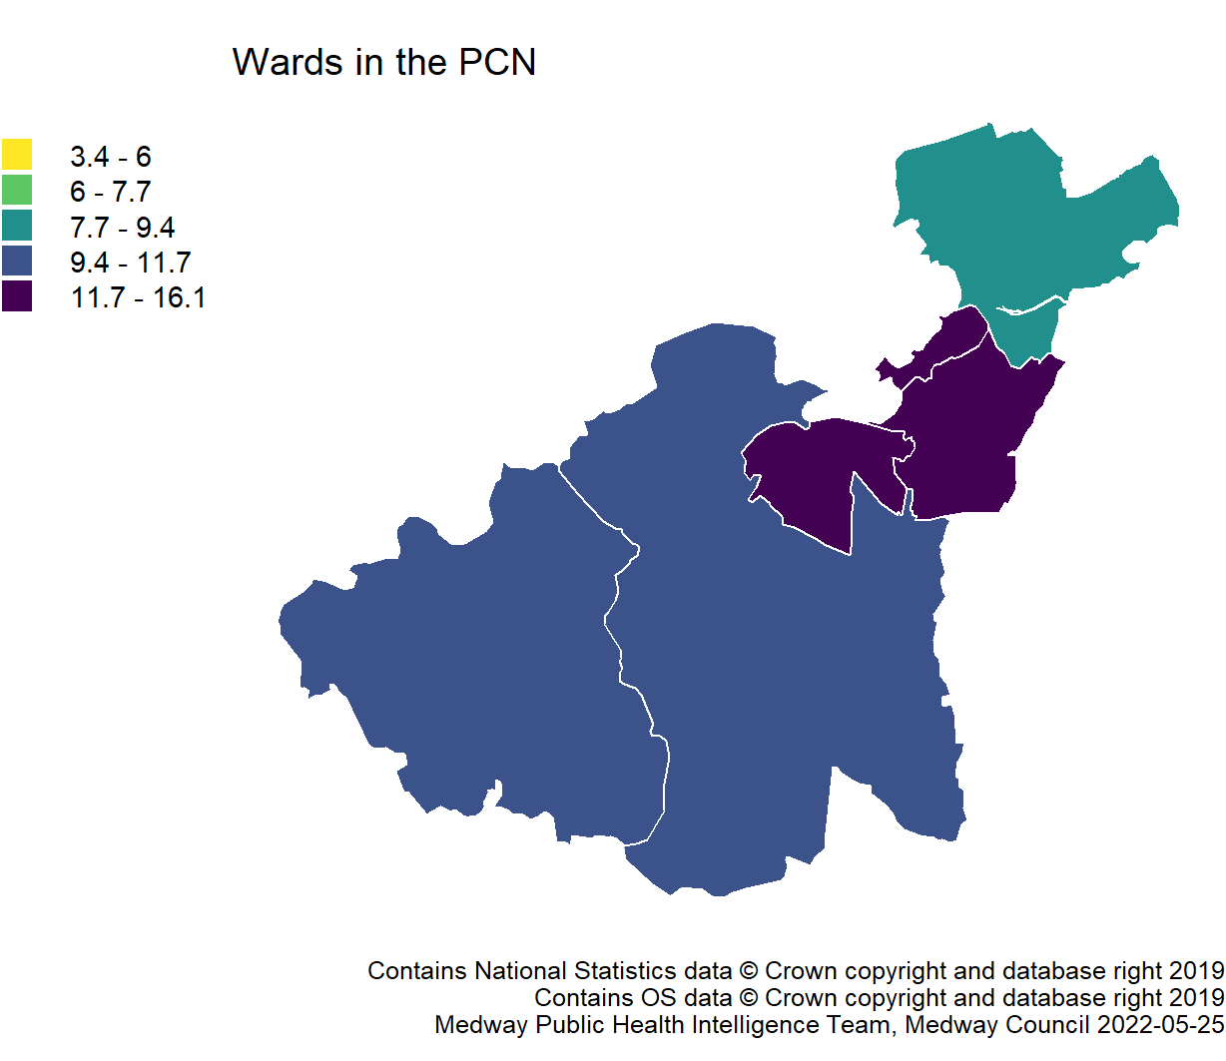
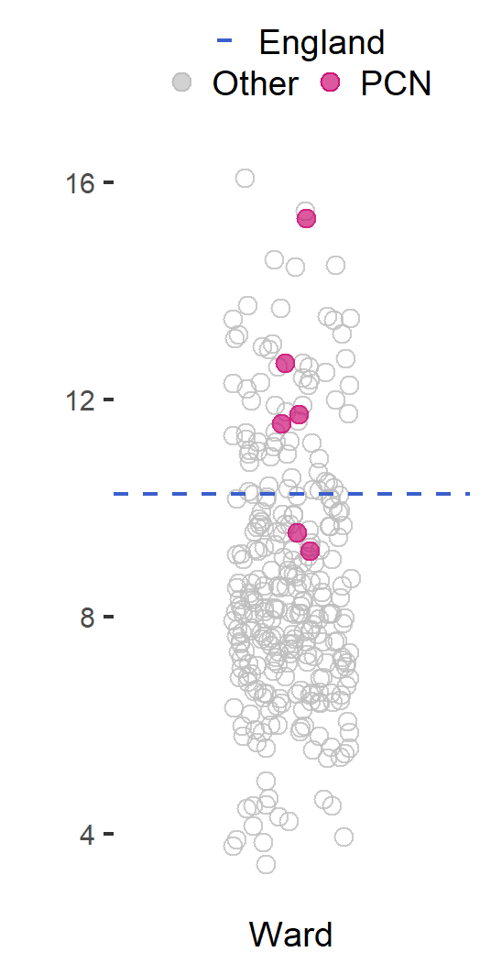
Fuel poverty
21
Trend data not available. A household is considered to be fuel poor if they have required fuel costs that are above average (the national median level) and, were they to spend that amount, they would be left with a residual income below the official poverty line.
This is used as a proxy indicator of need especially for those people who do not meet the usual criteria of living in a deprived area but have homes which are expensive to heat adequately.
This is a modelled estimate so cannot be compared.
Canterbury North PCN cannot be compared to England statistically.
Value type: Percentage households.
Latest time period: 2018.
Source: Public Health England. Fingertips. Indicator ID: 93280. Office for National Statistics, © Crown Copyright.
PCN average type: Mean.
PCN RAG method: None applied.
Small area type: Ward.

Slide 23
Prevention and Health Inequalities
22

Slide 24
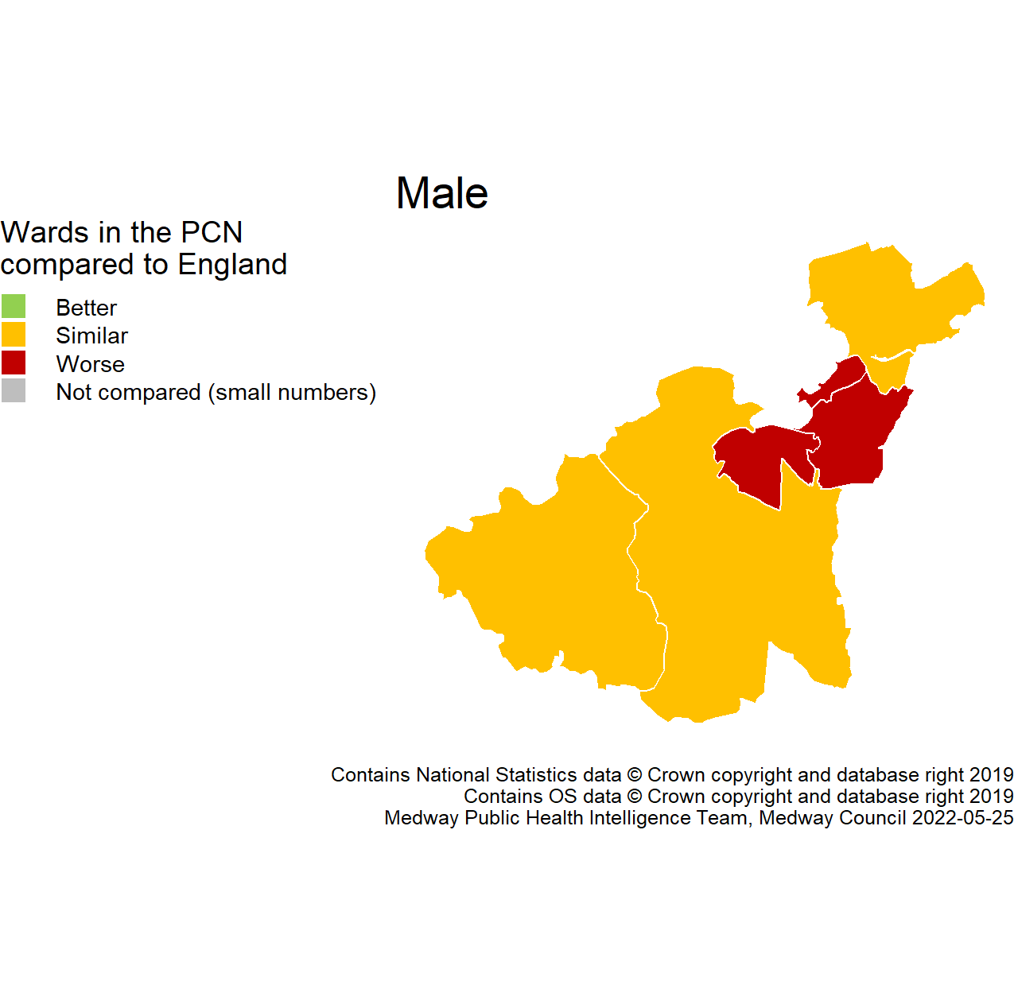
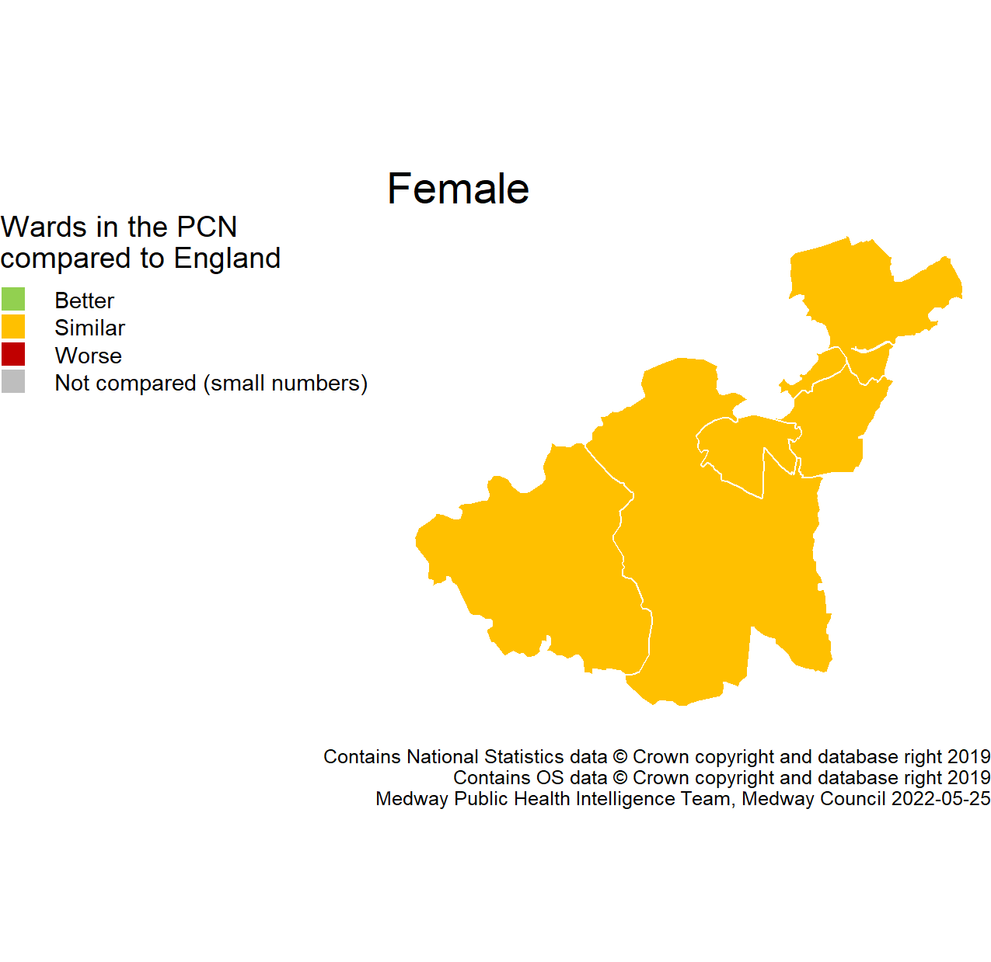
Life expectancy
23
The rate in Canterbury North PCN is worse than England.
Value type: Years.
Latest time period: 2015 - 19.
Source: Public Health England. Fingertips. Indicator ID: 93283. Office for National Statistics, © Crown Copyright.
PCN average type: Median.
PCN RAG method: England plus/minus 2%.
Small area type: Ward.
The rate in Canterbury North PCN is similar to England.
Value type: Years.
Latest time period: 2015 - 19.
Source: Public Health England. Fingertips. Indicator ID: 93283. Office for National Statistics, © Crown Copyright.
PCN average type: Median.
PCN RAG method: England plus/minus 2%.
Small area type: Ward.

Slide 25
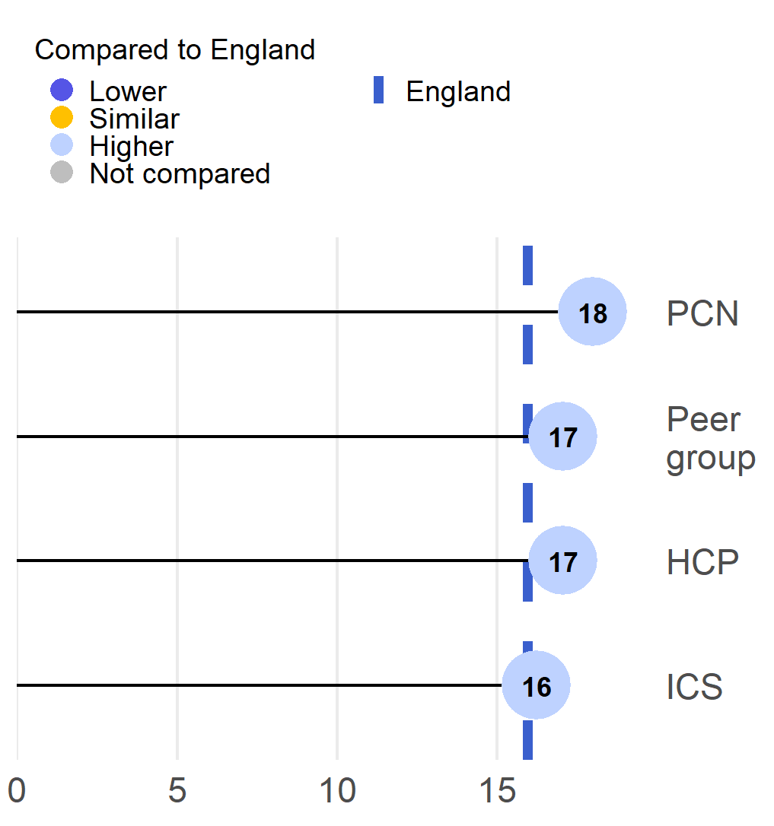
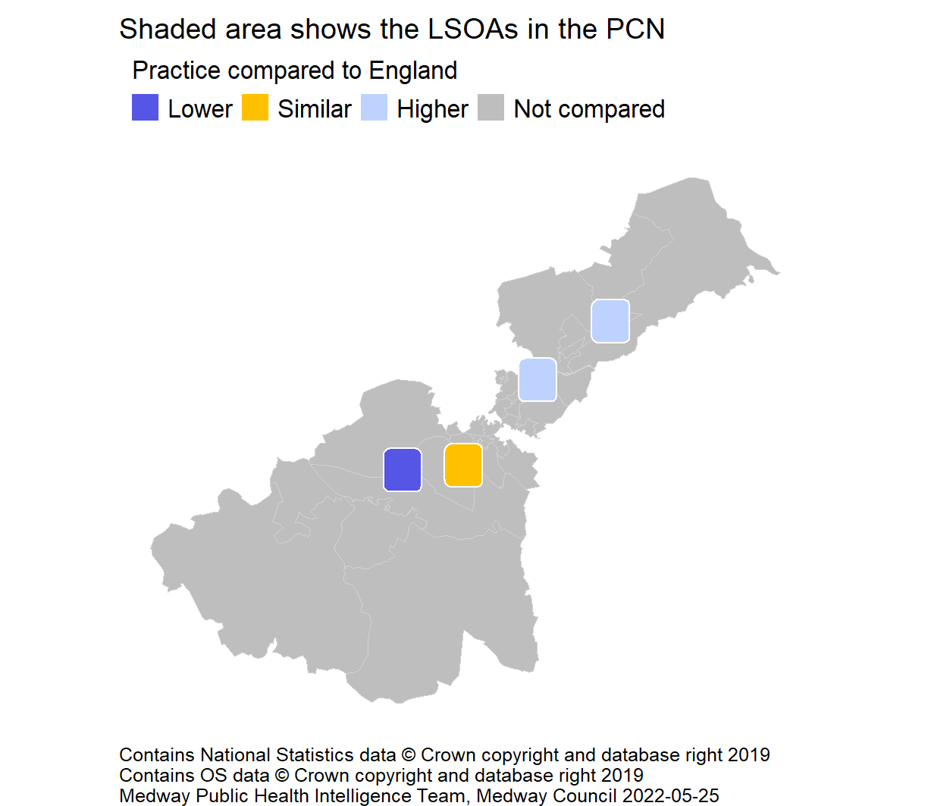
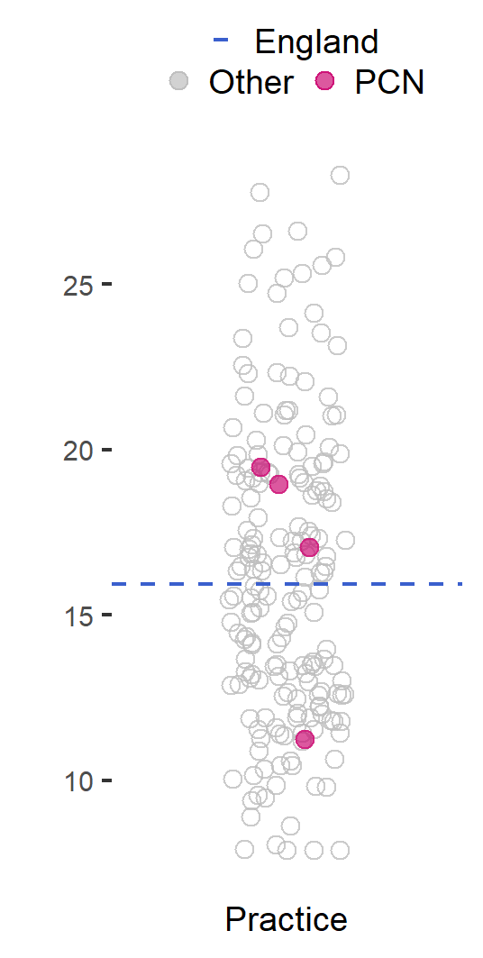
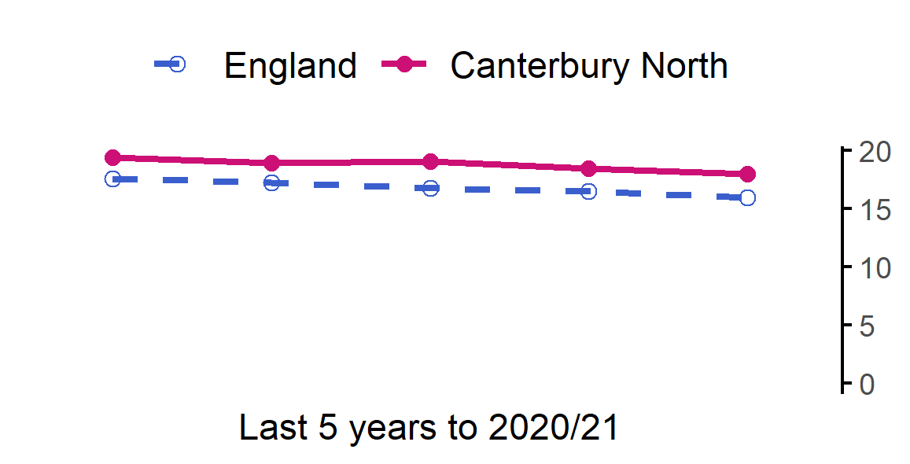
Estimated smoking prevalence (QOF)
24
The rate in Canterbury North PCN is higher than England.
Value type: Proportion - %.
Latest time period: 2020/21.
Source: Public Health England, Fingertips, Indicator ID: 91280.
PCN average type: Mean.
PCN RAG method: Confidence interval (99.8%) - Byar's method.
Small area type: Practice.

Slide 26
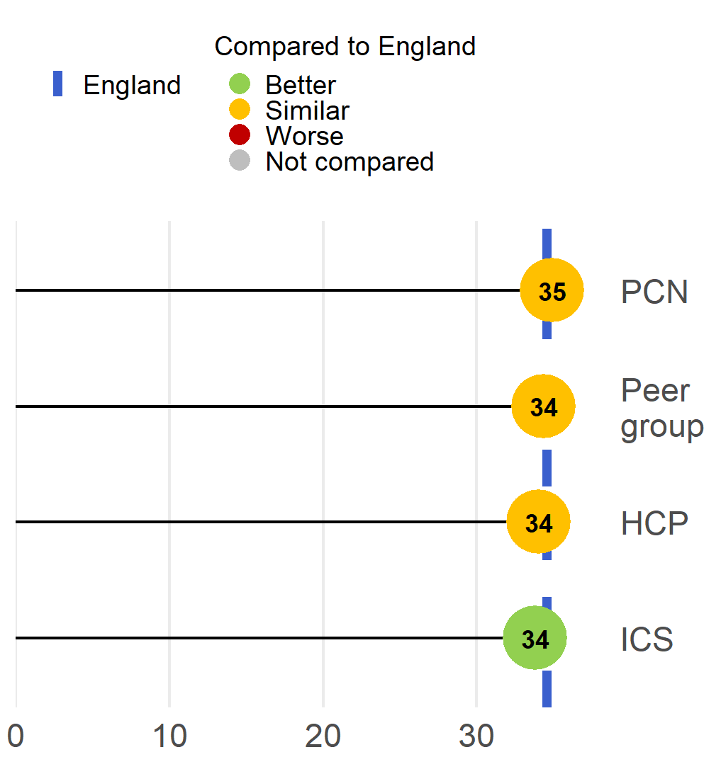
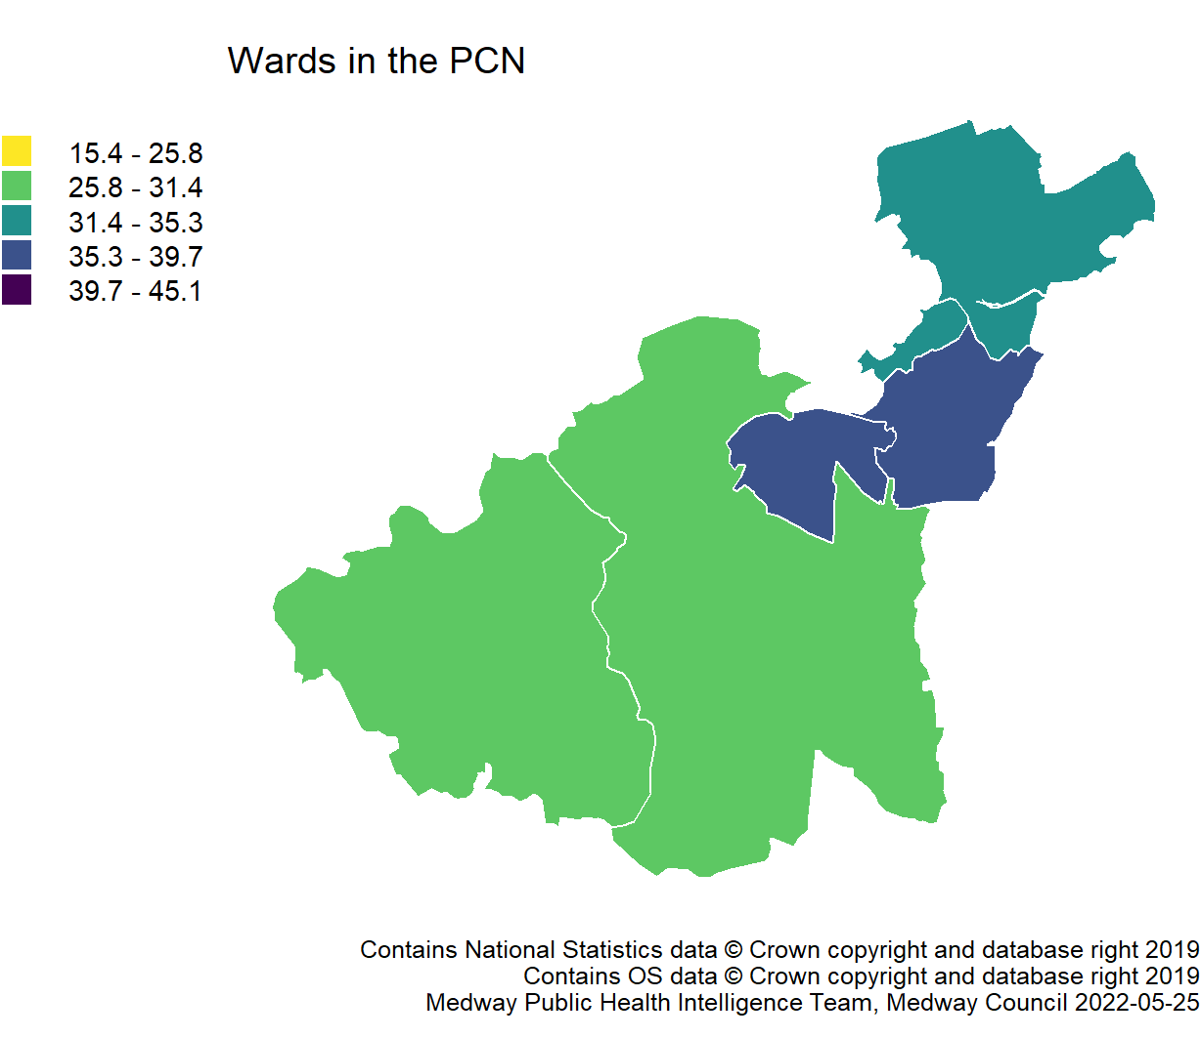
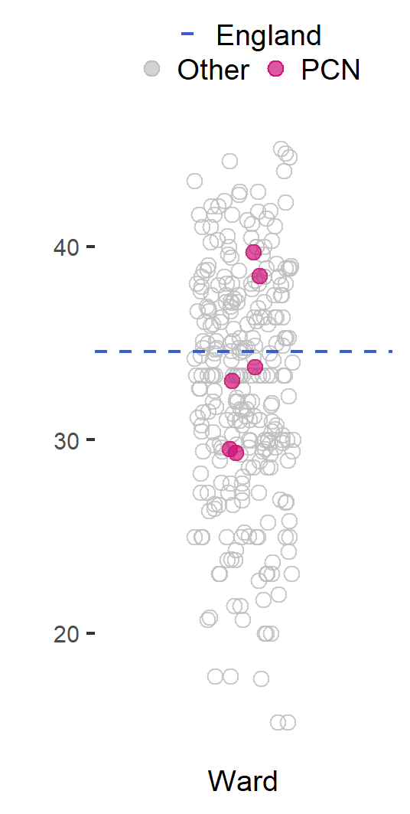
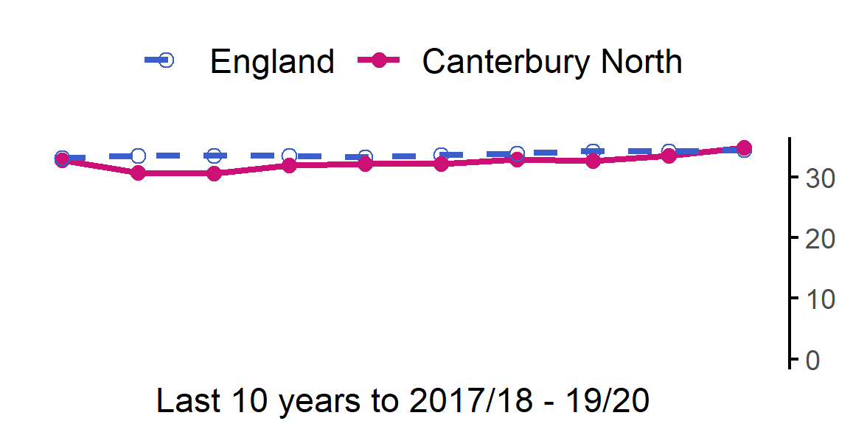
Year 6: Prevalence of overweight (including obesity)
25
The rate in Canterbury North PCN is similar to England.
Value type: Proportion - %.
Latest time period: 2017/18 - 19/20.
Source: Public Health England. Fingertips. Indicator ID: 93108. NHS Digital.
PCN average type: Mean.
PCN RAG method: Confidence interval (95%) - Wilson Score method.
Small area type: Ward.

Slide 27
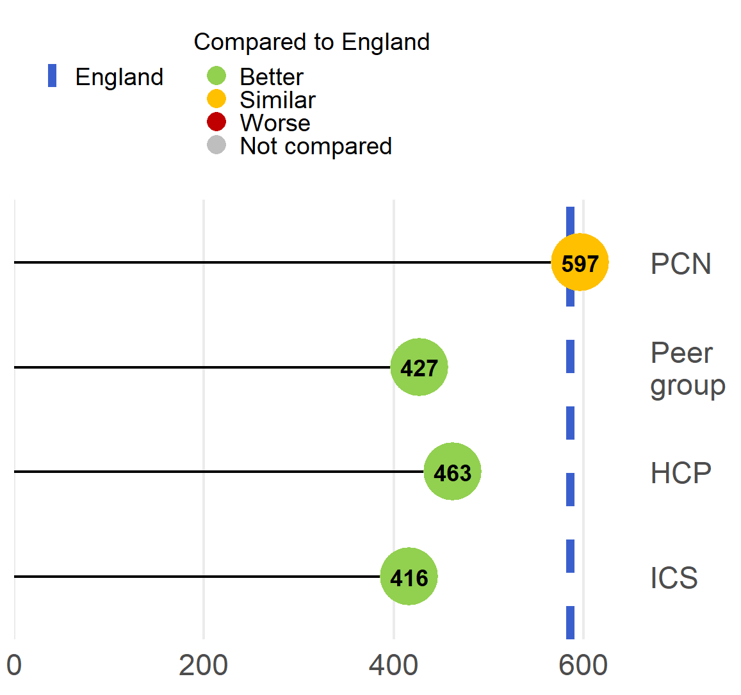
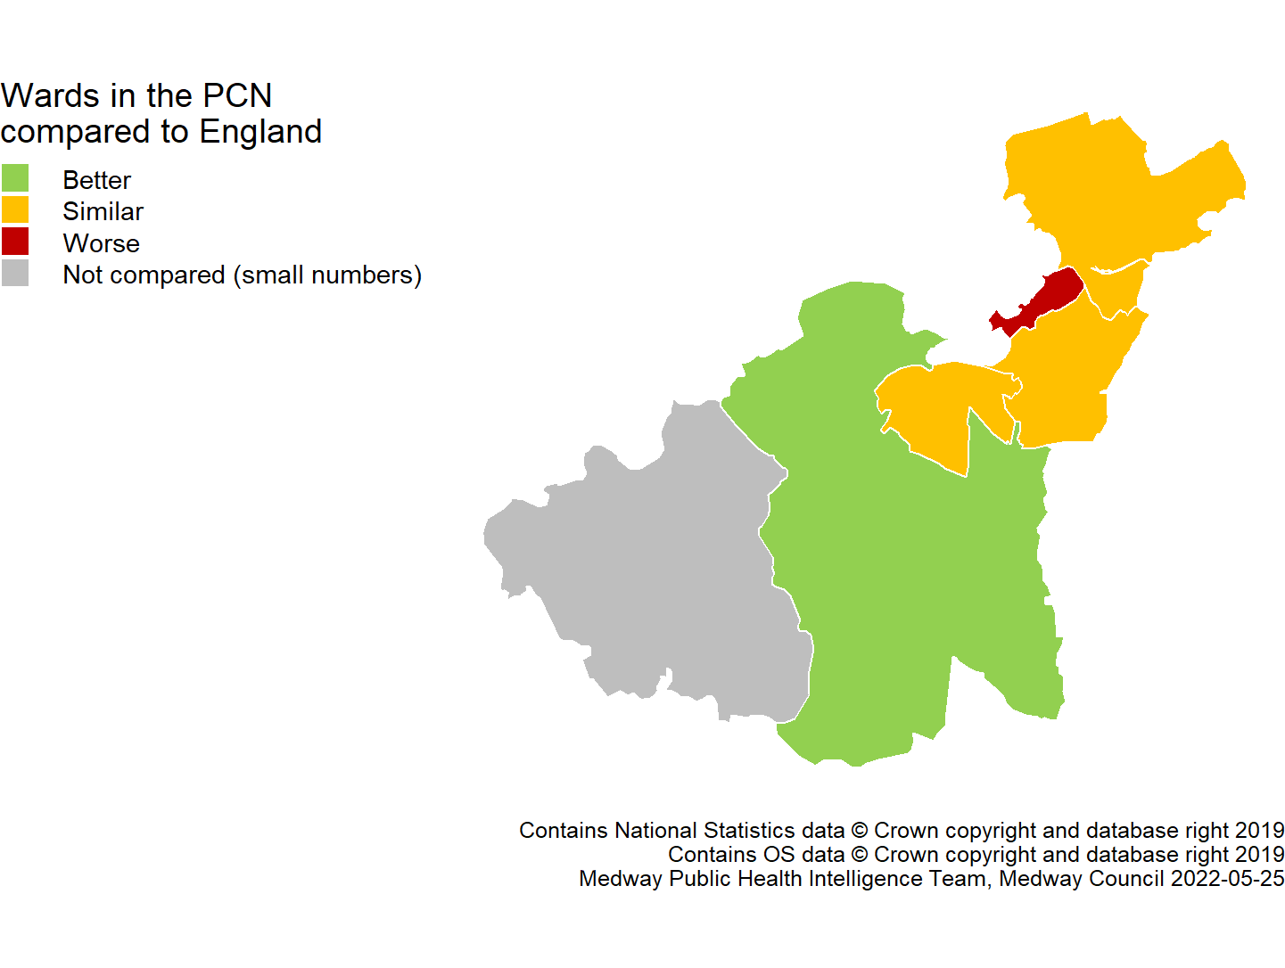
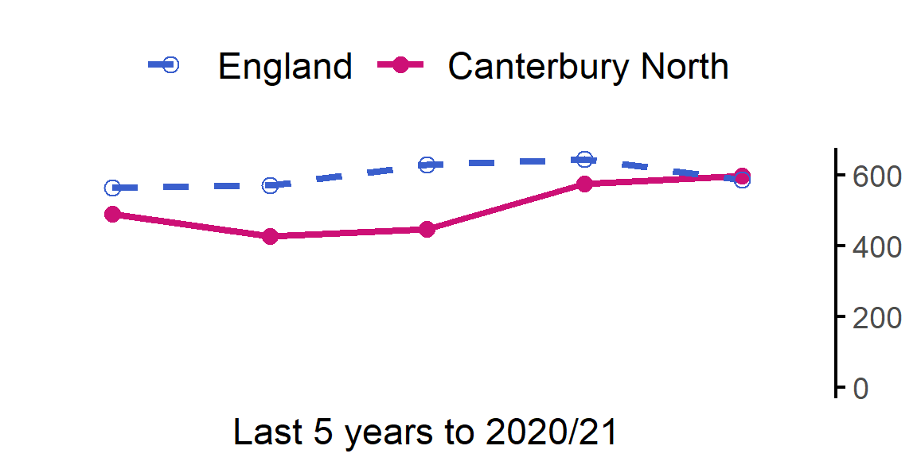
Admission episodes for alcohol-specific conditions
26
The rate in Canterbury North PCN is similar to England.
Value type: Directly standardised rate per 100,000.
Latest time period: 2020/21.
Source: Hospital Episode Statistics (HES), NHS Digital.
PCN average type: Mean.
PCN RAG method: Confidence interval (95%) - Dobson's method.
Small area type: LSOA.

Slide 28
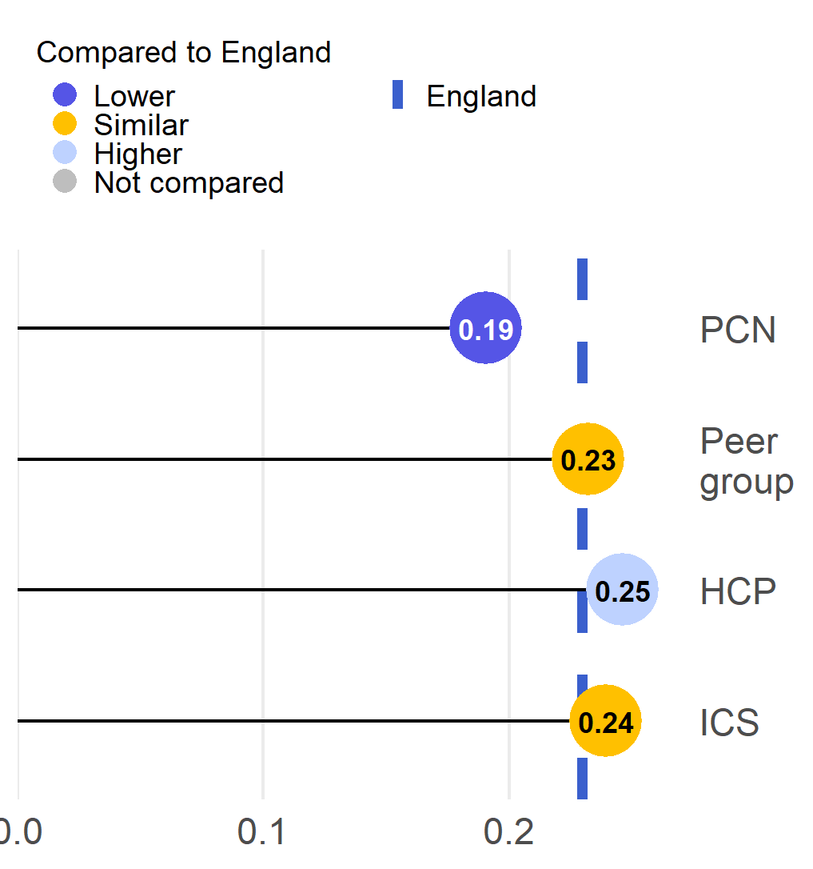
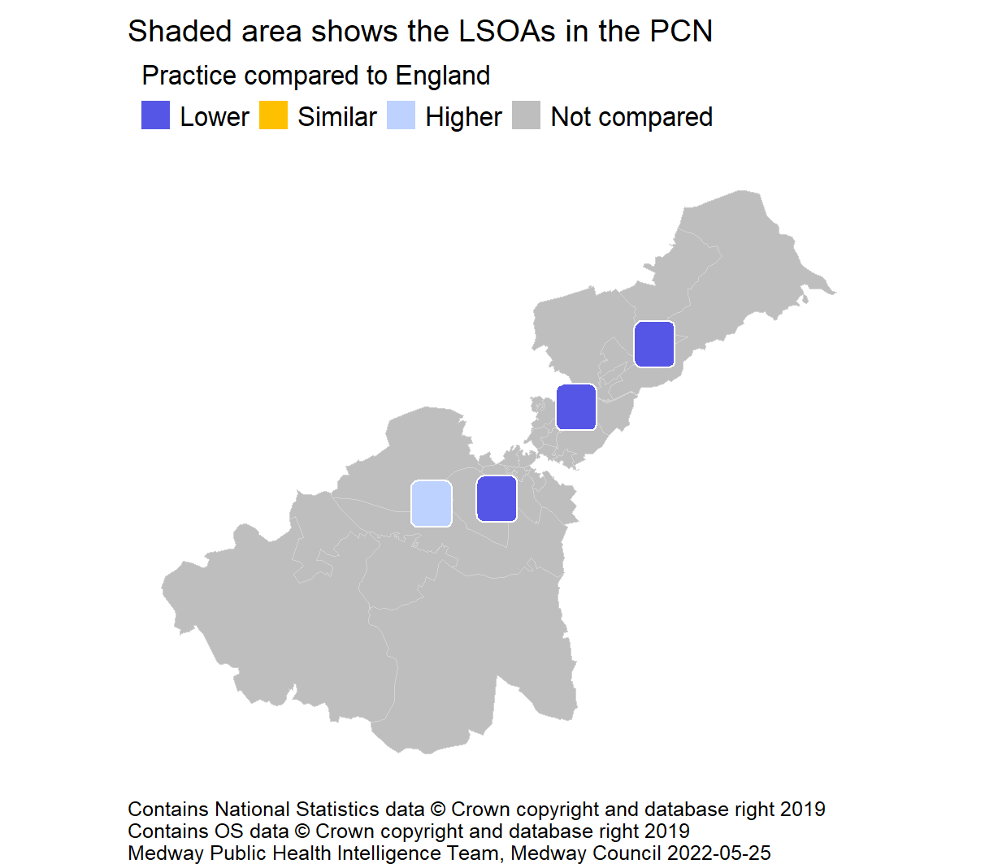
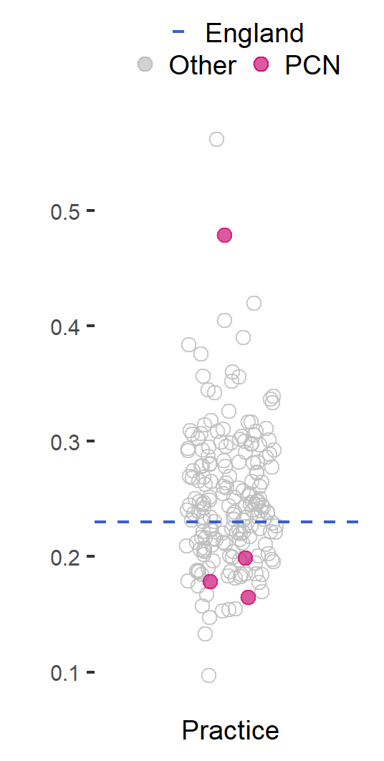
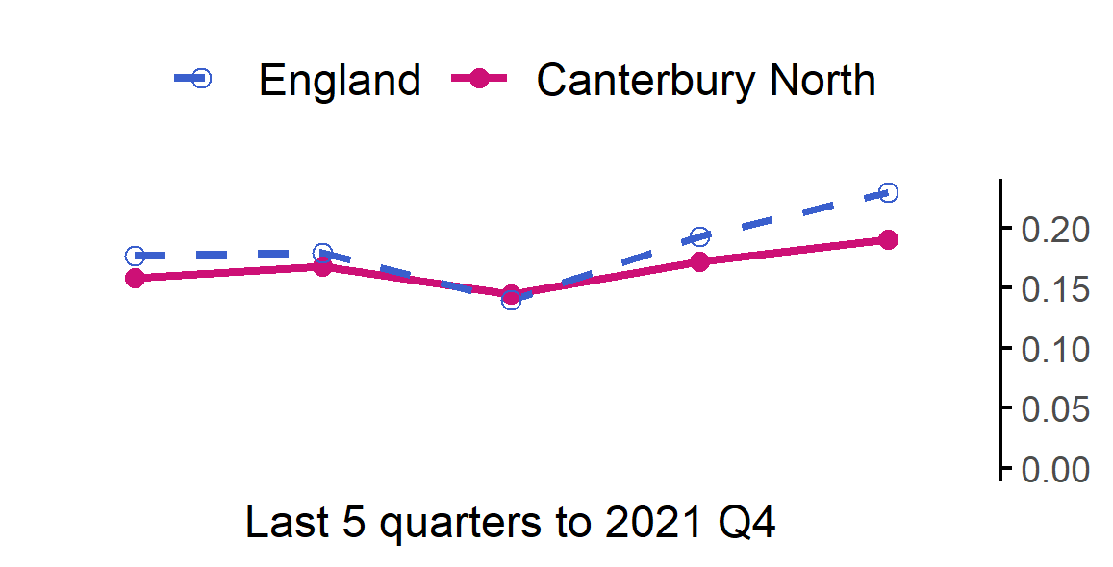
Total number of prescribed antibiotic items per STAR-PU
27
The rate in Canterbury North PCN is lower than England.
Value type: Indirectly standardised ratio.
Latest time period: 2021 Q4.
Source: Public Health England, Fingertips, Indicator ID: 91900. © Crown Copyright.
PCN average type: Median.
PCN RAG method: England plus/minus 5%.
Small area type: Practice.

Slide 29
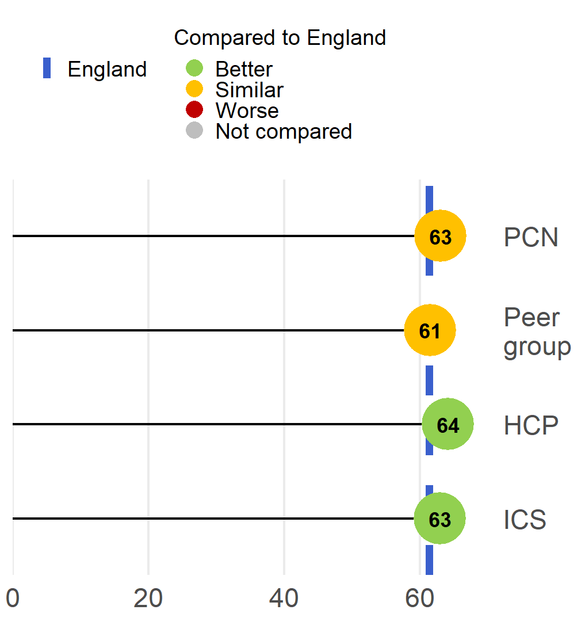
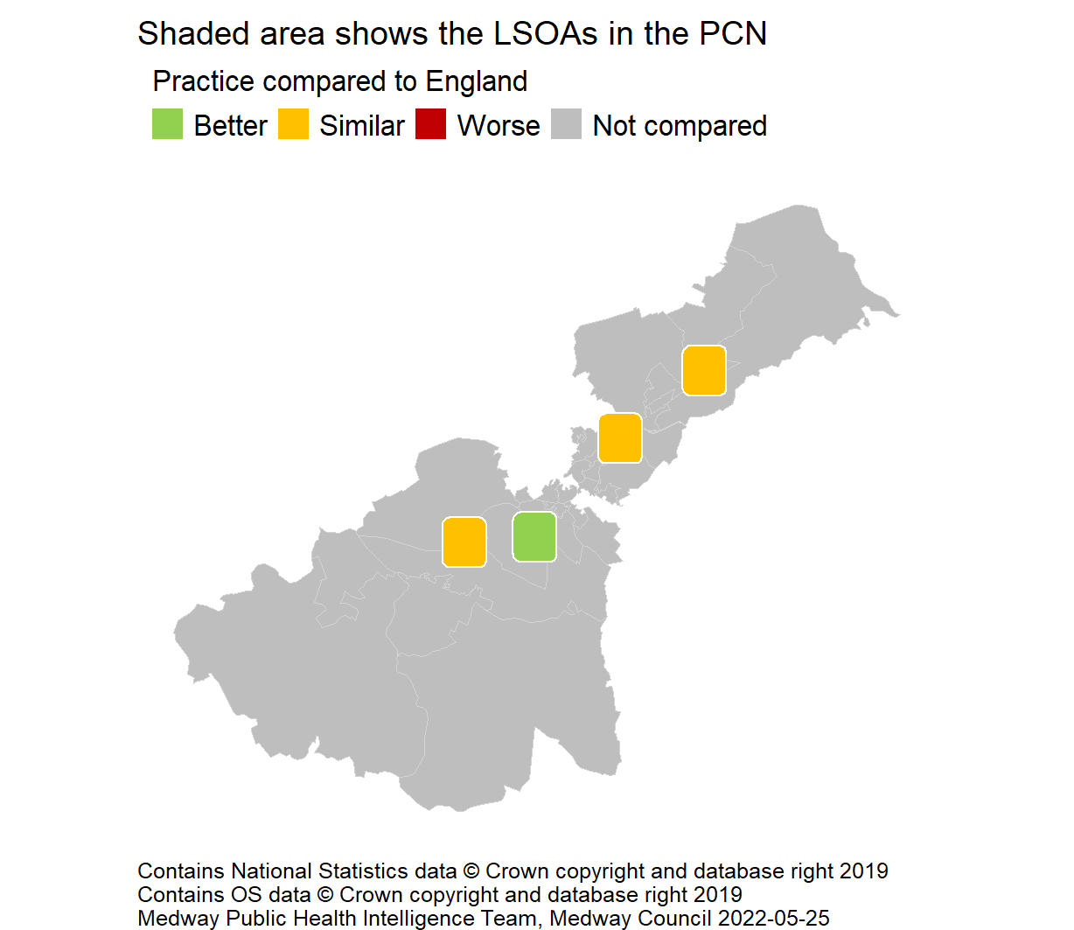
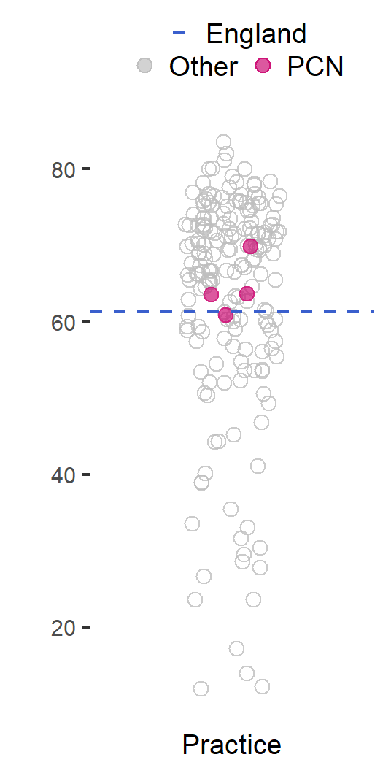
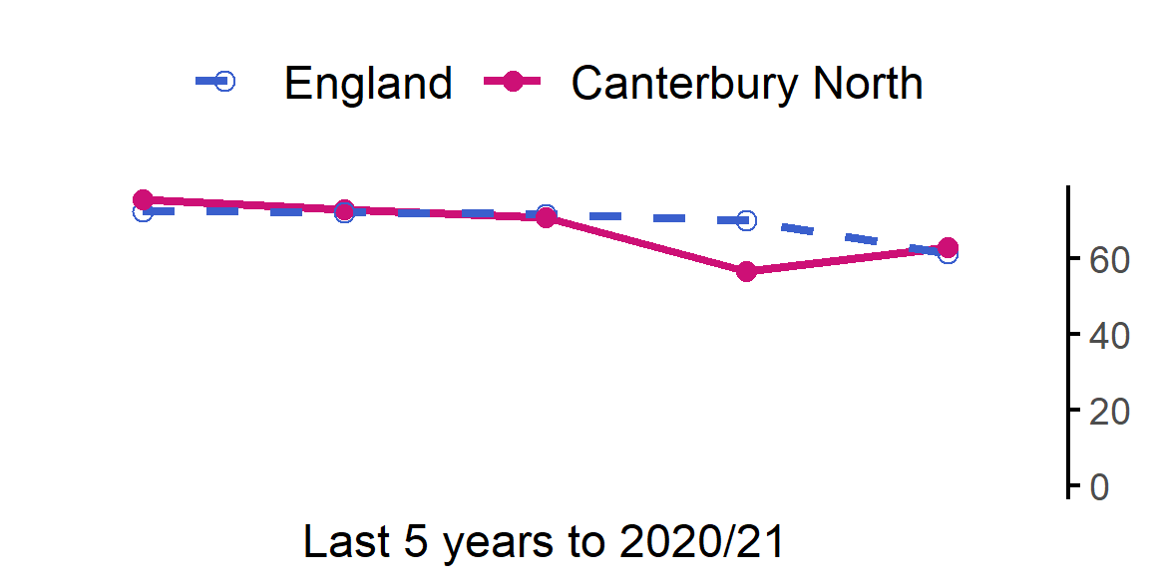
Breast cancer screening coverage (females aged 50-70)
28
The rate in Canterbury North PCN is similar to England.
Value type: Proportion - %.
Latest time period: 2020/21.
Source: Public Health England. Fingertips. Indicator ID: 91339.
PCN average type: Mean.
PCN RAG method: Confidence interval (99.8%) - Wilson Score method.
Small area type: Practice.

Slide 30
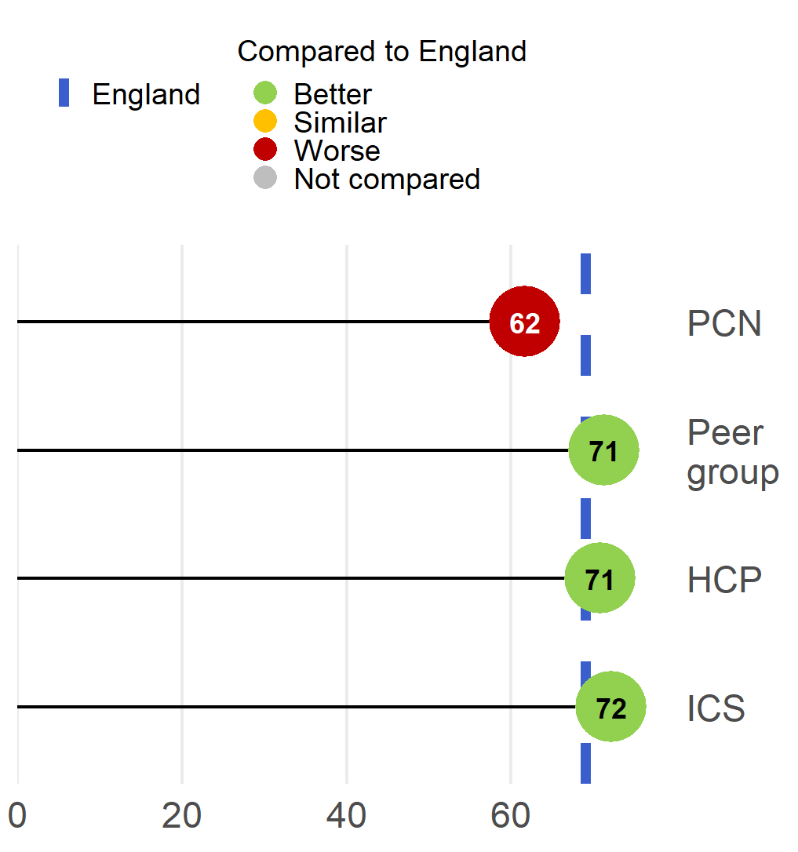
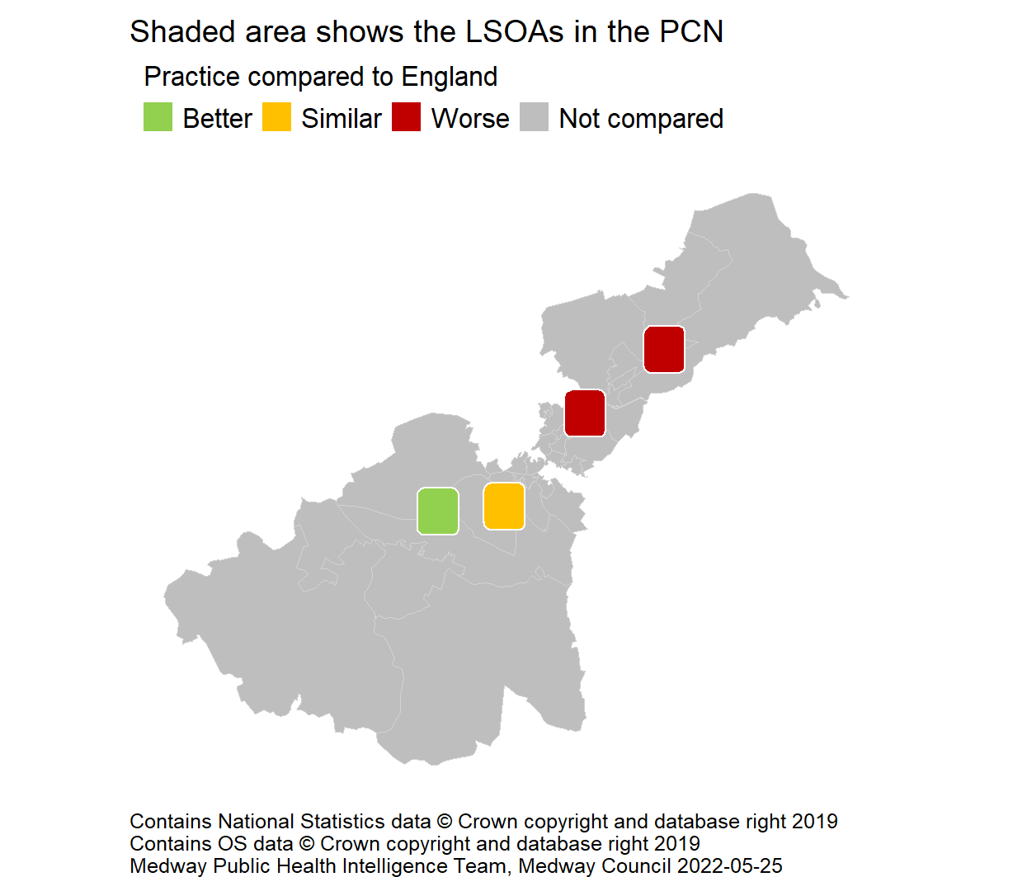
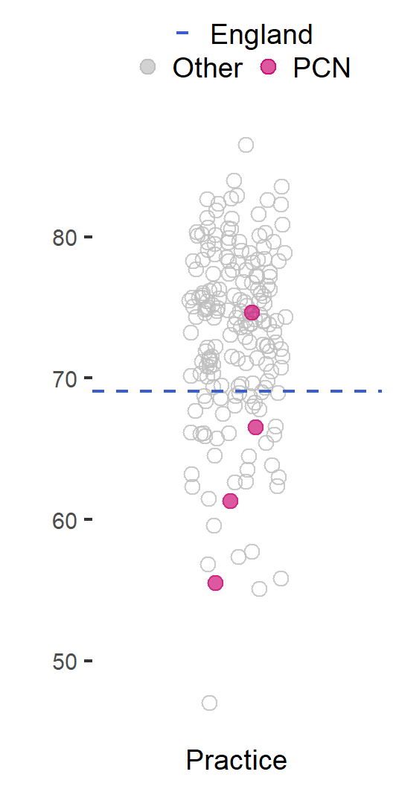
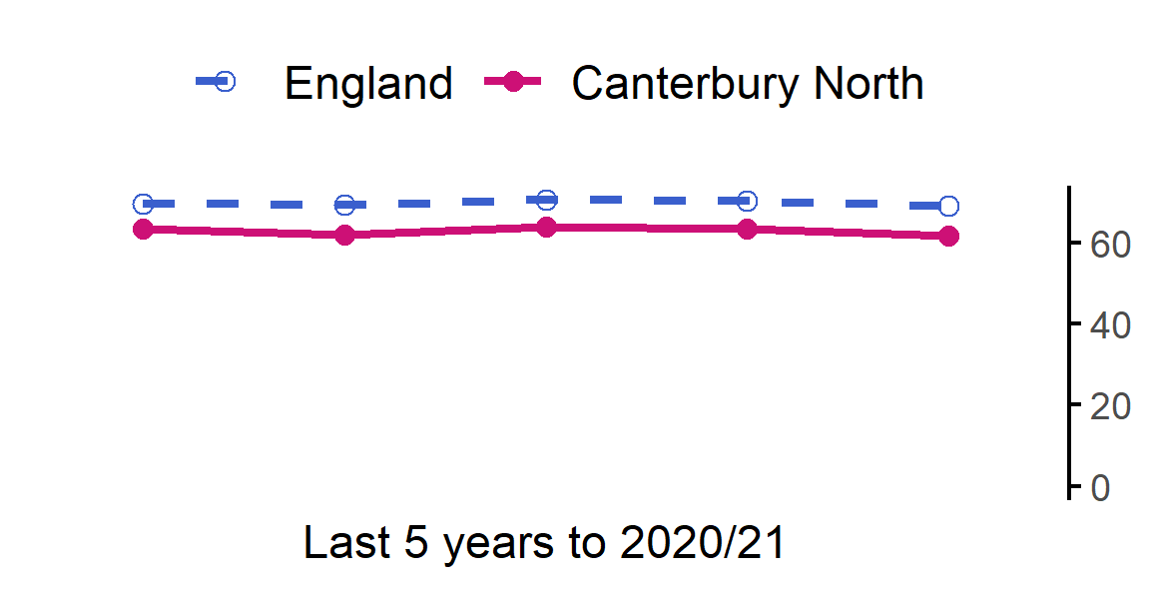
Cervical cancer screening coverage (females aged 25-49)
29
The rate in Canterbury North PCN is worse than England.
Value type: Proportion - %.
Latest time period: 2020/21.
Source: Public Health England. Fingertips. Indicator ID: 93725.
PCN average type: Mean.
PCN RAG method: Confidence interval (99.8%) - Wilson Score method.
Small area type: Practice.

Slide 31
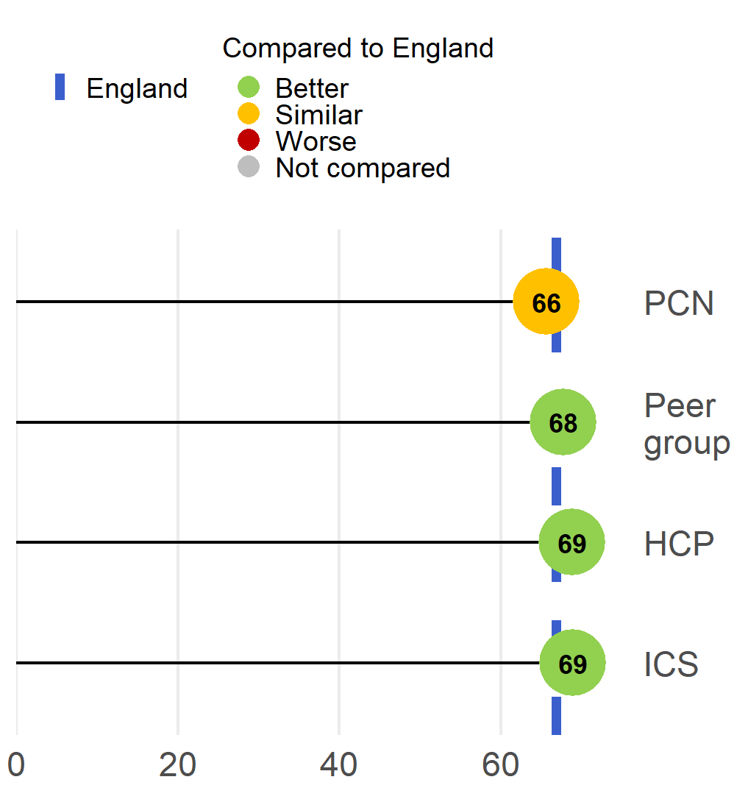
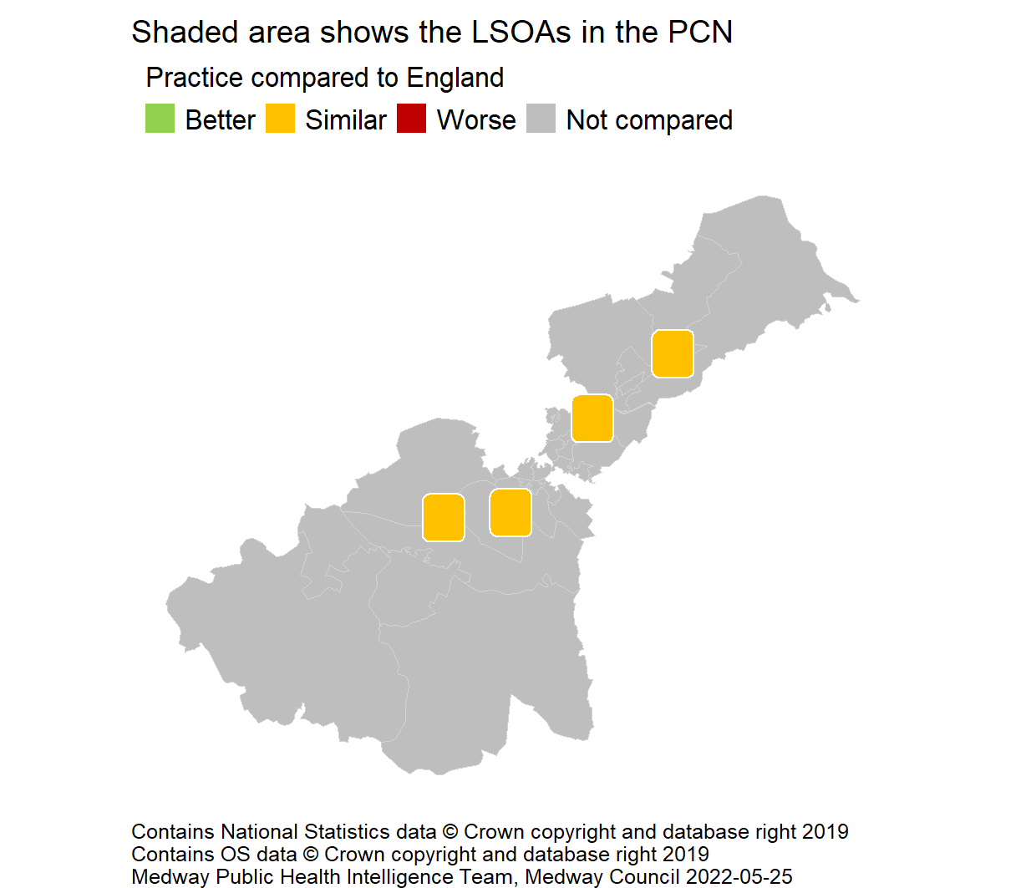
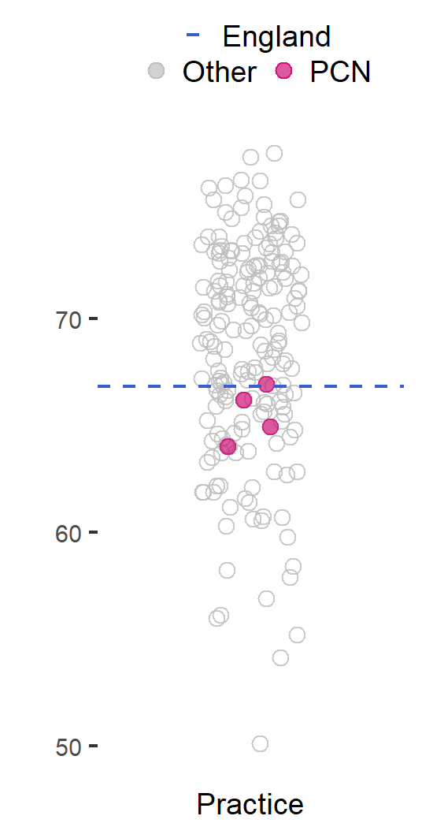

Bowel cancer screening coverage (persons aged 60-74)
30
The rate in Canterbury North PCN is similar to England.
Value type: Proportion - %.
Latest time period: 2020/21.
Source: Public Health England. Fingertips. Indicator ID: 92600.
PCN average type: Mean.
PCN RAG method: Confidence interval (99.8%) - Wilson Score method.
Small area type: Practice.

Slide 32
Best start in life
31

Slide 33



A&E attendances (0-4 years)
32
The rate in Canterbury North PCN is worse than England.
Value type: Crude rate per 1,000.
Latest time period: 2020/21.
Source: Hospital Episode Statistics (HES).
PCN average type: Mean.
PCN RAG method: Confidence interval (95%) - Byar's method.
Small area type: LSOA.

Slide 34


Smoking at time of booking
33
England level data is currently unavailable, as it is derived from SNOMED codes and is still being developed by NHS Digital.
East Kent HCP cannot be compared to England statistically.
Value type: Proportion - %.
Latest time period: 2020/21.
Source: Unofficial data from smoking in pregnancy midwives.
HCP average type: Mean.
HCP RAG method: None applied.
Small area type: Maternity team.

Slide 35



Emergency hospital admissions for asthma (< 19 yrs)
34
The rate in Canterbury North PCN is similar to England.
Value type: Crude rate per 100,000.
Latest time period: 2018/19 - 20/21.
Source: Hospital Episode Statistics (HES), NHS Digital.
PCN average type: Mean.
PCN RAG method: Confidence interval (95%) - Byar's method.
Small area type: LSOA to PCN.

Slide 36



Hospital admissions as a result of self-harm (10-24 years)
35
The rate in Canterbury North PCN is similar to England.
Value type: Age standardised rate - per 100,000.
Latest time period: 2020/21.
Source: Hospital Episode Statistics (HES), NHS Digital.
PCN average type: Mean.
PCN RAG method: Confidence interval (95%) - Dobson's method.
Small area type: LSOA to PCN.

Slide 37
Major health conditions
36

Slide 38

QOF prevalence: Cardiovascular disease
37
Public Health England. Fingertips. Indicator IDs: 273; 212; 92590; 262; 280; 219; 91280
In addition to measuring current recorded prevalence, from a public health perspective it is also important to understand the effectiveness of efforts to detect new cases of health conditions. It is also important to gauge if and how detection efforts vary across subgroups of our population - for example, by level of deprivation. As a result, both Medway Public Health Intelligence team and Kent Public Health Observatory plan to develop robust modelled estimates of undiagnosed prevalence in future versions of this PCN profile.

Slide 39

QOF prevalence: Cancer, diabetes and COPD
38
Public Health England. Fingertips. Indicator IDs: 276; 241; 253
In addition to measuring current recorded prevalence, from a public health perspective it is also important to understand the effectiveness of efforts to detect new cases of health conditions. It is also important to gauge if and how detection efforts vary across subgroups of our population - for example, by level of deprivation. As a result, both Medway Public Health Intelligence team and Kent Public Health Observatory plan to develop robust modelled estimates of undiagnosed prevalence in future versions of this PCN profile.

Slide 40

QOF prevalence: Mental health
39
Public Health England. Fingertips. Indicator IDs: 90581; 848; 247
In addition to measuring current recorded prevalence, from a public health perspective it is also important to understand the effectiveness of efforts to detect new cases of health conditions. It is also important to gauge if and how detection efforts vary across subgroups of our population - for example, by level of deprivation. As a result, both Medway Public Health Intelligence team and Kent Public Health Observatory plan to develop robust modelled estimates of undiagnosed prevalence in future versions of this PCN profile.

Slide 41



Premature mortality from all causes
40
Trend data not available.
The rate in Canterbury North PCN is worse than England.
Value type: Age-standardised mortality ratio.
Latest time period: 2015 - 19.
Source: Public Health England. Fingertips. Indicator ID: 93252. Office for National Statistics, © Crown Copyright.
PCN average type: Mean.
PCN RAG method: Confidence interval (95%) - Byar's method.
Small area type: Ward.

Slide 42


Premature mortality from all cancers and cardiovascular disease
41
The rate in Canterbury North PCN is similar to England.
Value type: Age-standardised mortality ratio.
Latest time period: 2015 - 19.
Source: Public Health England. Fingertips. Indicator ID: 93254. Office for National Statistics, © Crown Copyright.
PCN average type: Mean.
PCN RAG method: Confidence interval (95%) - Byar's method.
Small area type: Ward.
The rate in Canterbury North PCN is similar to England.
Value type: Age-standardised mortality ratio.
Latest time period: 2015 - 19.
Source: Public Health England. Fingertips. Indicator ID: 93256. Office for National Statistics, © Crown Copyright..
PCN average type: Mean.
PCN RAG method: Confidence interval (95%) - Byar's method.
Small area type: Ward.

Slide 43
Ageing Well
42

Slide 44


Osteoporosis prevalence and hip fracture hospital admissions
43
The rate in Canterbury North PCN is similar to England.
Value type: Prevalence (%).
Latest time period: 2020/21.
Source: Public Health England. Fingertips. Indicator ID: 90443.
PCN average type: Mean.
PCN RAG method: Confidence interval (99.8%) - Wilson Score method.
Small area type: Practice.
The rate in Canterbury North PCN is worse than England.
Value type: Age-standardised admission ratio.
Latest time period: 2015/16 - 19/20.
Source: Public Health England. Fingertips. Indicator ID: 93241..
PCN average type: Median.
PCN RAG method: England plus/minus 5%.
Small area type: Ward.

