Slide 1
Move together conference October 2023
Dr Anjan Ghosh
Director of Public Health, Kent County Council

Slide 2
Content
Our diverse and changing population
Physical activity and inactivity locally
Partnership working is key
Lots of good work is happening already across Kent
Move Together Strategy is an opportunity to build on this

Slide 3
Key messages
Identify areas of disadvantage and underserved communities
Partnership working and co-production
Evidence led but also learning by doing

Slide 4
Diverse, changing population

Slide 5
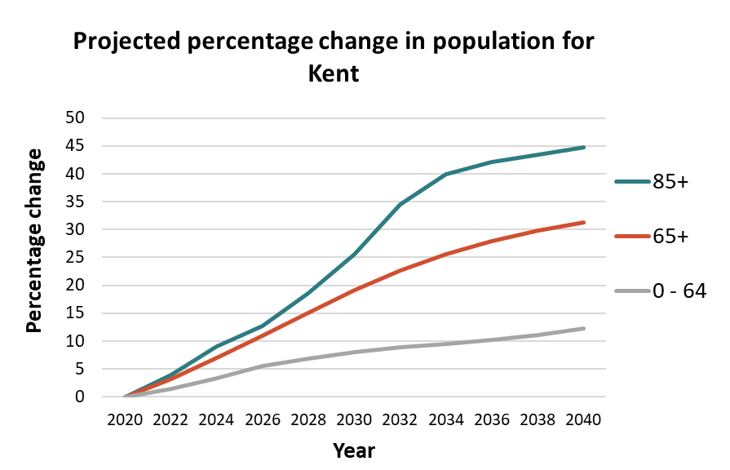
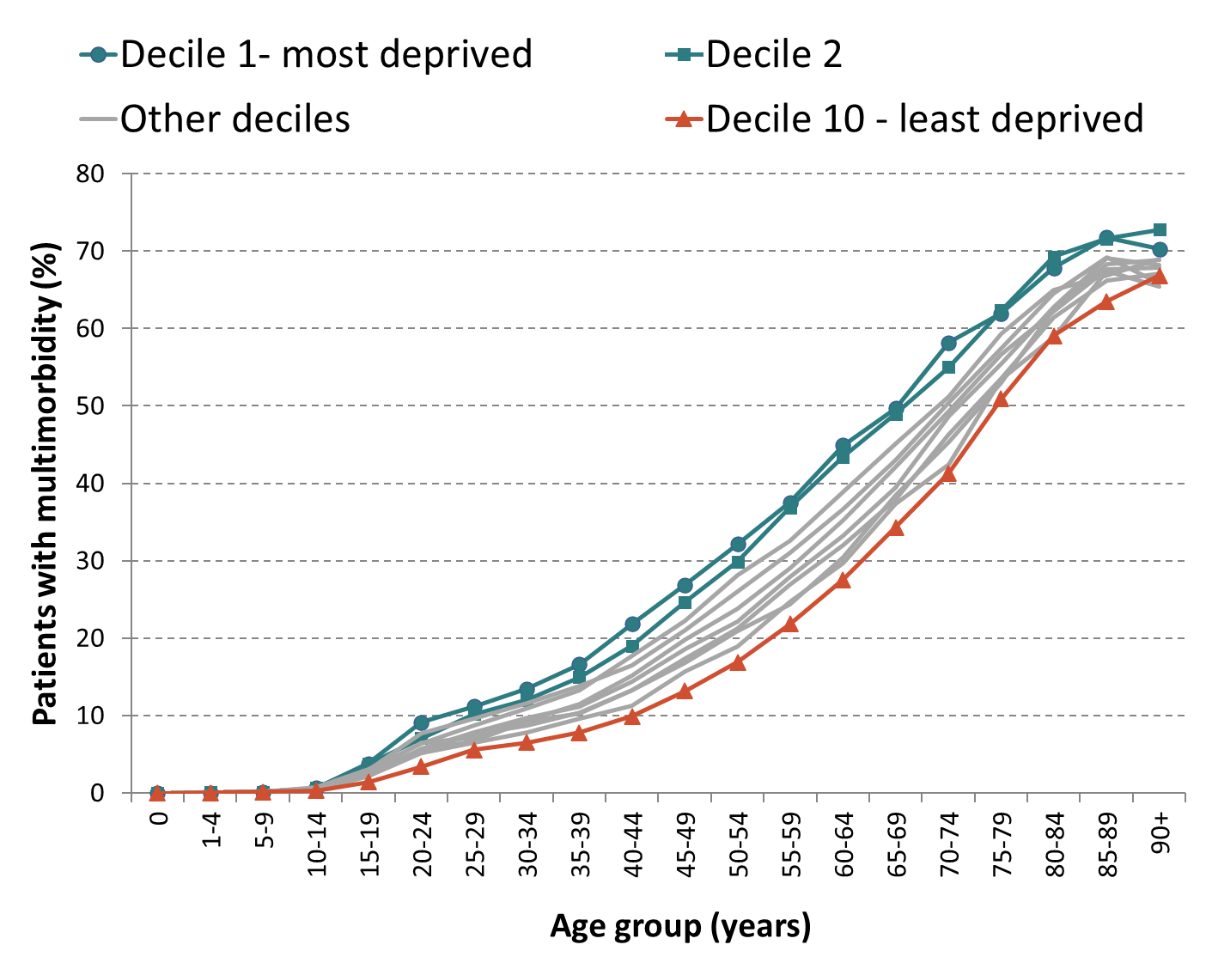
Ageing and long-term conditions
Source: KCC Housing Led Forecasts, KPHO
Source: Kent Integrated Dataset (KID), prepared by KPHO (TG), March-2018
Notes:
Absolute projected population increases:
Under 65: + 177,000
65+: + 147,000
85+: + 35,000

Slide 6
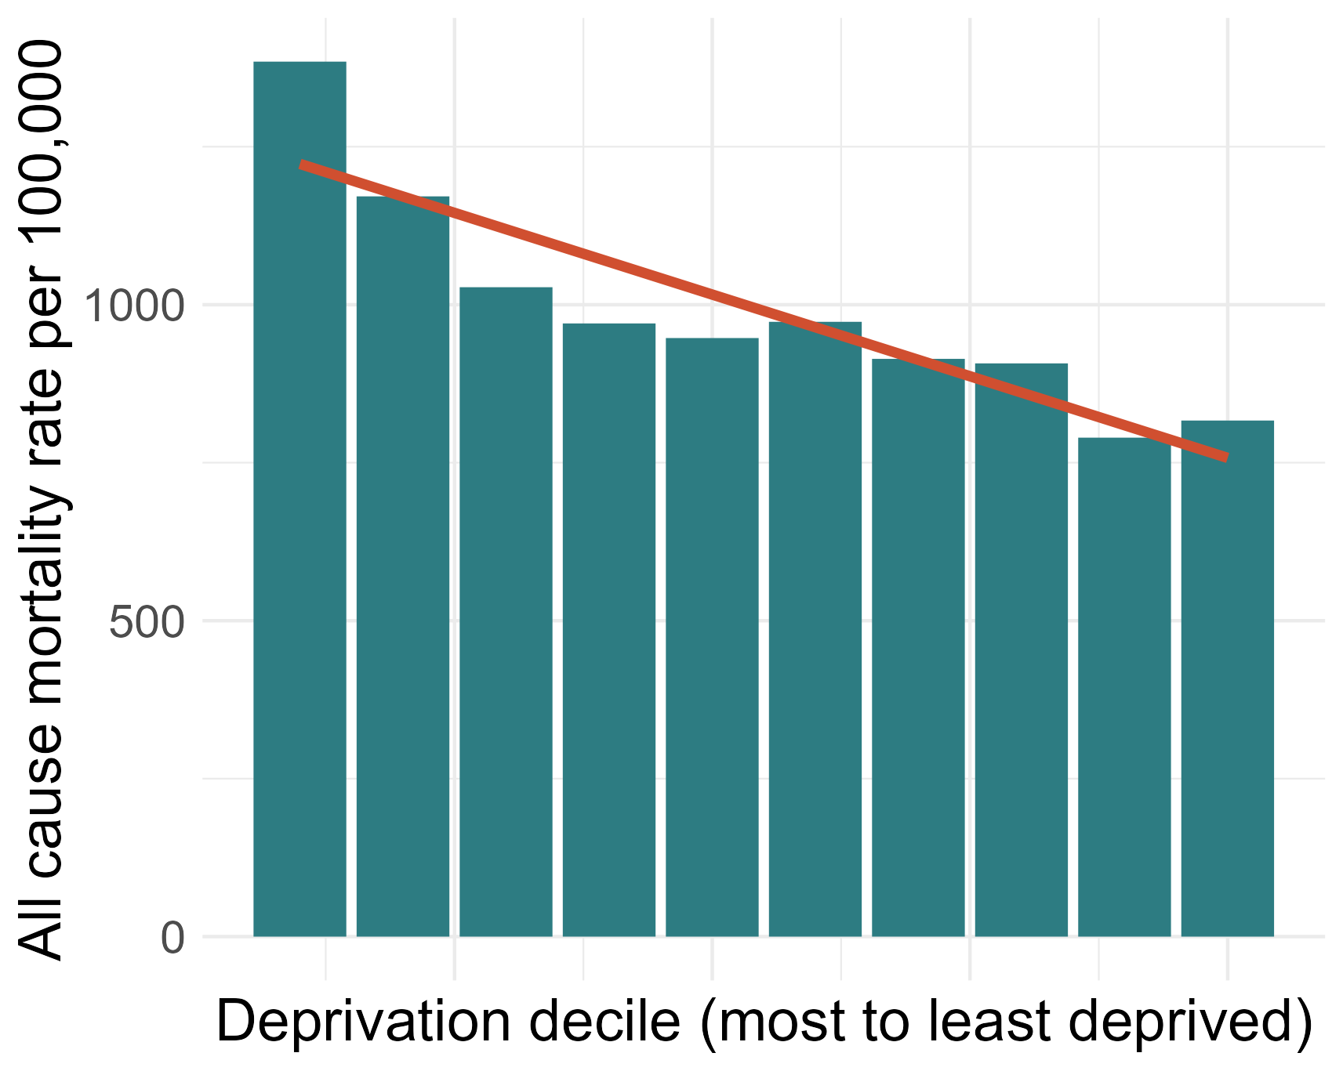
Social gradient of health
All-age all-cause mortality rate by Kent deprivation decile, 2022
Source: Primary Care Mortality Database, KPHO
Notes:
Built environment
Natural environment
Lifestyles
Social connections

Slide 7
We need to address ALL the wider determinants of health (WDH)

Slide 8
Physical Activity is one important part – hence its prominence in our Integrated Care Strategy
Subdomain of shared outcome 3: Support adoption of positive mental and physical health behaviours.
deliver evidence based support to all at an appropriate scale
work with communities to develop community led approaches and local active and sustainable travel
increase the use of ‘making every contact count’ and social prescribing
... by addressing socioeconomic determinants and aiding mental wellbeing we will help people adopt healthy lifestyles

Slide 9
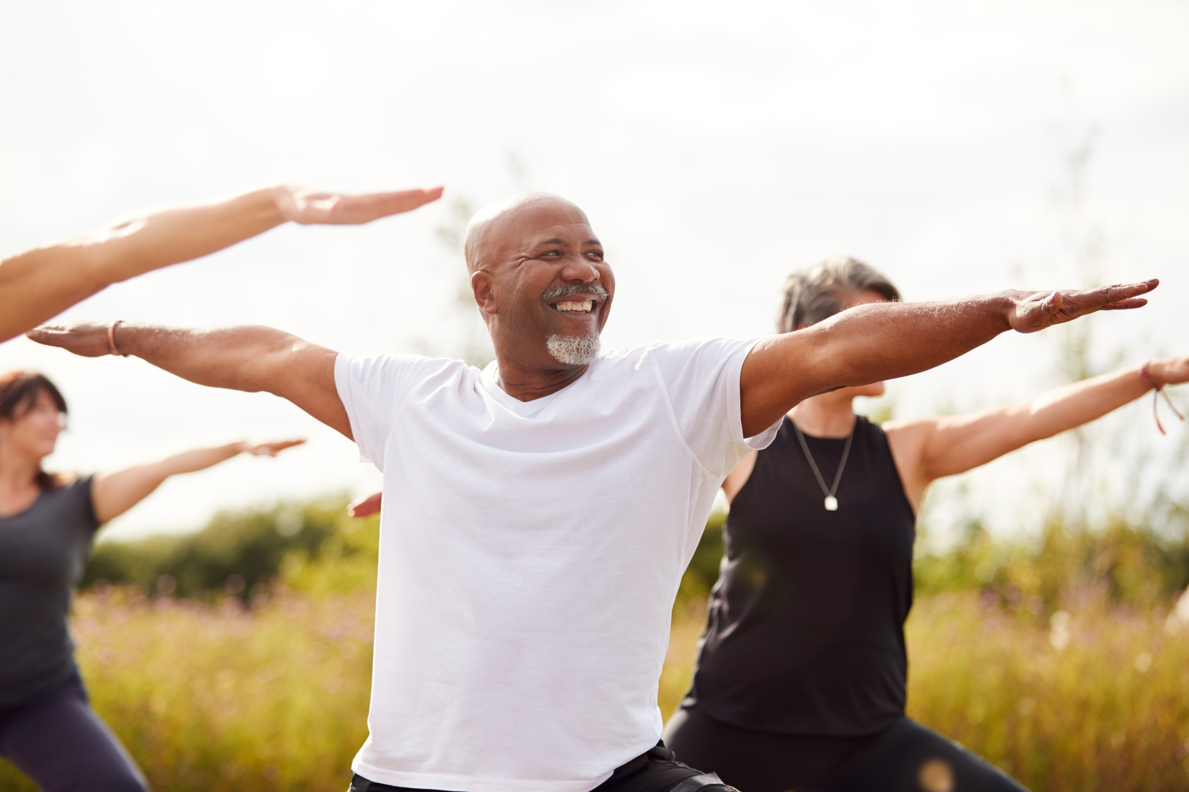
PHYSICAL ACTIVITY

Slide 10
CMO guidance
Adults should be physically active everyday
The UK Chief Medical Officer recommends that children should engage in sport and physical activity for an average of 60 minutes per day
Mon
Tue
Wed
Thu
Fri
60
Adults should engage in moderate-intensity exercise for a minimum of 150 minutes per week
Notes:
The UK Chief Medical Officer recommends that adults engage in moderate-intensity exercise for a minimum of 150 minutes per week, while children should engage in sport and physical activity for an average of 60 minutes per day. This affects not only individuals over their lifetimes and their families, but also health services and society as a whole.
Department of Health and Social Care (2019) UK Chief Medical Officers' Physical Available at: UK Chief Medical Officers' Physical Activity Guidelines (publishing.service.gov.uk)

Slide 11
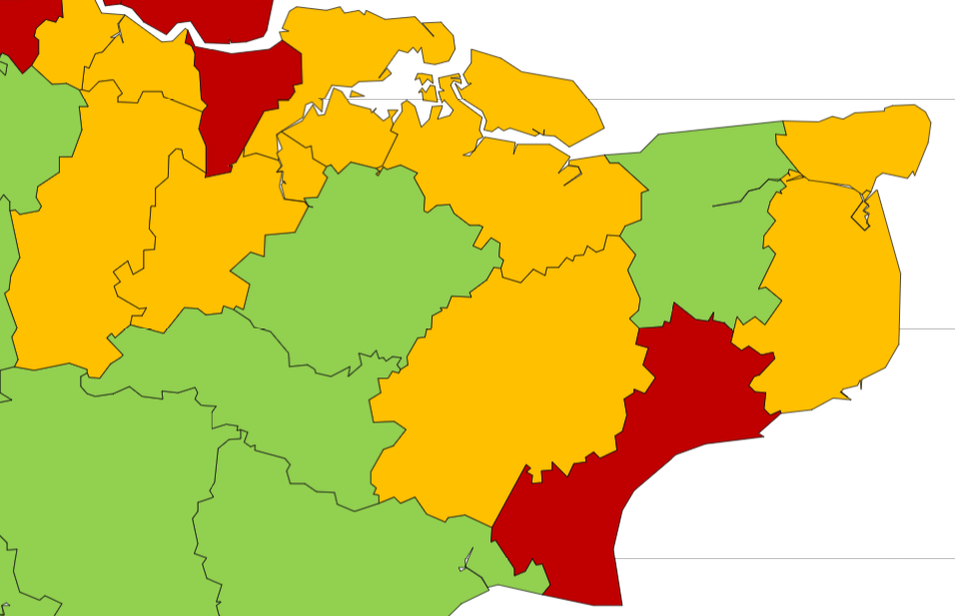
Physical Activity & Inactivity in Kent
In Kent, 68% of adults were physically active similar to England average (67%)
Gravesham and Folkestone & Hythe significantly lower than England average (~62%)
Association of lower levels of physical activity with age and deprivation
Men (70%) more active than women (59%)
Disabled people half as likely to be active
Physically active adults 2021/22 by district and unitary authority
Source: Office for Health Improvement & Disparities. Public Health Profiles. [2023-10-13] https://fingertips.phe.org.uk © Crown copyright [2023]
Notes:
Public Health Scotland (2022) A systems-based approach to physical activity in Scotland A framework for action at a national and local level. Available at: a-systems-based-approach-to-physical-activity-in-scotland.pdf
Sport England (2022) Annual Disability and Activity Survey. Available at: Annual Disability and Activity Survey: 2021-22 (activityalliance.org.uk)

Slide 12
Benefits of physical activity
Mental health
Other long-term conditions
Self-esteem and mood
-30-40% risk of diabetes
Sleep quality
-30%
all-
cause mortality
-30% risk of colon cancer
General energy levels
-20% risk of breast cancer
-20-35% risk of cardiovascular disease, coronary heart disease, stroke
Loneliness and social isolation
Anxiety
Dementia
Depression
Older adults
-30% risk of falls
Physical decline
Notes:
Physical activity has many positive effects on noncommunicable diseases, increases life expectancy, and contributes to the attainment of sustainable development goals. Individuals who meet physical activity recommendations can reduce all-cause mortality by 30%, risk of developing diabetes by 30 to 40%, risk of developing breast cancer by 20% and colon cancer by 30%, and risk of developing cardiovascular disease, coronary heart disease, and stroke by 20% to 35%.
Physical activity also reduces the physical decline and limitation with older adults, including a 30% reduction in the rise of falls. It has a positive effect on mental health by enhancing self-esteem, mood, and sleep quality, and reducing anxiety and fatigue levels. Additionally, it can reduce loneliness, social isolation, lower the risk of depression and dementia.
Public Health England (2016) Working together to promote active travel. Available at: Working_Together_to_Promote_Active_Travel_A_briefing_for_local_authorities.pdf
Department of Health and Social Care (2019) UK Chief Medical Officers' Physical Available at: UK Chief Medical Officers' Physical Activity Guidelines (publishing.service.gov.uk)

Slide 13
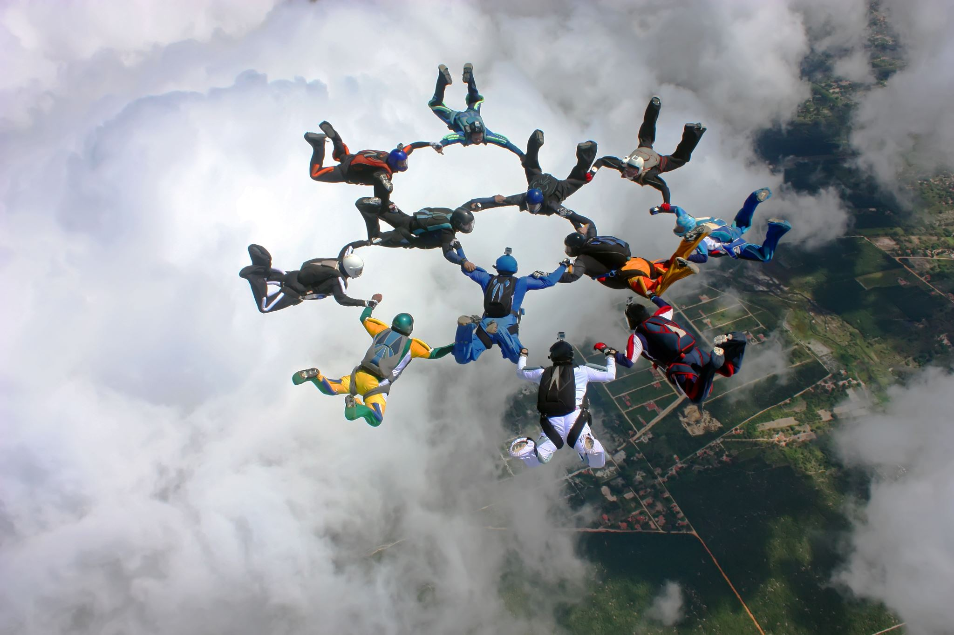
opportunities

Slide 14
Taking a ‘Whole system approach’ to partnership working
Partners from Kent and Medway local authorities, the voluntary sector, community groups, health and social care, faith groups, the education sector and workplaces are required to work together in achieving the desired goals.
In addition, involvement from partners from transport, housing, planning, businesses, disability groups, and others is important.
Active hospitals and workplaces
Enhanced travel route design and town planning
Social prescribing
Embedding physical activity into outpatient pathways
Make every contact count training
Notes:
- creating active hospitals and workplaces
- Embedding physical activity into outpatient pathways
- Encourage more health and social care professionals to complete Make Every Contact training will enable them to have more conversations about the physical, mental, and social advantages of being more active.
- social prescribing, which is part of whole system approach to get more people moving. Social prescribing can provide person-cantered management by referring individuals to parks, recreational fields, libraries, and other community services.
- Enhanced travel route design and town planning

Slide 15
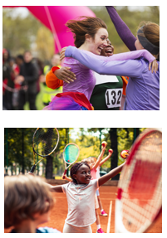
Current activities
Daily mile (in schools)
Park runs
Holiday activity programme
Cycle training
Outdoor gyms
This Girl can
Education materials for employees to become physically active

Slide 16
Move Together Strategy
Move Together Strategy is a call to action for stakeholders across sectors to work together to encourage more individuals to engage in physical activity.
Partners are invited to pledge your support and contribute to the vision of More people, More Active, More Often by supporting and encouraging people to take part in sports and physical activity.
Everyday Active and Live Longer Better Network tools provide access to information about available activities with focus on people who could benefit most owning to health conditions and other personal circumstances.

Slide 17
Our public health team can support – for example Research and Evaluation
Kent County Council has a Research Innovation and Improvement (RII) team whose function is to generate best available evidence to commission the highest quality services and deliver better health. The RII team:
raises awareness about research opportunities
promotes good practice and training
support funding bid applications
The Kent Public Health Observatory can assist with population health analysis and designing project evaluation.

Slide 18
Summary
Inequalities gap can be narrowed with concerted action across the social determinants of health
Average overall physical activity levels masks differences by age, sex, ethnicity, deprivation, disability and geography
Partnership action via a “Whole System approach” is needed
Move Together Strategy offers a good opportunity

