Slide 1
East Kent
Health Needs Assessment
Dr Joseph Deegan, Public Health Registrar, Kent County Council
Stephen Cochrane, Public Health Specialist, Kent County Council
Dr Abraham George, Consultant in Public Health, Kent County Council
Enquiries to: kpho@kent.gov.uk

Slide 2
Preface and Purpose
Health needs in East Kent are changing. This needs assessment sets out those needs, relevant services, and recommendations to improve health, across several health domains.
This is a high-level overview of health status and need in East Kent across a range of health domains. These health domains were chosen by a steering group at the outset of the work, as they were felt to have particular relevance to the needs of East Kent. As such, the scope of this work focused on breadth rather than depth.
Findings, analysis, and recommendations can be found in greater depth for several domains in the focused health needs assessments available on the Kent Public Health Observatory website. Omissions are not indicative of lack of importance or need — rather, they are due to the necessarily limited scope of this high-level assessment.

Slide 3
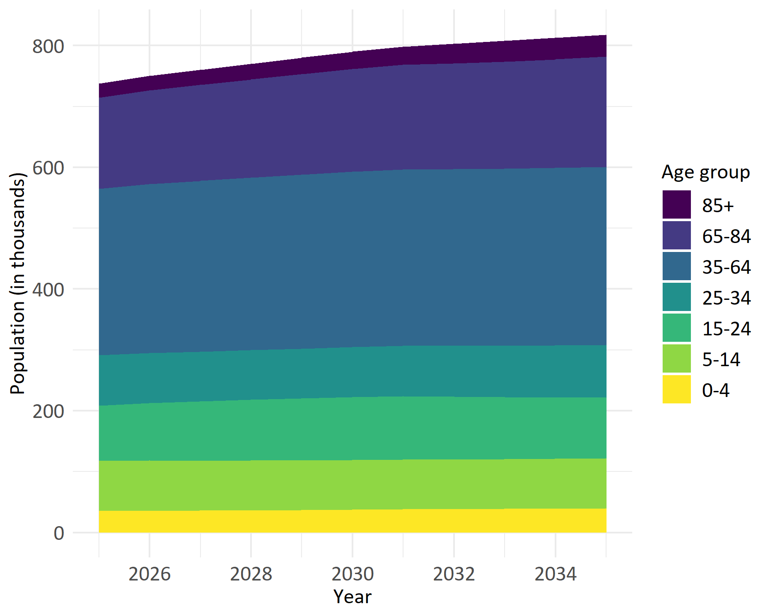
Population growth
By 2035, the total population of East Kent is expected to be about 818,000.

Slide 4
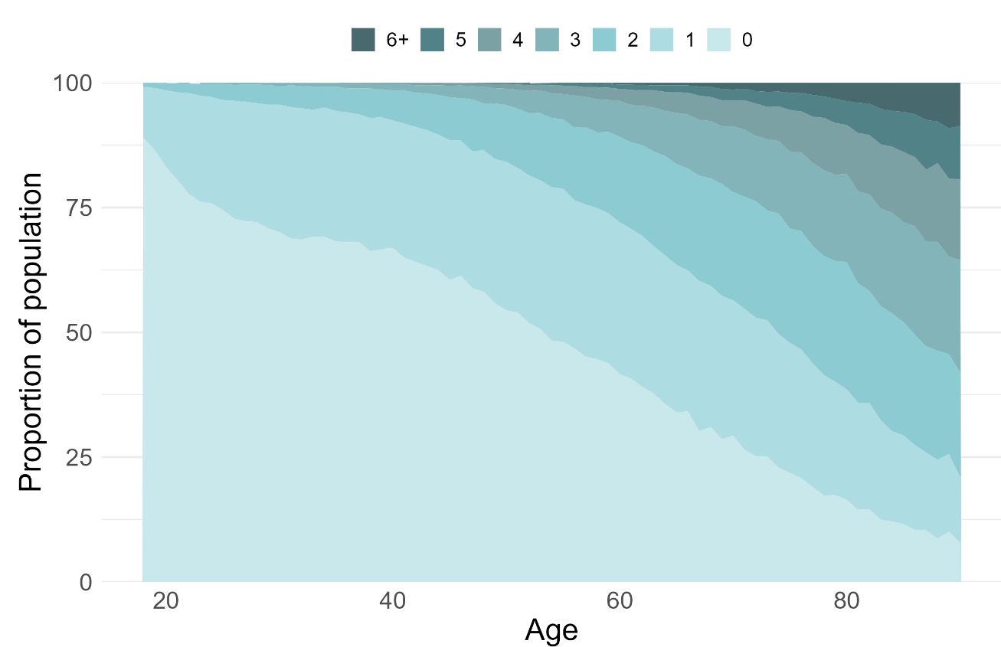
Multimorbidity
Older adults in East Kent see an increasing number of long term conditions.
By age 50 approximately 46% of people have at least 1 long term condition.
Count of long-term conditions by age of people in East Kent HCP aged 18, October 2024. Source: KMCR.

Slide 5
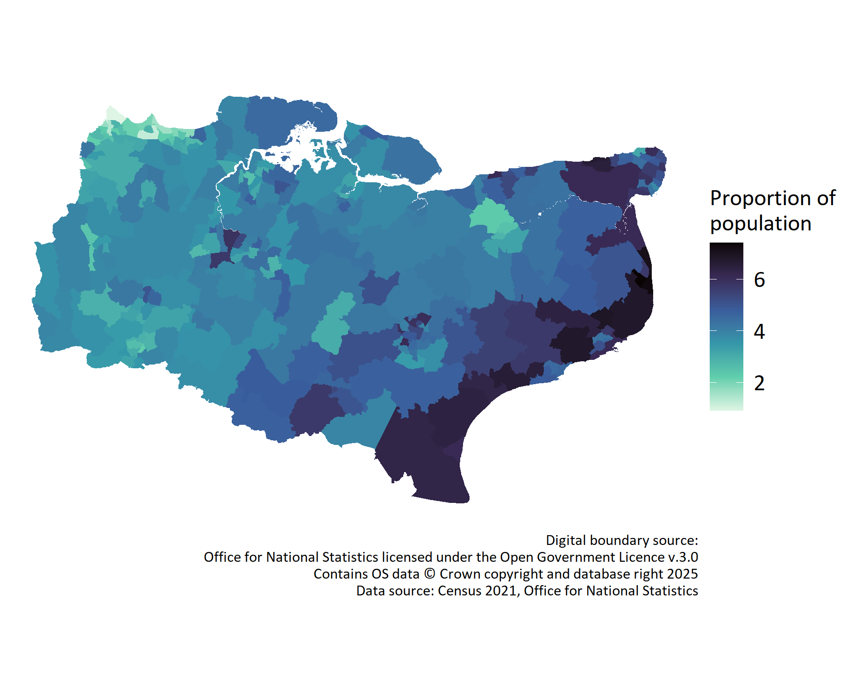
Geography
The coastal regions are the most densely populated in East Kent

Slide 6
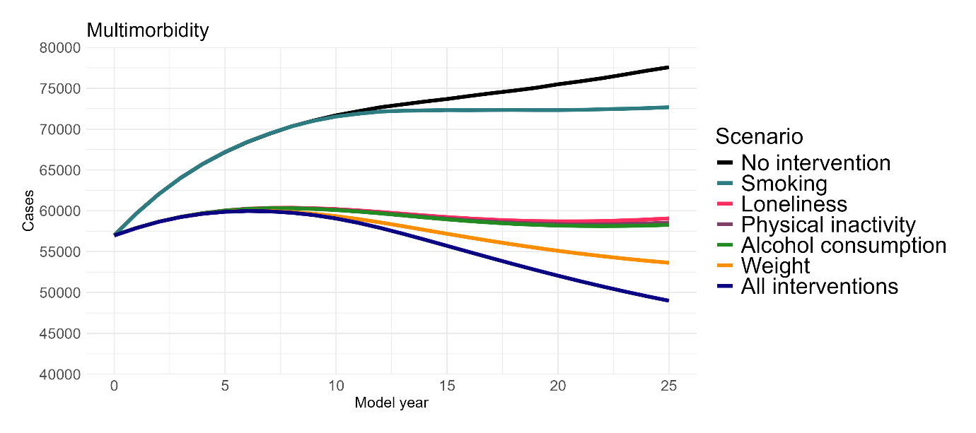
Looking to the future
More people will be living with multiple long-term conditions in the future. We can act to reduce the rate of multimorbidity through a combination of interventions.
This plot shows predicted rates of multimorbidity, which were calculated using system dynamics modelling.
More information on the methods used is available in the full report.

Slide 7
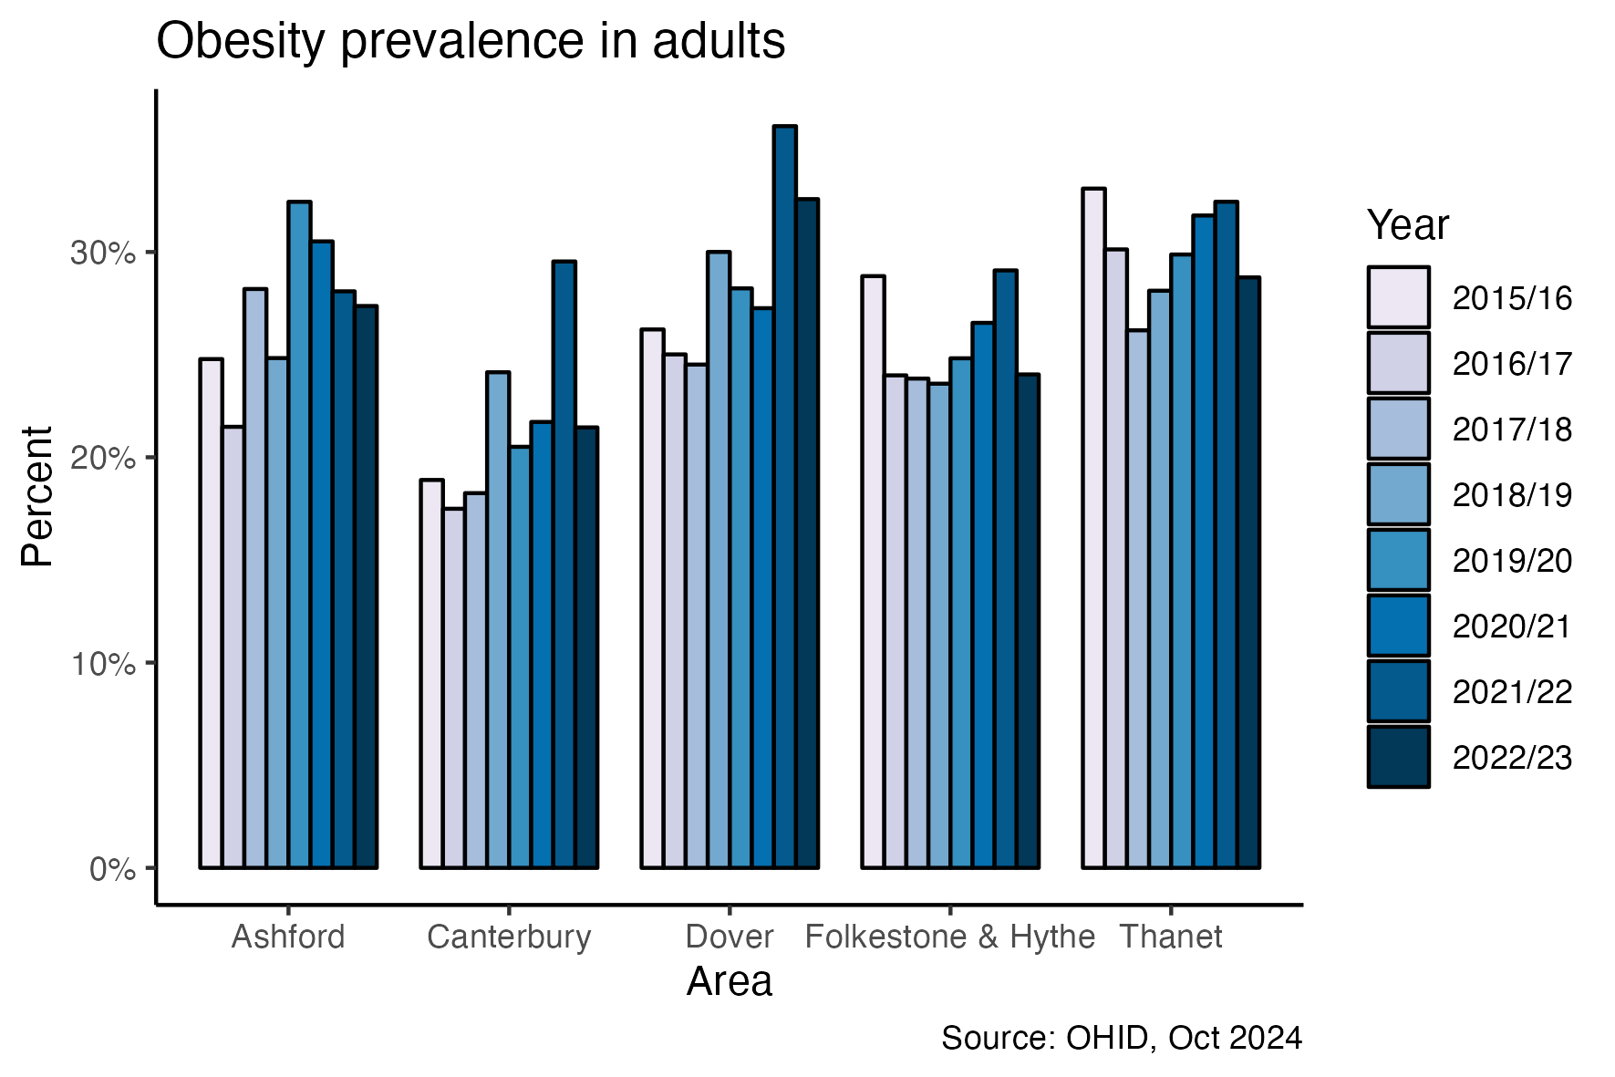
Obesity
There is a general increasing trend in the prevalence of obesity in adults in East Kent.

Slide 8
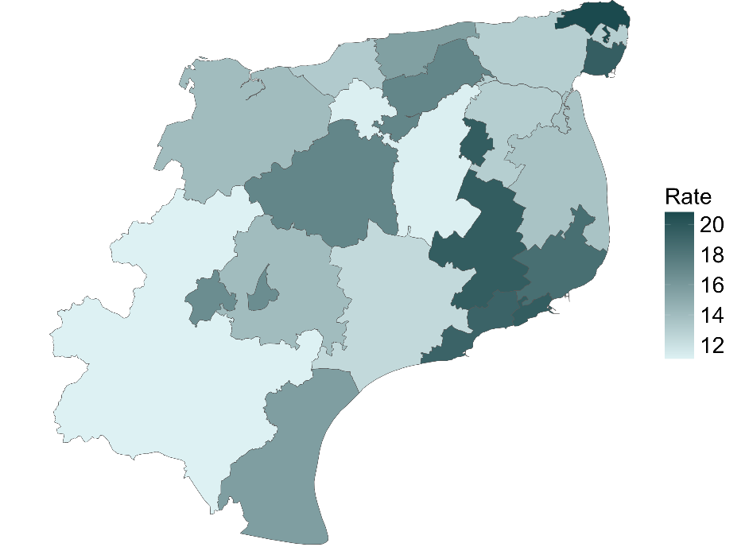
Smoking
There are high rates of smoking across East Kent. Smoking rates are particularly high in Thanet and Folkestone & Hythe.
Smoking prevalence in East Kent PCNs, based on patients’ GP as recorded in August 2024

Slide 9
Sexual Health
The STI testing rate is lower in Kent than the national average. Ashford and Dover see particularly low rates.

Slide 10
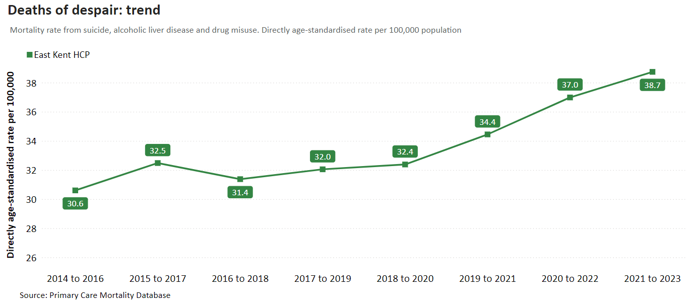
Deaths of Despair
There is a rising trend in the mortality rate from suicide, alcoholic liver disease, and drug misuse.

Slide 11
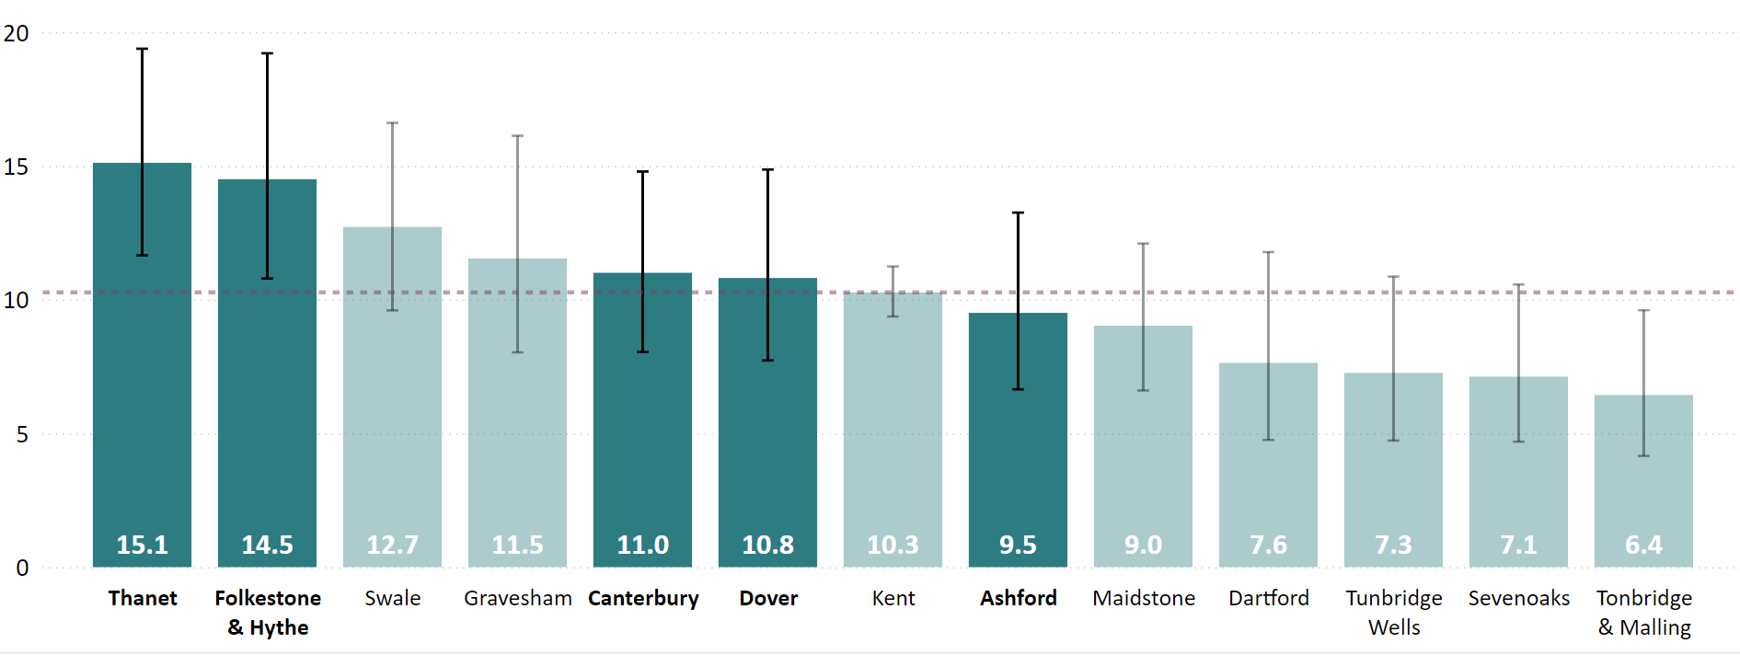
Alcoholic Liver Disease
Thanet and Folkestone & Hythe see the highest rates of alcoholic liver disease
Age standardised alcoholic liver disease mortality rates by Kent district, per 100,000.

Slide 12
Recommendations
Improving access
The population is increasingly older and more diverse – services should acknowledge this and adapt to provide the best service to all users.
Several of the aims of the 10 year plan will work to improve access and deliver more proximal care, including the role of neighbourhood health centres, ending the 8am scramble, and shifting health spending to out-of-hospital care. It is important that commissioners and local decision makers use this shift to maximally deliver benefits to people in East Kent.
Example actions
Ensuring parents who home-educate their children are aware of support available to them from school public health workforce.
Supporting family access services in the most deprived areas to improve health and wellbeing
Investing to increase capacity in the weight management programme to reduce the gap between demand and supply.
Recommendations are discussed in more detail in the full report.
Further example actions are also given, disaggregated by health domain.

Slide 13
Recommendations
Planning for the future
The population and their health needs are set to grow, even in the face of our most optimistic estimate of the impact of public health interventions. This reality should be recognised, and service adaptation should begin now – expanding their reach and capacity to best serve the population.
The NHS 10 year plan highlights the steps necessary to adapt to this increasing demand, including a focus to the importance of prevention, and devolving power to local places.
As a result, expansion of services, local investment in prevention, and further developing services for older adults are made all the more important.
Example actions
Investing in early identification and support for perinatal mental health and parent infant relationship challenges for pregnant women, new mums and their partners.
Increasing public awareness of the steps individuals can take to reduce their risk of dementia
Ensuring services are provided to support family carers of people with dementia
Recommendations are discussed in more detail in the full report.
Further example actions are also given, disaggregated by health domain.

Slide 14
Recommendations
Health in all policies
Good health is created across all policies, not just those labelled as related to health and wellness. Placing a focus on the importance of work as a determinant of health is a priority for the Kent Marmot Coastal Programme as well as the 10 year plan.
Downstream demand can be reduced and prevented through appropriate planning and investment in resources which promote good health. For example, public transport should allow people to access health services. Active lifestyles should be made easy to practice, to prevent frailty and other downstream ill-health. Tackling loneliness should be a priority across departments and organisations.
“Health in All Policies” should be a widely practiced mantra.
Example actions
Activities which address wider determinants of health should be undertaken – e.g. addressing damp and mould in housing, which increases the risk of asthma.
Recommendations are discussed in more detail in the full report.
Further example actions are also given, disaggregated by health domain.

Slide 15
Recommendations
Culturally competent services
We recognise cultural sensitivity as an important capability of organisations and services. Organisations should be aware of, and avail of, training to help them deliver the best possible services to all users.
This includes cultural competence training on working with people from ethnic minorities, LGBTQ+, neurodiverse, and Gypsy, Roma, Traveller backgrounds, among others.
Example actions
Trauma informed approaches should be used more widely, and all professionals working with children should be trained in these approaches. In particularly, they are fundamental for children who have experience a traumatic event and should be used to manage wellbeing and prevent further traumatisation.
Develop a peer support service for HIV, as recommended by best practice.
Identify patient insights into ease of access for LARC services, alongside further analysis of the map of LARC providing GPs in the county to explore areas of low or distant access.
Recommendations are discussed in more detail in the full report.
Further example actions are also given, disaggregated by health domain.

Slide 16
Recommendations
Building analytical capabilities
A key finding across all domains was the relative paucity of high-quality evaluation to guide service planning. Existing evaluation capabilities should be expanded in all services, led by national best practice – e.g. The Magenta Book.
Evaluation should aim to address both estimates of service impact, through quantitative and qualitative methods. Evaluations should also aim to develop understanding of how services, programmes and interventions work, who they work for, and under what circumstances.
Advances in data sharing and linked data is needed to make the best use of evidence, to best plan services and deliver best value to the population.
Example Actions
Embed data sharing and data linkage in services, particularly between maternity care, family hubs, early help, health visiting, social care, and early years education.
Ensure that evaluation is considered in all services, with special focus on collecting data on health outcomes as well as process measures.
Recommendations are discussed in more detail in the full report.
Further example actions are also given, disaggregated by health domain.

