Slide 1
Dartford District
September 28th 2023

Slide 2
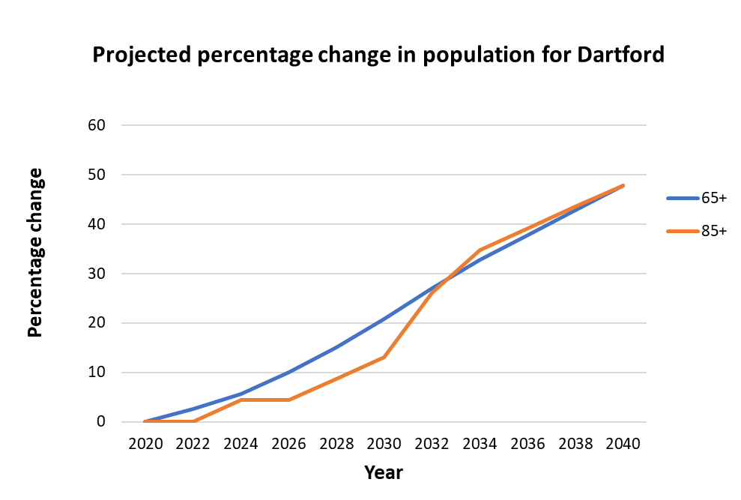
Population Projections
By 2040:
7,600 additional people aged 65+
15,900 in 2020
1,100 additional people aged 85+
2,300 in 2020
People aged 0-64 will grow by 23.2%, equating to ~22,700 people
Notes:
Updated

Slide 3
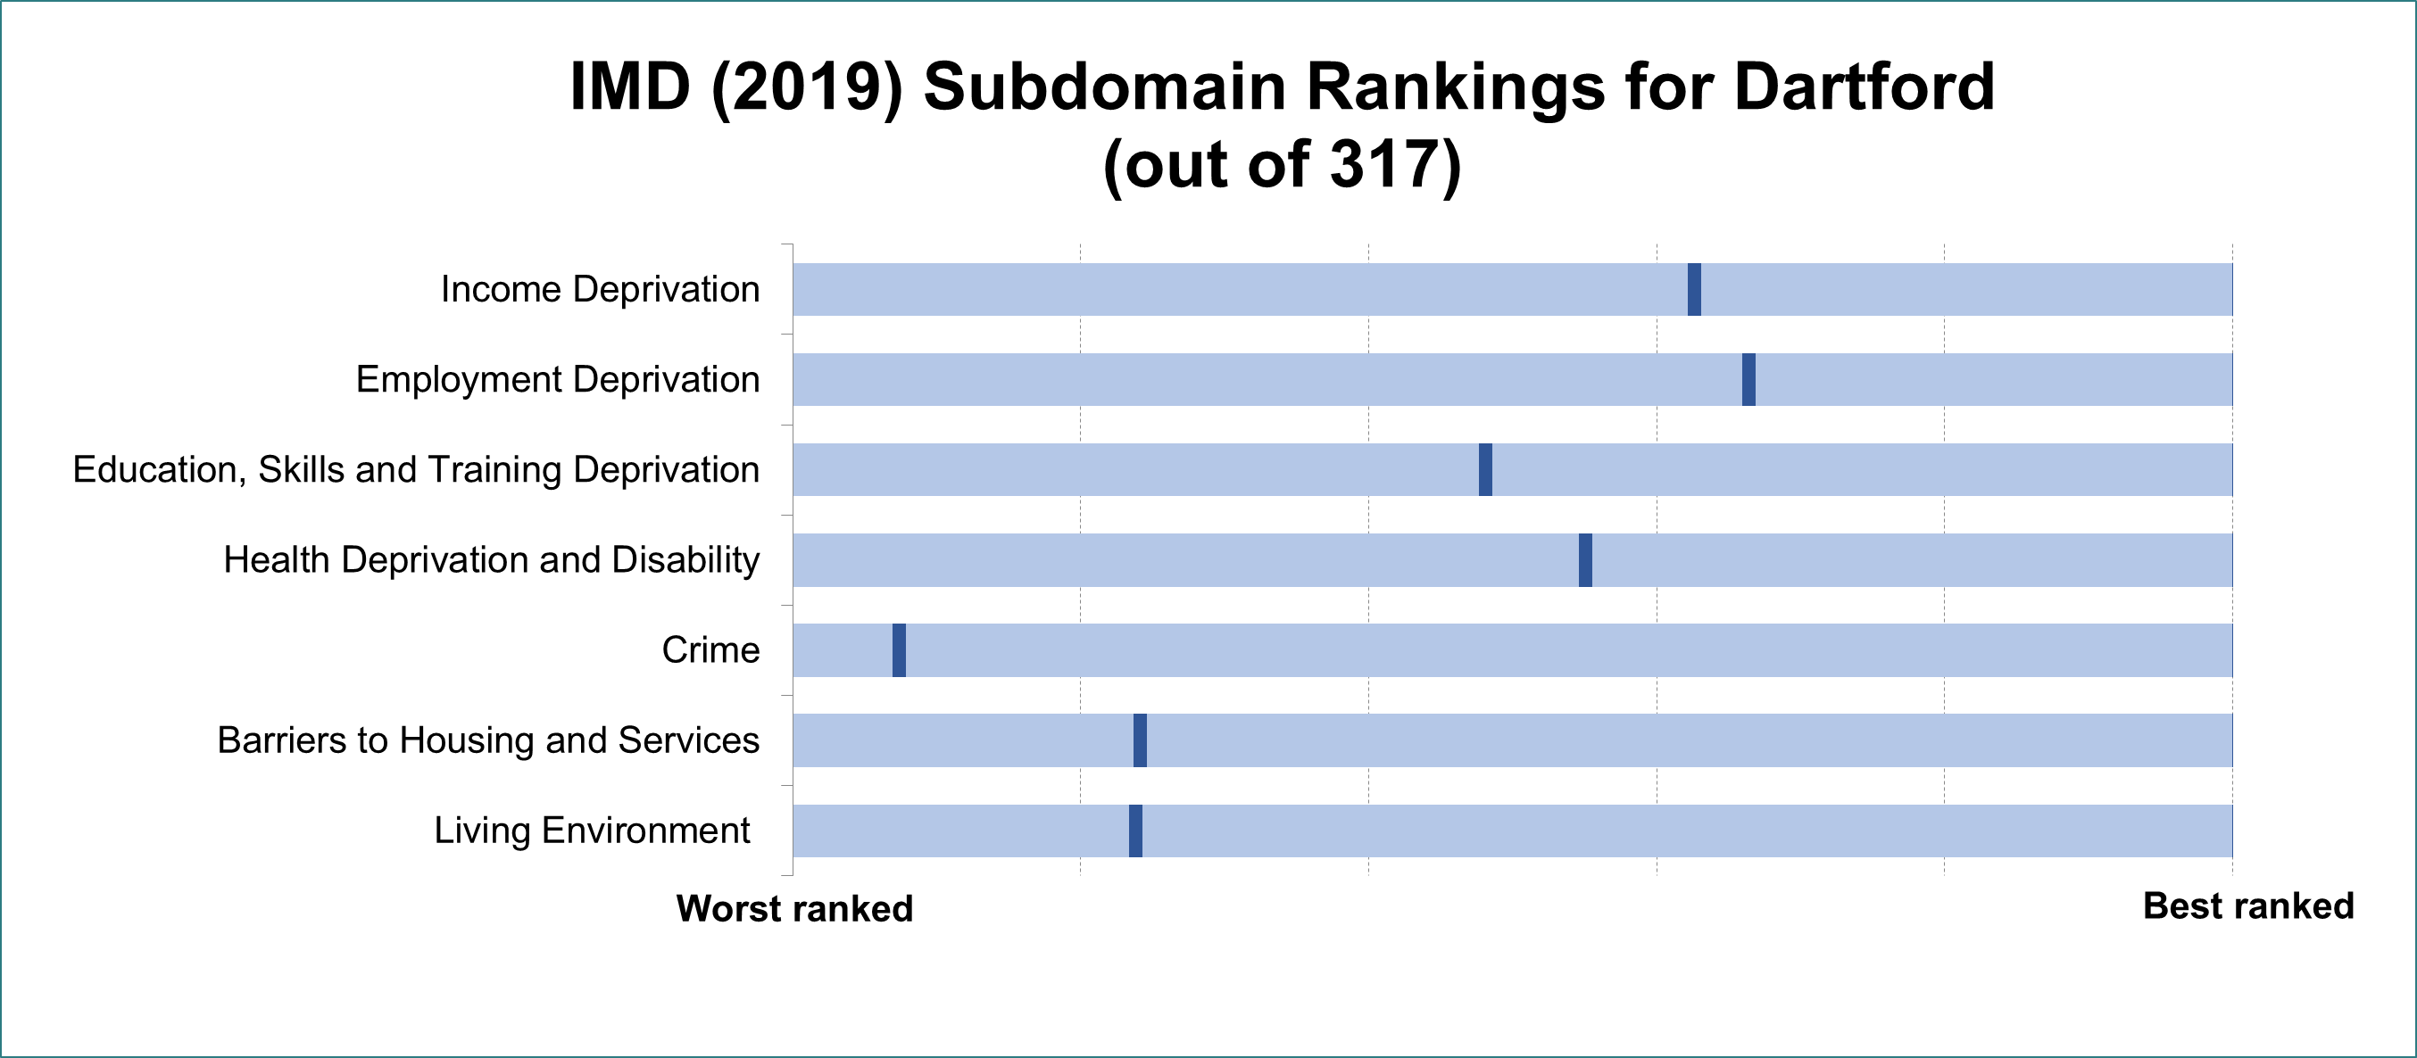
Deprivation
Dartford ranks 145 out of 317 local authorities overall across these seven sub-domains
Notes:
The index of multiple deprivation is a measure used to asses the level of deprivation an area sits at.
Dartford ranks 145 out of 317 overall. (1 is worst, 317 is best)
This is calculated from these seven sub-domains seen here.
This graph shows how Dartford ranks against all 317 other local authority districts in England (marked by the dark blue line)
Dartford has lower income and employment deprivation, as well as Health deprivation and Education but higher in crime, barriers to housing and living environment.
The rankings are provided below for reference (1 is most deprived, 317 is least deprived):
Income Deprivation 198
Employment Deprivation 210
Education, Skills and Training Deprivation 152
Health Deprivation and Disability 174
Crime 23
Barriers to Housing and Services 76
Living Environment 75
Data source: (File 10) https://www.gov.uk/government/statistics/english-indices-of-deprivation-2019
More on the indicators used to measure each sub-domain can be found in pages 65-70 of this technical report: https://www.gov.uk/government/publications/english-indices-of-deprivation-2019-technical-report

Slide 4
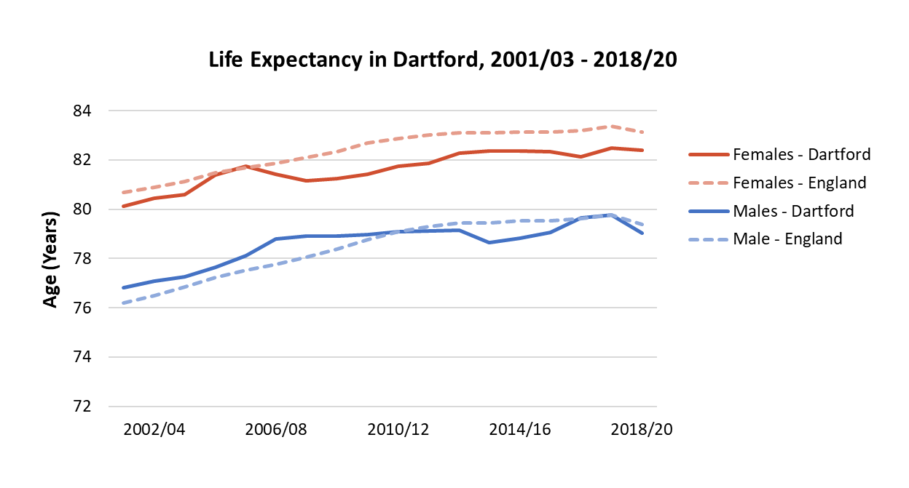
Life Expectancy
Life expectancy has plateaued, or even fallen in most recent years.
Inequality in life expectancy is decreasing for both sexes
6 years
FEMALES
5.4 years
7.5 years
MALES
7 years
2010/12
Dartford
2018/20
Stark inequality in healthy life expectancy
10% most deprived
10% least deprived
52.2 years
70.7 years
National
Notes:
Updated
This indicator measures inequalities in life expectancy at birth. Life expectancy at birth is calculated for each deprivation decile of lower super output areas within each area and then the slope index of inequality (SII) is calculated based on these figures. The SII is a measure of the social gradient in life expectancy, i.e. how much life expectancy varies with deprivation. It takes account of health inequalities across the whole range of deprivation within each area and summarises this in a single number. This represents the range in years of life expectancy across the social gradient from most to least deprived, based on a statistical analysis of the relationship between life expectancy and deprivation across all deprivation deciles.
In Kent, mortality is 85% higher in the most deprived fifth of the population compared to the least deprived
Nationally, all Asian and Black ethnic groups have higher cumulative mortality rate than White. Pakistani and Bangladeshi group is 2.5 times higher. ‘Other Black’ group is over 3.5 times higher.

Slide 5
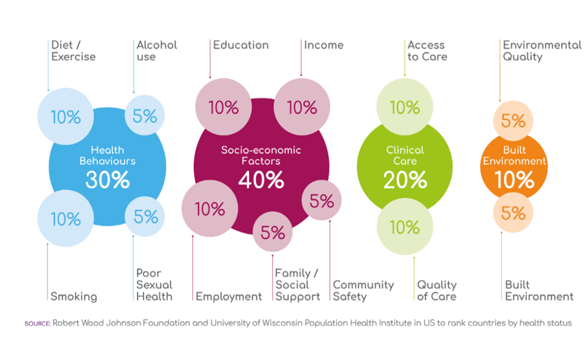
Robert Wood Johnson Model

Slide 6
Infant health –in Dartford district
In 2019-21 the crude rate of infant deaths under 1 year of age was 3.9 per 1,000 live births in England and in Kent 3.6, Dartford district 4.8 per 1,000 live births.
In 2021/22 the crude rate of emergency admissions for gastroenteritis in infants aged under one year was 154.7 per 10,000 population in Kent statistically higher than the England average 123.0 per 10,000 population under 1 year of age.
The crude rate of emergency admissions for gastroenteritis amongst 0–4-year-olds over a three-year time period 2019/20-2021/22 in England was 56.7 per 10,000 0-4 year olds. Looking at this by primary care network [PCN] in North Kent shows higher crude rates per 10,000 0–4-year-olds in Dartford model PCN 92.2, Dartford central PCN 89.5
Notes:
Garden City PCN 100.2, Dartford model PCN 92.2, Dartford central PCN 89.5, Gravesham alliance PCN 86.3 and Gravesham central PCN 83.2
Differences in populations living in Kent by ethnic group and/or living in higher levels of deprivation with outcomes impacted by cultural practices or expectations, language differences or barriers.

Slide 7
Childhood Obesity
Reception: Prevalence of obesity (including severe obesity), 5-years data combined Dartford district 10.9% England average 9.7%
Year 6 : Prevalence of obesity (including severe obesity), 5-years data combined
Dartford district 22.9% England average 21.0%
Kent
x2
Children in Year 6 living in Dartford are twice as likely to be severely obese compared to children in Tonbridge and Malling (2021/22)
Least deprived
6.4% Obese
Most Deprived
12.9% Obese
Notes:
To ensure that large enough numbers were available for analysis, an additional year of NCMP data is included instead of 2020/21; data for 2017/18-21/22 uses 2016/17 data instead of 2020/21.
Sources: NCMP 2021/22
NCMP 2019/20

Slide 8
Educational Attainment
42% disadvantaged Key Stage 2 pupils met the expected standard in reading, writing and maths (RWM) in Dartford, 2021/22
69% non-disadvantaged pupils met this standard
2.91
3.23
62% of pupils in Dartford achieved the expected standard in RWM in 2021/22, down 8% since 2018/19
2019
2022
Nationally, the disadvantage gap index is at the highest level since 2012, suggesting that disruption to learning during the COVID-19 pandemic has had a greater impact on disadvantaged pupils.
Notes:
In 2022 the proportion of aged 2 ½ Kent children that met all the developmental metrics used in the ages and stages questionnaire was 78% in Kent for 2021 and in Dartford district (71%)
40% / 66% in Kent, 43% / 66% in England
In Kent there was a general trend of increased attainment from 2011 – 2019, then no recording during the pandemic, and the latest figures show reduced attainment.
Learning loss for disadvantaged pupils has been consistently greater than for pupils overall and, as a result, the gap in attainment has grown since 2019. The disadvantage gap index (a measure of the difference in attainment between disadvantaged and other pupils) at the end of primary school was 3.23 in 2022, compared with 2.91 in 2019. Left unaddressed, lost learning may lead to increased disadvantage and significant missing future earnings for those affected.
Updated

Slide 9
Overcrowding
14.5%
12.3%
The proportion of households deemed overcrowded by lack of overall rooms
7.9%
Dartford
Princes
Temple Hill
8.8%
10.2%
8.4%
… and by lack of bedrooms
6.05%
Dartford
Swanscombe
Burnham
Temple Hill
Notes:
According to the 2021 Census, an average of 7.9% of households in Dartford have fewer rooms than required. This rises to 12.3% in Princes and 14.5% in Temple Hill electoral wards. All other wards had proportions below 11%.
In terms of bedrooms, 6.05% of households in Dartford qualify as overcrowded, rising to 8.4% in Swanscombe, 8.8% in Burnham, and 10.2% in Temple Hill. The remainder of wards were less than 8% overcrowded.
England averages
Rooms: 6.44%
Bedrooms: 4.37%
Kent averages
Rooms: 5.36%
Bedrooms: 3.56%
Sources: Occupancy rating for bedrooms - Office for National Statistics (ons.gov.uk)
Occupancy rating for rooms - Office for National Statistics (ons.gov.uk)

Slide 11
Respiratory Illness
Fuel Poverty
7.6% of households in Dartford were fuel poor in 2021
As high as 15.2% in some areas
9.8% in Kent and 13.2% nationally
Children living in cold homes are twice as likely to develop respiratory problems as those in warm homes.
People living in the 20% most deprived areas in Kent have approximately 4 times more emergency hospital admissions for COPD, than those in the 20% least deprived areas
Stark inequality in Kent annual COPD admissions
~430 per 100,000 population
~100 per 100,000 population
Smoking prevalence in Dartford district
11.7%
20% most deprived
20% least deprived
Notes:
15.2% fuel poor in Swanscombe ward LSOA 004B
Smoking prevalence according the GP patient survey (GPPS)
2017/18 14.6%
2018/19 14.2%
2019/20 12.6%
2020/21 16.8% (CI 14.7, 18.8)
2021/22 11.7% (CI 9.8, 13.7)
Between 2017/18 and 2019/20 the COPD admission rates don’t vary significantly within quintiles 1 and 5, however in 2020/21 the admission rates in both quintiles falls by nearly half. In 2021/22 the rate in both groups is still slightly lower than pre-2020.
Fuel poverty
https://www.gov.uk/government/statistics/sub-regional-fuel-poverty-data-2023-2021-data
Smoking
https://fingertips.phe.org.uk/search/smoking#page/3/gid/1/pat/6/par/E12000008/ati/401/are/E07000110/iid/92304/age/168/sex/4/cat/-1/ctp/-1/yrr/1/cid/4/tbm/1

Slide 12
Adult weight
In 2021/22 the percentage of adults (aged 18 plus) classified as overweight or obese was 64.5% compared to the England average 63.8%
In 2021/22 the percentage of adults (aged 18+) classified as obese was 23.9% in Dartford district lower thena the England average 25.9%

Slide 13
Impacts of poor sexual health
In 2021/22 the crude rate of pelvic inflammatory disease (PID) admissions in women in Dartford district was 322.4 per 100,000 female population aged 15-44 years statistically higher than England average 224.4
In 2021/22 the crude rate of ectopic pregnancy admissions to hospital in women in women in Dartford district was 161.2 per 100,000 female population aged 15-44 years statistically higher than the England average 90.6
Notes:
PID is a clinical syndrome referring to infection and inflammation of the upper female genital tract which may lead to serious complications such as ectopic pregnancy, tubal factor infertility and chronic pelvic pain. Both PID and ectopic pregnancy have a multi-factorial aetiology although chlamydial infection and other sexually transmitted infections are considered to be major causes of both conditions.
In 2022 STI testing rate [ex under 25 years chlamydia] in Dartford was 4012.2 compared to England average 3856.1 per 100,000 15-64 year olds.

