Slide 1
Kent Sexual Health Needs Assessment
2024
Written by Durka Dougall, Stephanie Hyams, Hannah Brisley, and Tami Sonubi
Key contact: hannah.brisley@kent.gov.uk

Slide 2
Sexual Health and Wellbeing
Sexual Health is a key part of ensuring the overall health and wellbeing of the population. Good sexual health and wellbeing can improve fundamental aspects of people's lives including protection from long term consequences of disease and risks to physical and psychological health. In addition, it can contribute to people’s access to education, economic participation, and access to opportunities in the social and community spheres.

Slide 3
Context
This health needs assessment was undertaken to understand the sexual health needs of the Kent population in 2024. It was felt particularly important given that since the publication of the last Sexual Health Needs Assessment (SHNA) in 2018 there has been a growing body of evidence about how best to improve sexual health (SH) outcomes as well as multiple changes that have impacted on the SH of the Kent population including:
•The COVID-19 pandemic has resulted in a changed landscape in sexual health. Kent services have adapted by introducing more availability of online services, for example asymptomatic testing via the online testing route.
•Since 2020, there have been several national policy changes and strategies that influence sexual health including the Women’s Health Strategy, the addition of oral contraception availability in pharmacies, introduction of statutory relationship and sex education in schools and changes in the way people can access termination of pregnancy services.
•Sexual health attitudes and behaviours have changed, for example with the growth of digital and social media apps and engagement in risky sexual behaviours.
•Reductions in spending for sexual health services has been affected by cuts to the public health grant.

Slide 4
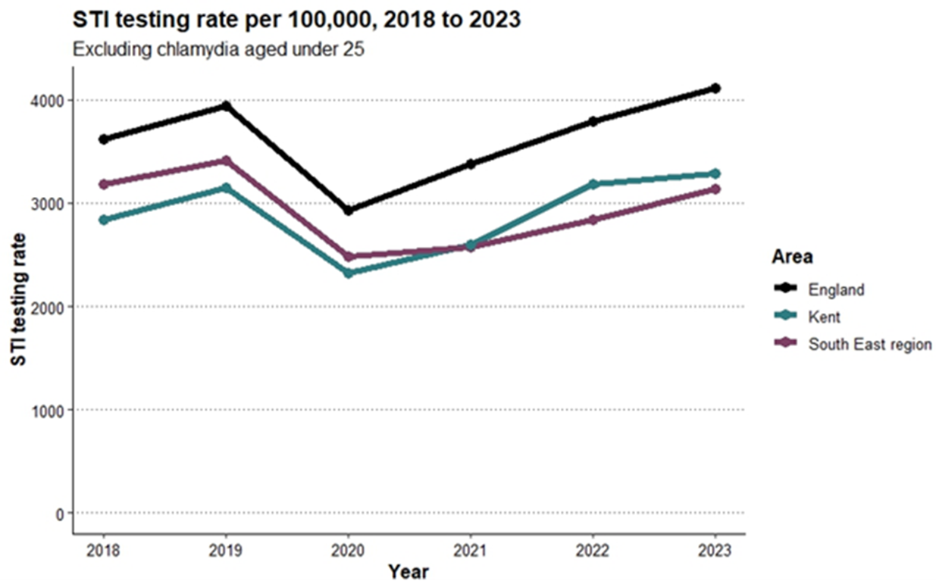
Data and trends
STI testing is increasing as a whole across Kent and has recently risen above pre-pandemic levels, but the trajectory is slower than in England.

Slide 5
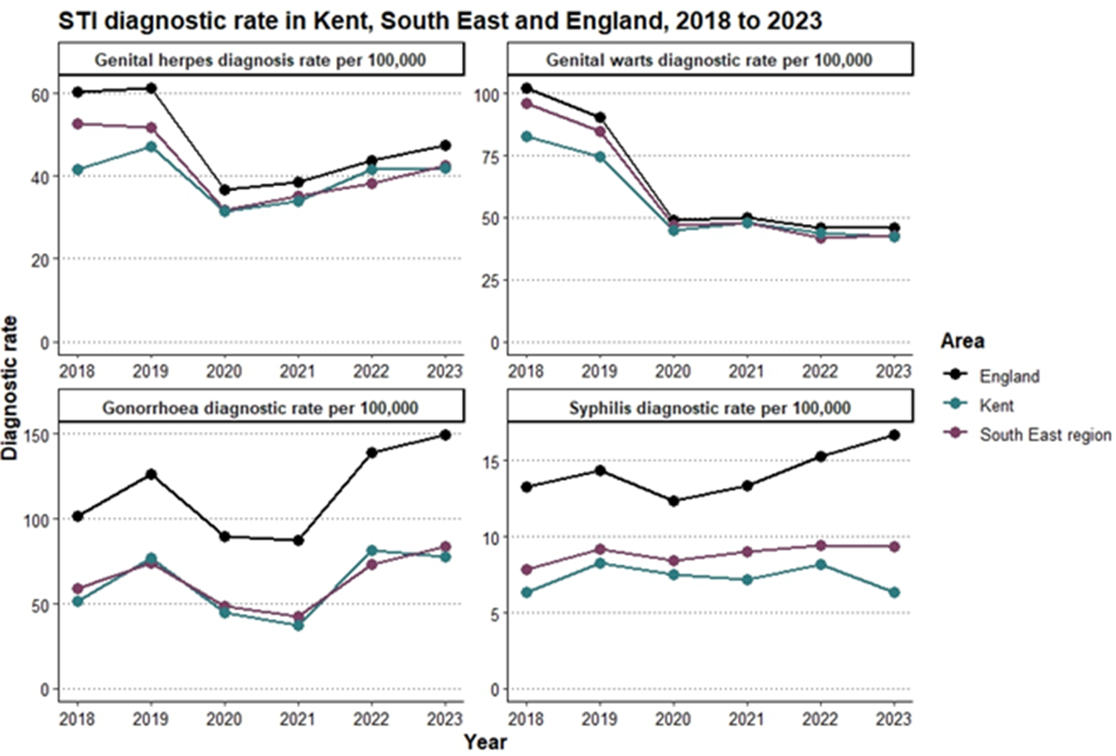
Data and trends: STI Diagnoses
STI diagnoses decreased during the Covid-19 pandemic. Gonorrhoea has risen to above pre-pandemic levels. Syphilis in Kent does not appear to be following the trend of England and has decreased. Other STI diagnoses are following national trends.

Slide 6
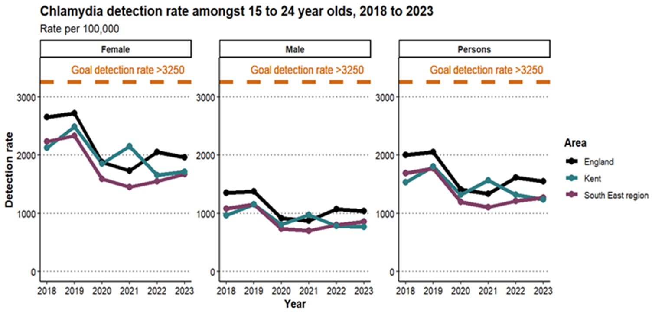
Data and trends: Chlamydia detection
Chlamydia detection is half of the national target.
Chlamydia testing rates for women aged 15-24 is lower than England and South East percentages.

Slide 7
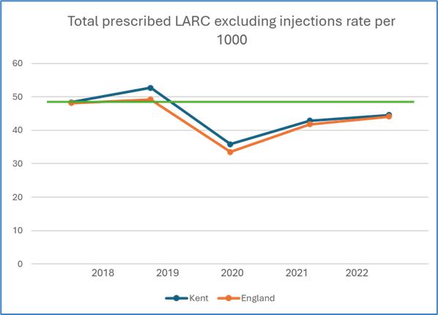
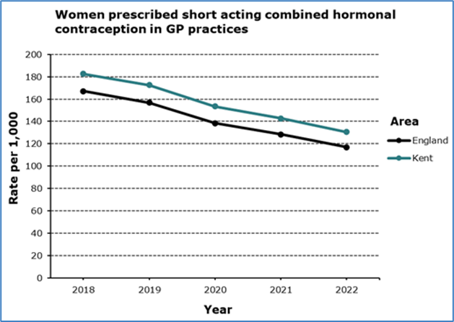
Data and trends: Contraception
Use of hormonal contraception overall is declining. LARC prescriptions have not returned to pre-pandemic levels, however, Kent has stayed in line with England rates. Oral contraception use has been steadily and consistently declining since 2018.

Slide 8
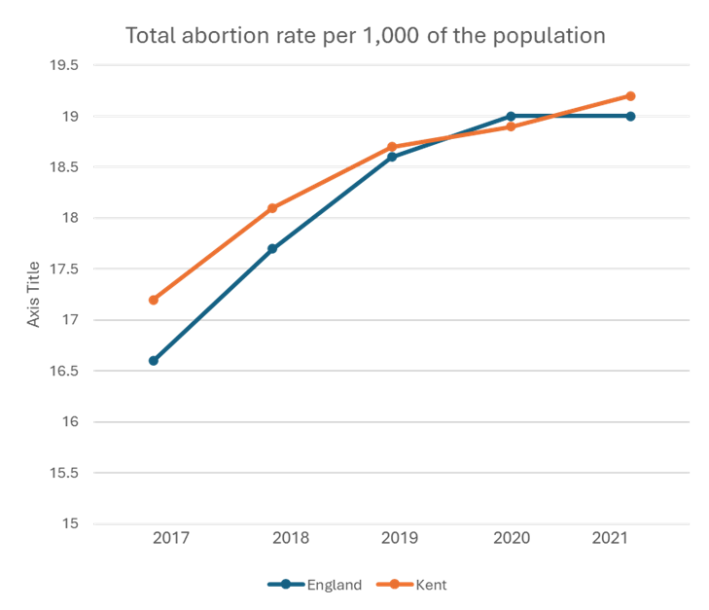
Data and trends: Abortions
Abortion rates are rising, and have returned to exceeding the England rates after a brief change in 2020. However, of note is that this data is from 2021.

Slide 9
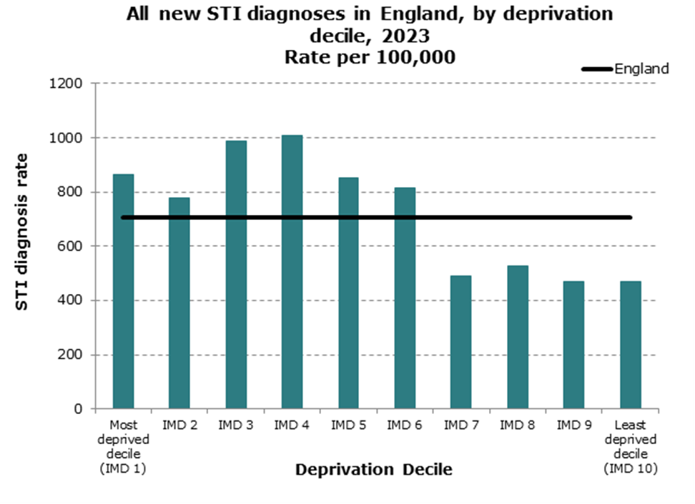
Data and trends: inequalities
Geographical differences exist in prevalence rates, both between and within district populations.
This is accounted for in almost all sexual health indictors including STI prevalence, testing, and reproductive health.
Those in inclusion groups remain a key focus, therefore, the SHNA explored the impact of poor sexual health of groups including how deprivation decile impacts on STI diagnosis as demonstrated here.

Slide 10


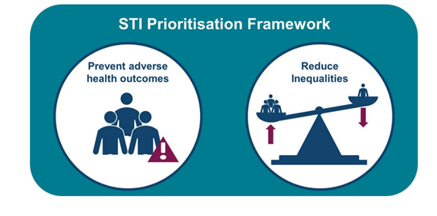
National Strategies
The SHNA has taken important guidance from both the Women’s Health Strategy and the STI Prioritisation Framework to complement our local data and inform our recommendations and next steps. As well as the NICE guidelines.
Key messages are that everybody's sexual health matters, and there is evidence that targeting certain groups in our populations will help reduce infection transmission and access to the right care and support.

Slide 11
At risk/underserved groups 1/3
The SHNA was able to identify groups in our communities who may be more at risk and/or are from underserved groups. This highlights the inequalities experienced in Kent and gives focus to which groups should benefit from additional focus.
Young people are at a higher risk of STIs and unplanned pregnancy, making this group a key focus for sexual health services. There is a need to raise awareness about services and healthy relationships.
Deprived areas in Kent should be a targeted focus to reduce under 18 conceptions and find and treat STIs.
Black and ethnic minority populations can be more at risk of some STIs, although local data for Kent is required. More work is needed to understanding sexual health issues specific to local communities.
Migrant communities face barriers to accessing sexual health services, such as difficulty registering with NHS services, and in some cultures a perceived lack of risk of poor sexual health is present, preventing people from engaging with services.

Slide 12
At risk/underserved groups 2/3
LGBTQ+ people make up a greater proportion of those accessing sexual health services in Kent, compared to the population demographics. An increased risk of poor sexual health relating to STIs and chemsex exists, along with the need for better education around healthy relationships and addressing barriers such as stigma and the use of inappropriate language.
Kent has areas of high Gypsy, Roma Traveller (GRT) populations, particularly the Isle of Sheppey, where it is not understood how well engaged ISHS are with this community. GRT populations should be a focus for sexual health to understand more about use of contraception, abortion rates, and identify opportunities to improve sexual health outcomes.

Slide 13
At risk/underserved groups 3/3
Alcohol and drug misuse can result in an increase in sexually risky behaviours including unprotected sex and inability to give consent to sexual activity. There is a need to improve links between sexual health and drug and alcohol services to minimise compounded risks between the two factors on sexual health outcomes
People in contact with the justice system are at a higher risk of poor sexual health and this is often underreported in national datasets. More understanding is required of sexual health service provision in prisons, along with what support is available to reduce sexual health risks on release from prison.
The homeless population of Kent are particularly affected by changes to services, such as shifts to online or virtual services requiring an address. This population should remain a key focus of outreach work.

Slide 14
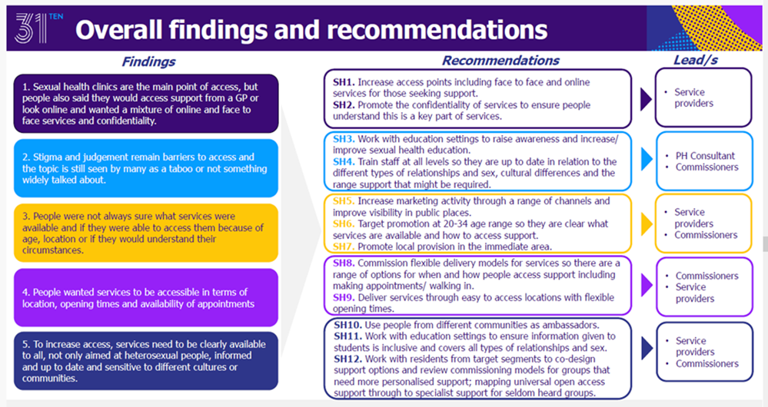
Insights and what the population have told us
Insights conducted as part of the transformation programme have shown us that overall, Kent residents are happy with the SH service offer as a whole. However, more awareness of how to access them would be preferred.
The key findings are here in the graphic.
More insights are needed across a broader section of the population.

Slide 15
Key Overarching Recommendations
The recommendations from the needs assessment have been broken down into overarching, system, and provider recommendations. Whilst this is an overview, the full report gives more detail.
Increase Insights: Gather more feedback from residents, including those who do not currently use services.
Understand Inclusion Groups: Work with stakeholders to understand and meet the needs of diverse groups, like those affected by chemsex.
Establish a Network: Create a sexual health network with various service providers to offer holistic care.
Increase Collaboration: Work with wider stakeholders, like education and community leaders, to improve sexual health outcomes.
Women’s Health Hubs: Collaborate on setting up women’s health hubs in Kent.
Research Opportunities: Engage in research to inform policies and improve sexual health outcomes.
Raise Awareness: Increase visibility of sexual health services through marketing and campaigns.
Address Violence: Focus on the link between sexual health and violence against women and girls, and work with partners to reduce sexual violence.

Slide 16
Key recommendations for the sexual health system
Monitor Trends: Update the needs assessment annually to see if sexual health trends are returning to pre-pandemic levels.
Gather Insights: Collect more feedback from residents, including those who do not currently use services.
Engage Residents: Involve local residents in designing services to better meet their needs.
Tackle Health Inequalities: Use existing resources to focus on reducing health inequalities.
Outreach Services: Provide outreach in areas far from clinics to improve young people's sexual health outcomes.
Reinstate Outreach Group: Bring back the Outreach Provider group to coordinate outreach efforts and support key groups like Gypsy, Roma, Traveller communities, and the homeless.
Collaborate with Partners: Work with partners like women’s health hubs, abortion care, mental health, and drug and alcohol services to offer holistic care. Explore co-locating services.
Review Needs and Resources: Regularly review needs and resources to focus on key sexual health outcomes and reduce health inequalities. Including actioning deep dives into HIV, Chlamydia, and geographical hotspots.

Slide 17
Recommendations for services
Focus on Outcomes: Shift from activity-focused KPIs to outcome-focused ones with support of commissioners.
Apply NICE Standards: Ensure NICE Quality Standards are robustly applied.
Promote Testing: Increase the number of people getting tested for STIs. Particularly those who are symptomatic, and those who are most at risk.
Collaboration: Encourage providers to work together and share resources. One way this can be achieved is by committing to joining and contributing to the Kent Sexual Health Collaborative.

Slide 18
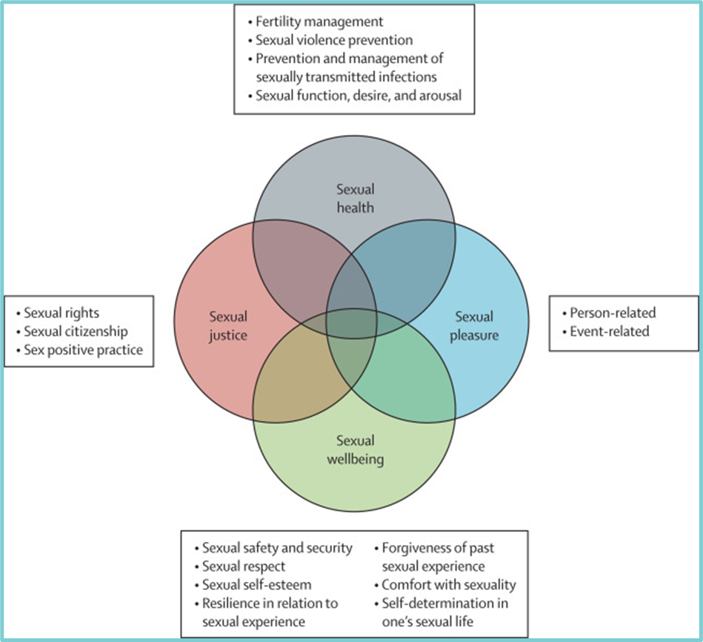
Holistic Sexual Health
The model here, proposed by Mitchell et al, visualises the different remits that when put together, encompass holistic sexual health needs.
Many aspects of this model have been reflected in the SHNA, including contraception, STI transmission, violence against women and girls, reducing stigma, and psychosexual aspects of sexual health.
It is therefore a recommendation of the needs assessment that work to improve sexual health in Kent, is undertaken with this holistic approach.
Mitchel. K et al (2021) What is sexual wellbeing and why does it matter for public health? Volume 6, Issue 8e608-e613

Slide 19
Conclusion
Kent’s Sexual Health Needs Assessment has given us the data and intelligence to inform our transformation programme, as well as beginning focused and amplified efforts in tackling the transmission of STI’s, access to contraception, and has put a spotlight on those groups in our community that will become a focus of efforts in 2025.
Kent’s Sexual Health Collaborative has been rebranded and relaunched to support the achievement of these ambitions.
The key message is that there needs to be an increase in testing for infections in Kent. Chlamydia testing rates in young women are currently half of the national target, and testing of GBMSM for HIV has fallen by 30%. In other aspects of sexual health, the use of LARC is decreasing, as is oral contraception, and abortions are increasing. Under-18 conceptions remain higher than the England average, with Thanet, Swale and Dover having the highest rates.

