Slide 1


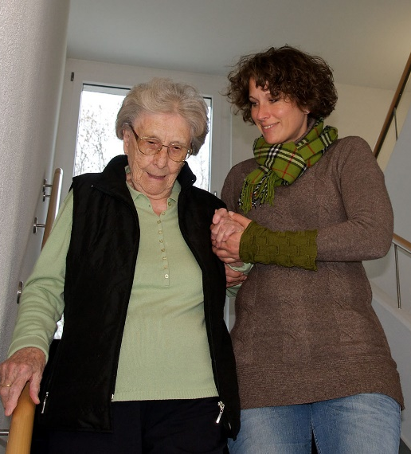

Carers
Health Needs Assessment

Slide 2
Introduction
A Health Needs Assessment (HNA) is a systematic process to identify the needs of a population and determine recommendations for action. It is a highly evidence-driven document and is a ‘systems view’, rather than the perspective of one organisation.
Carers were identified as a key priority group within the ASC Prevention Framework 2025-2035
Carer breakdown is a considerable driver of demand for adult social care.
Desire to strengthen the evidence base for the next phase of the Kent Adult Carers Strategy 2022–2027
A need to focus on prevention, early intervention and reducing the risk of carer burnout and breakdown.
Opportunity to inform the re-designed Kent Carers Service

Slide 3
Context
People in the UK have a 65% chance of providing care in their adult life.
In 2024, Centre for Care produced an economic value for unpaid care for the UK at £184 billion per year, which is almost equivalent to the budget of a second NHS.
An area of weakness identified in (2023-2026) CQC assessments was how local authorities planned in either the short or long term with carers for any potential changes of circumstances that may affect their ability to provide effective care and support in the future. The ADASS Spring Survey July 2026 reported an increase in carer breakdown, with carer burnout cited by directors as the number one reason.
In our most recent JSNA report Kent's rate for % of carers who have as much social contact as they would like was 17.6%, which was the 2nd lowest in the South East; 41.5% lower than the England average and 32.2% lower than the South East average.

Slide 4

What does caring impact?
Physical Health
Poorer physical health, poor sleep, higher LTC burden, fatigue & injury risk
Economic Security
Reduced employment security, loss of incomes, added costs and increased poverty risk
Quality of Life
Loss of routine and identity, major disruption to everyday living
Mental Health
High emotional strain, stress, burnout and elevated risk of poor mental health
Social Connectedness
Greater social isolation, reduced participation and loss of time
Access to care and support
High barriers, fragmented and insufficient & many not known to services

Slide 5
Methodology
The HNA was overseen by a Steering Group, with membership from commissioning, public health, operations, VCSE providers, Health and Lived Experience
A literature review was undertaken to understand the key evidence, and gaps.
Qualitative analysis was done using the Kent and Medway Care Record (KMCR).
Grants using the Accelerator Reform Budget, which funded Crossroads Care Kent, Involve Kent & lived experience involvement in the HNA
Designed a survey containing pre-coded and free text questions.
Focus groups and interviews with carers
Further workshops with carers, internal and external colleagues to co-design the recommendations
We engaged with 1077 people;
987 carers
44 internal colleagues
55 partners

Slide 6
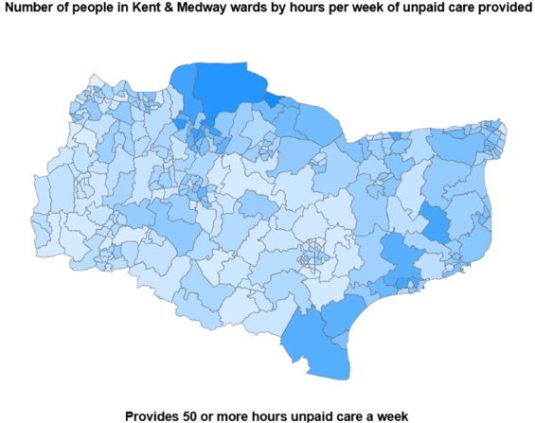
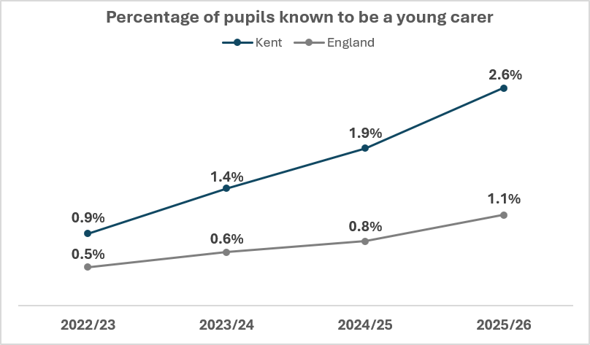
What does caring look like in Kent?
Figure 1
Kent has a higher prevalence of carers (9.1%) aged 5+, than the South East (8.4%) and England and Wales overall (8.9%)
The number of young carers in Kent has been increasing each year, since 2022.
Caring responsibilities are unevenly distributed. Out of the Kent local authority districts, Dover (11,504 people) and Thanet (13,847 people) have the highest proportion of adult carers both with 10.4%, and Tunbridge Wells has the lowest (7.9%).
24% of the Kent’s primary school age Young Carers (Yr R – 6) live in Thanet.
A substantial proportion (31.9%) of Kent adult carers provide high intensity care (50+ hours per week)
Figure 2
Notes:
Figure 1: shows the number of people in Kent and Medway who are providing 50 hours or more unpaid care per week, by Ward. The darker the blue is the greater the population size providing unpaid care. The darker blue areas are concentrated more around the coastal regions of Kent.
Figure 2: shows the percentage of pupils known to be an unpaid carer. The dark blue trend line is Kent, the grey trend line is England. The trend lines show that Kent has a higher percentage on average than England.

Slide 7
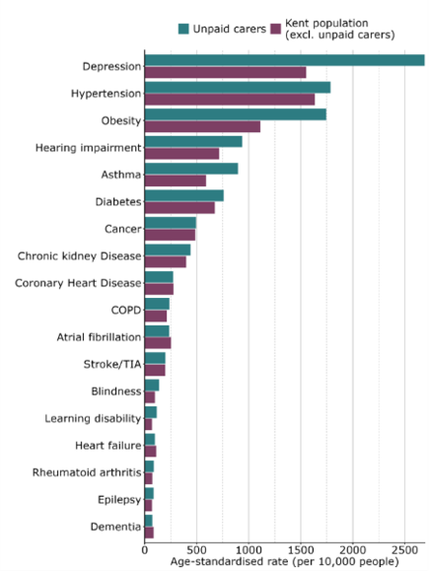
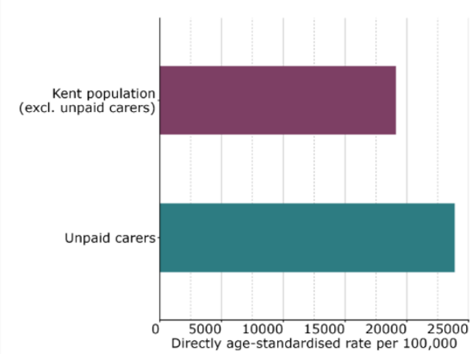
What have we learnt from the Kent and Medway
Care Record?
Figure 3
135,895 people self-reporting as a carer in Kent (2021 Census) or 9.1% of the population
In KMCR, the number of coded and recorded carers (aged 5+) for Kent is 47,098. This suggests there is a large gap between self reporting in the Census and the coding of carers on health records.
After adjusting for age, carers in Kent have higher recorded rates of depression, hypertension and obesity, than non-carers.
After adjusting for age, carers in Kent have higher rates of all-cause hospital admissions (planned and unplanned) than non-carers
Figure 4
Notes:
Figure 3 shows the prevalence of long term conditions amongst unpaid carers (green) and non carers (purple) in Kent (aged 5+). The figure shows that unpaid carers have notably higher rates of depression, hypertension and obesity than non-carers.
Figure 4: shows the rates of all cause hospital admissions for carers (green) and non-carers (purple), this includes both planned and unplanned admissions. The figure shows that unpaid carers exhibit higher rates of all cause hospital admissions than non-carers, when adjusted for age.

Slide 8
What have we learnt from Kent and
Medway Care Record?
Table 1: Percentage of carers and non-carers across the Patient Needs Groups in Kent
Patient Need Group (PNG) | % of carers | % of Kent population (non-carers)
1 – Non-user | 0.3 | 5.2
2 – Low Need Child | 1.0 | 14.1
3 – Low Need Adult | 18.6 | 28.4
4 – Multi-morbid low complexity | 25.3 | 21.6
5 – Multi-morbid medium complexity | 24.1 | 12.9
6 – Pregnancy low complexity | 0.9 | 1.1
7 – Pregnancy high complexity | 0.1 | 0.1
8 – Dominant psych behavioural condition | 6.0 | 4.1
9 – Dominant major chronic condition | 14.9 | 8.9
10 – Multi-morbid high complexity | 6.5 | 2.7
11 – Frailty | 2.3 | 0.8
Carers have a higher proportion of individuals in Patient Need Groups (PNG) 8-11 which are associated with greater levels of need and potentially more complex health status, as well as PNG5 (Table 1).
This suggests that many carers are managing their own significant health needs alongside their caring responsibilities.
Supporting carers earlier, particularly those in medium and high complexity groups, could help prevent deterioration, reduce crisis escalation and sustain caring arrangements in the community.

Slide 9
Carer Profiles
Using the survey data, we were able to group carers using a data-driven clustering approach, using four indices; caring intensity, support access, caring impact and carer strain. This approach identifies distinct carer profiles and highlights groups with higher unmet need…
31% High-need carers facing barriers to accessing support
Most vulnerable group, combining high intensity, high strain, and barriers to accessing support. Many carers have their own disabilities.
Primary needs: Crisis prevention and intensive support
23% High-need carers with relatively good access to support
Provide high levels of care, experience substantial strain, and are often long‑term carers. Access some support but feel it is insufficient.
Primary needs: Sustainability and relief from long-term pressure
22% Moderate-need carers with low strain
have Moderate caring intensity but low strain. Many are older, often caring for a spouse or partner, and supported by strong coping strategies, stable finances, and low co‑residence.
Primary needs: Prevention and maintenance
23% Low-need, low strain carers
Resilient group of carers providing the lowest levels of care, often caring for a parent. Benefit from strong coping strategies, lower financial pressure and non-co-residential arrangements.
Primary needs: Accessibility and early identification

Slide 10
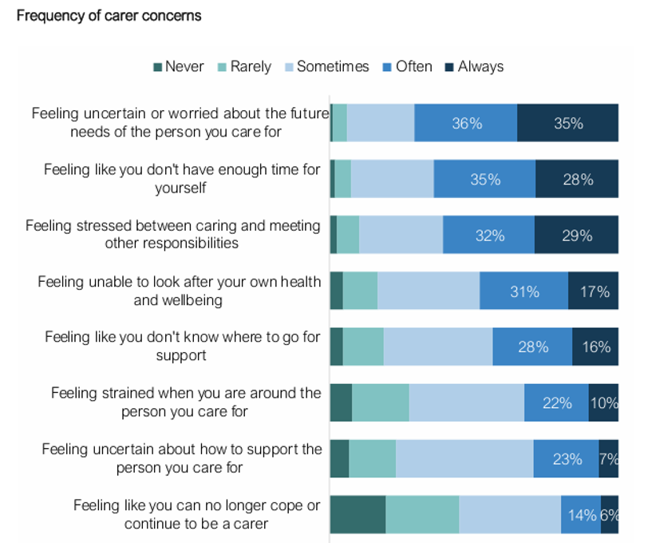
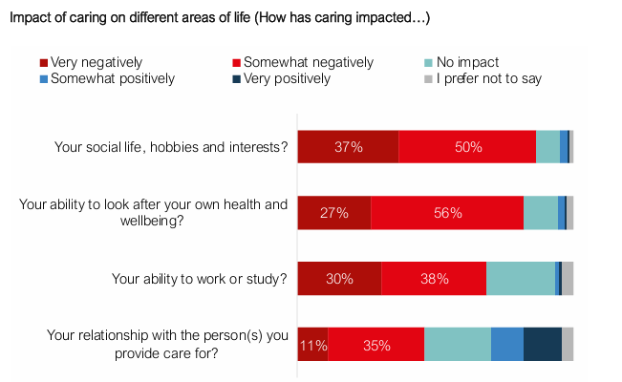
What have we found?
Figure 5
Only 9% of current carers felt they had the right amount of support for them in place
Practical barriers were the most reported challenge when trying to access support (87%); transport, accessibility, scheduling, balancing work and caring
System access barriers (e.g. waiting times) was the next common challenge (73%)
Most carers (93%) fall into the very high or high impact categories
Often, carers told us they wait until they reach a point of crisis before seeking help for themselves, citing needing to reach ‘rock bottom’ before feeling able to reach out
Carers face significant barriers in managing their own long-term condition(s) due to difficulty accessing their medical appointments, and many felt the professionals didn’t have a good understanding of caring or the impact.
Carers describe multiple factors that lead them to feelings of burnout and breakdown, including chronic lack of sleep, constant exhaustion, high vigilance and needing to “battle the system” constantly for the right support.
Figure 6
Notes:
Figure 5: shows how carers rated the frequency of their concerns, when asked in the Life as a Carer survey. The results show that the highest concern was relating to ‘Feeling uncertain or worried about the future needs of the person you care for’. The dark blue shows where carers answered with ‘Always’ and the dark teal shows where the carers answered ‘never’.
Figure 6: shows how carers rated the impact of caring on different aspects of their life, when asked in the Life as a Carer Survey. The results show that carers rated the highest negative impact on their ‘social life, hobbies and interests’. The dark red shows where the carer rated ‘Very negatively’ and the dark blue shows where the carer rated ‘Very positively’/

Slide 11
Caring journey:
Caring is not a linear journey, and there are multiple opportunities in the caring journey to prevent, reduce and delay escalation of need…
Breakdown
Becoming a carer
Taking on more responsibility
Managing with limited support
Experiencing strain
Deteriorating health & burnout
Needs Escalate
Life after caring
Notes:
This diagram shows an example of how the caring journey may change over time for the carer. This diagram has been designed based off the feedback and findings from the Carers Health Needs Assessment.

Slide 12
From evidence to action:
If carers are identified earlier, recognised as partners in care, and supported to maintain their own health, wellbeing and capacity to care, then caring relationships are more likely to be sustained, crisis can be prevented or delayed, and avoidable demand across health and social care may be reduced.
Earlier identification
& recording
Proportionate support based on need and risk
Sustained caring relationships where carers are willing and able
Reduced or delayed escalation, carer breakdown and crisis demand
What we need to consider:
Which recommendations are most likely to support these outcomes?
Where should targeted prevention be prioritised?
What success measures should be agreed across partners?
What governance is needed to oversee progress and accountability?
This could be developed further through a multi-agency carers group

Slide 13
Recommendations (Themes):
Improving identification, awareness and recognition of carers
Strengthening assessment, prevention and anticipatory support
Making services easier to access, navigate and use
Improving practice in hospitals, discharge pathways and wider health settings
Addressing inequalities and improving support for specific carer groups
Expanding practical support, breaks and flexible respite
Supporting carer’s employment, financial wellbeing and wider socioeconomic resilience
Strengthening strategy, commissioning, accountability and promoting systems leadership
Strengthening safeguarding and supporting complex caring relationships
Notes:
Recommendations are set out into 9 themes

Slide 14
Carers are essential to the functioning of the health and care system, but many are hidden, under-supported and experiencing significant strain. A more systematic, preventative and targeted approach is needed to identify carers earlier, support them proportionately and reduce avoidable escalation across the system.
Summary

