Slide 1
Thanet District PH Presentation

Slide 2
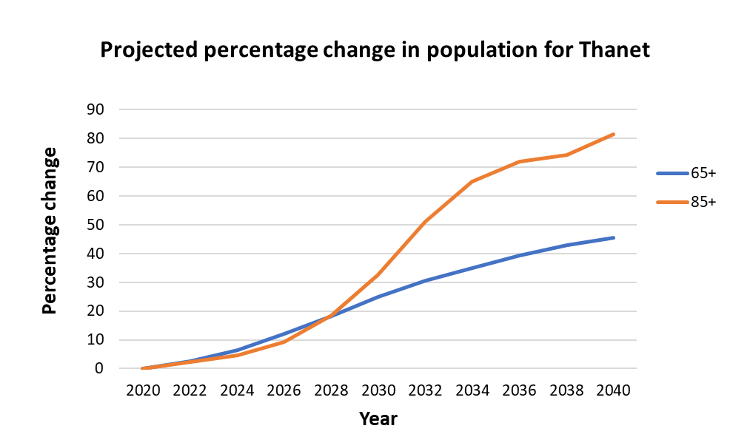
Population Projections
By 2040:
15,500 additional people aged 65+
  34,000 as of 2020
3,500 additional people aged 85+
  4,300 as of 2020
People aged 0-64 will grow by 18%, equating to ~19,200 people
Notes:
Updated

Slide 3
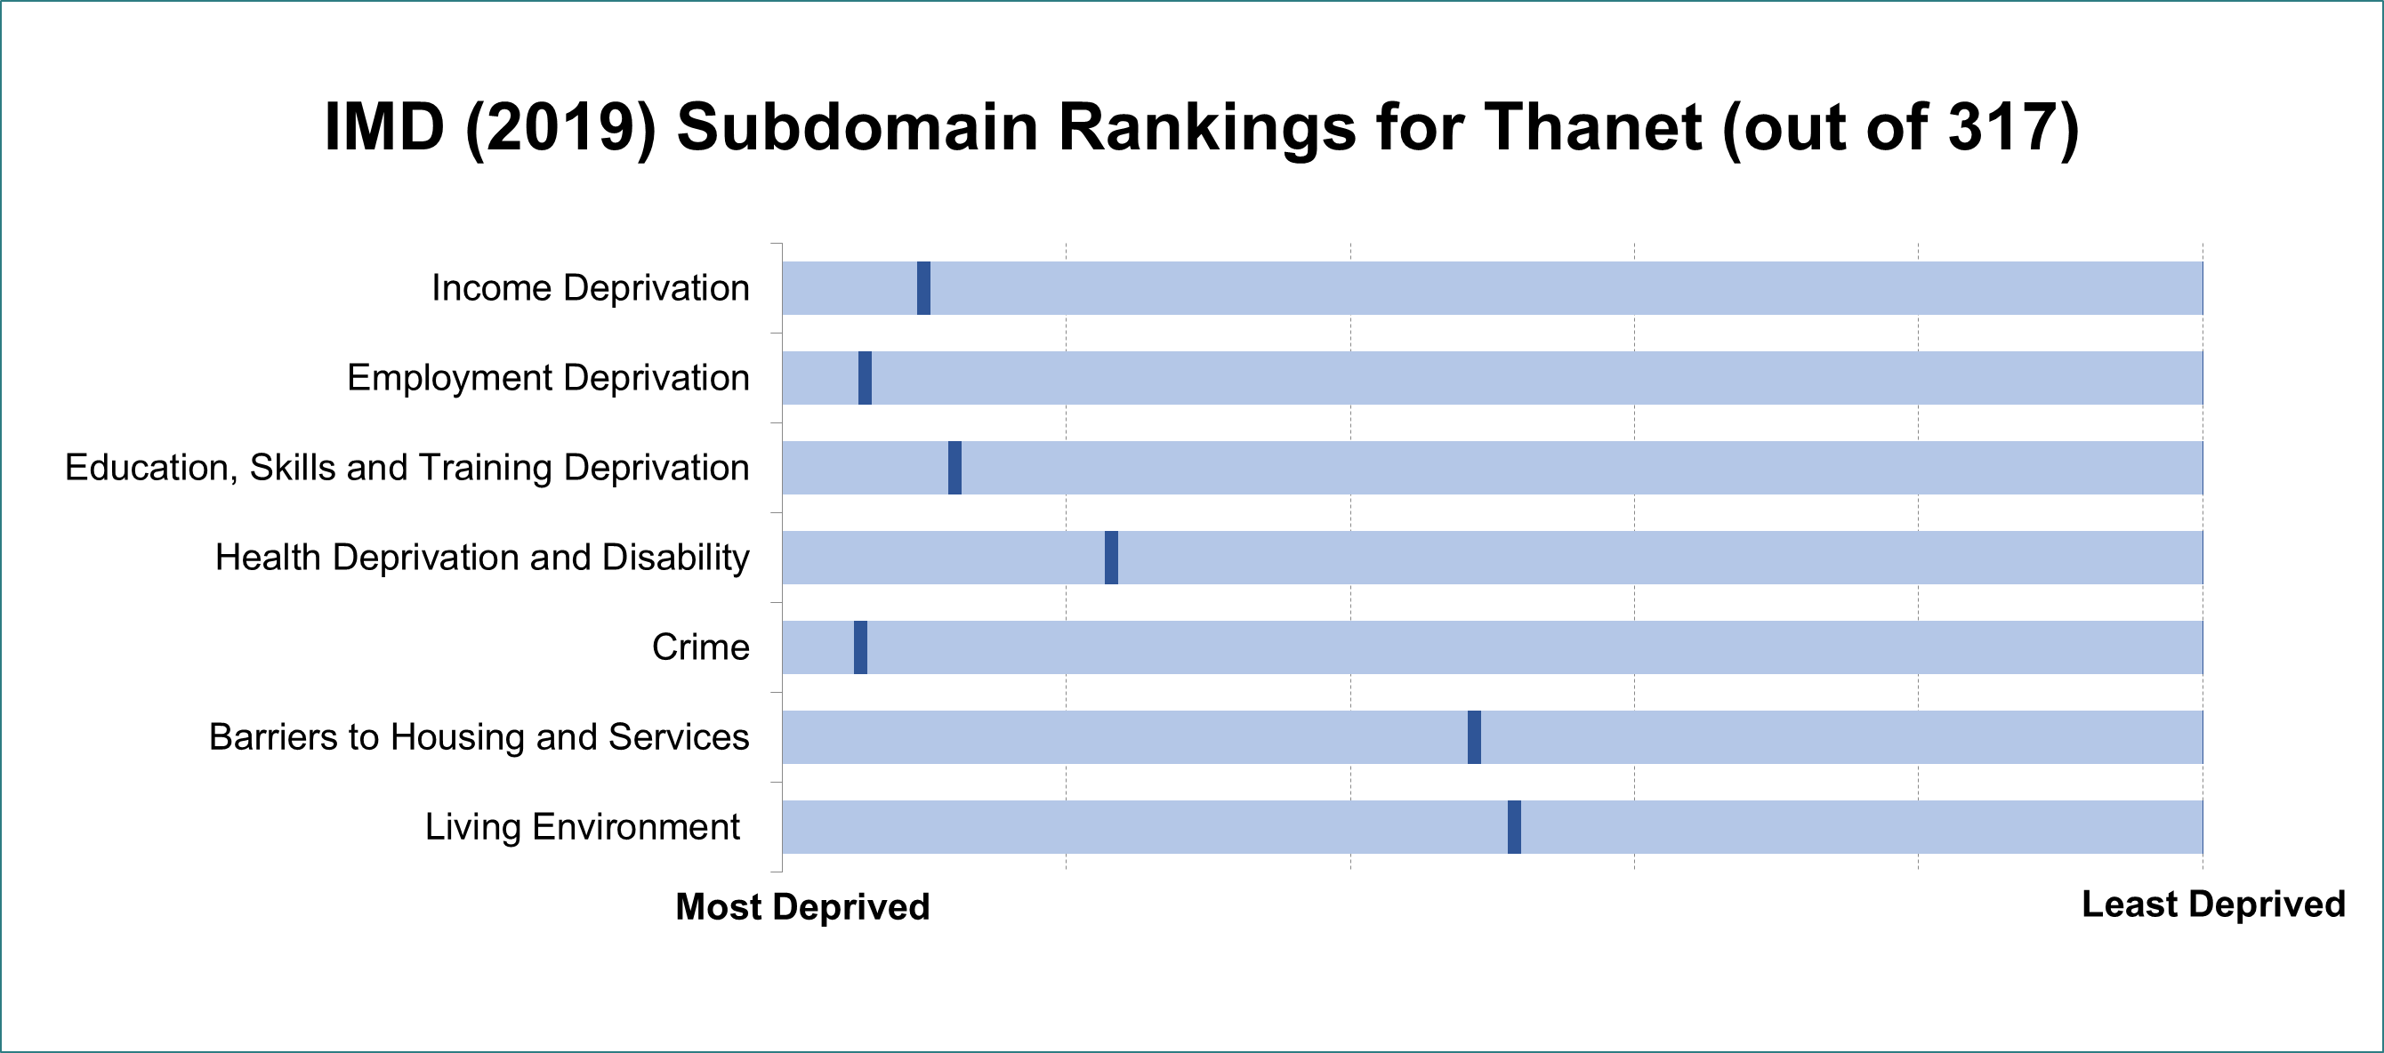
Deprivation
Thanet ranks 34 out of 317 local authorities in England across these seven sub-domains
Notes:
The index of multiple deprivation (IMD) is a measure used to assess the level of deprivation an area lies at.
Thanet ranks 34 out of 317 overall. (1 is the most deprived, 317 is the least deprived)
This is calculated from these seven sub-domains seen here.
This graph shows how Thanet ranks against all 317 other local authority districts in England (marked by the dark blue line)
Thanet is less deprived in terms of living environment and barriers to housing/services but is much more deprived in other domains.
The rankings are provided below for reference (1 is the most deprived, 317 is the least deprived):
Income Deprivation 31
Employment Deprivation 18
Education, Skills and Training Deprivation 38
Health Deprivation and Disability 73
Crime 17
Barriers to Housing and Services 154
Living Environment 163
Data source: (File 10) https://www.gov.uk/government/statistics/english-indices-of-deprivation-2019
More on the indicators used to measure each sub-domain can be found in pages 65-70 of this technical report: https://www.gov.uk/government/publications/english-indices-of-deprivation-2019-technical-report

Slide 4
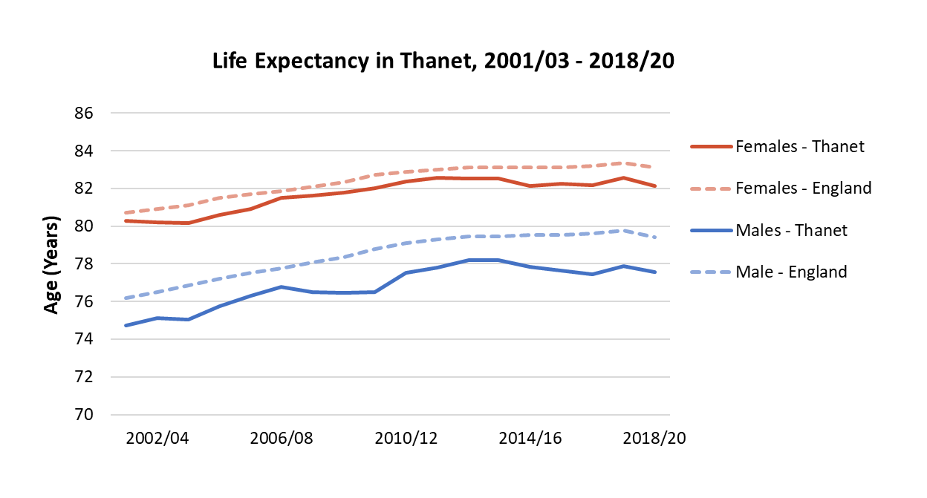
Life Expectancy
Life expectancy has plateaued, or even fallen in most recent years.
Inequality in life expectancy has increased in Thanet for females
10.1 years
MALES
8.5 years
FEMALES
9.7 years
8.3 years
2010/12
2018/20
Stark inequality in healthy life expectancy
10% most deprived
10% least deprived
52.2 years
70.7 years
National
Notes:
Updated
This indicator measures inequalities in life expectancy at birth. Life expectancy at birth is calculated for each deprivation decile of lower super output areas within each area and then the slope index of inequality (SII) is calculated based on these figures. The SII is a measure of the social gradient in life expectancy, i.e. how much life expectancy varies with deprivation. It takes account of health inequalities across the whole range of deprivation within each area and summarises this in a single number. This represents the range in years of life expectancy across the social gradient from most to least deprived, based on a statistical analysis of the relationship between life expectancy and deprivation across all deprivation deciles.
A line chart showing life expectancy in males and females in England and Ashford from 2001/03 to 2018/20. The lines for all increase up to about 2010/12 and then level off, with a noticeable drop for males in the most recent year. Life expectancy is consistently higher for females.

Slide 5
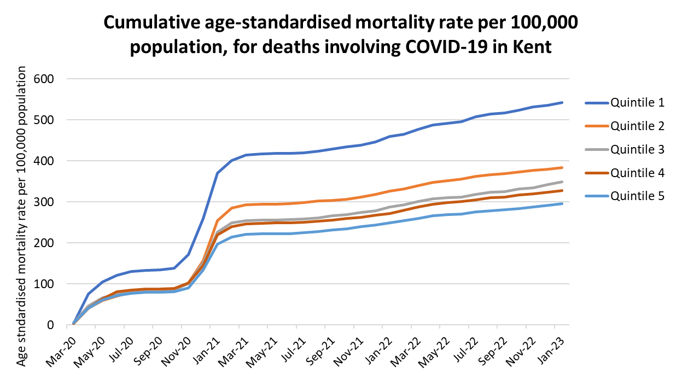
Inequalities in COVID Mortality
In Kent, mortality is 85% higher in the most deprived fifth of the population compared to the least deprived
Nationally, all Asian and Black ethnic groups have higher cumulative mortality rate than White. Pakistani and Bangladeshi group is 2.5 times higher. ‘Other Black’ group is over 3.5 times higher.
Notes:
Source: CHIME tool - CHIME - COVID-19 Health Inequalities (phe.gov.uk)
COVID Mortality rate is 85% higher in the most deprived fifth of the population in Kent compared to the least deprived.
At England level, all Asian and Black ethnic groups have higher cumulative mortality rates than White. Pakistani and Bangladeshi group is 2.5 times higher. ‘Other Black’ group is over 3.5 times higher.

Slide 6
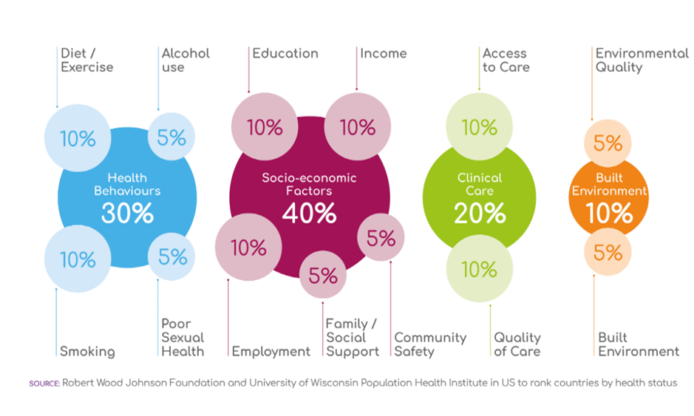
Robert Wood Johnson Model

Slide 7
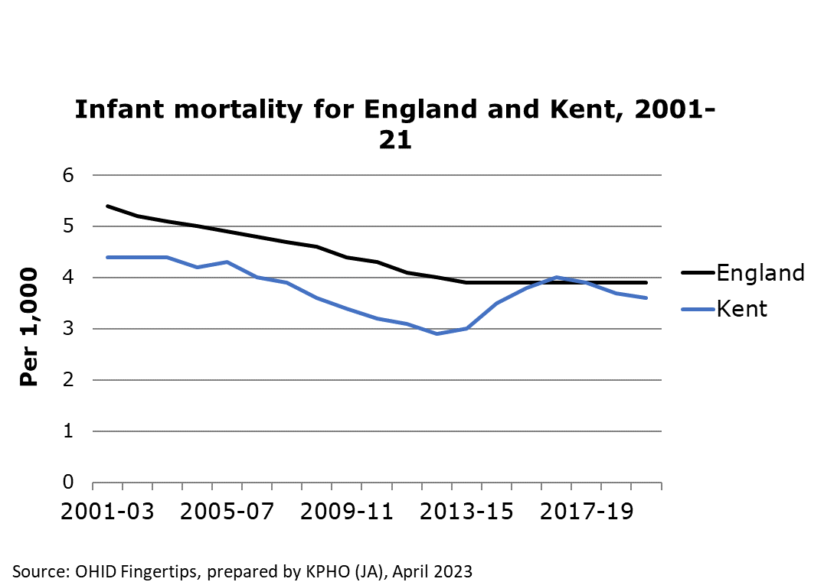
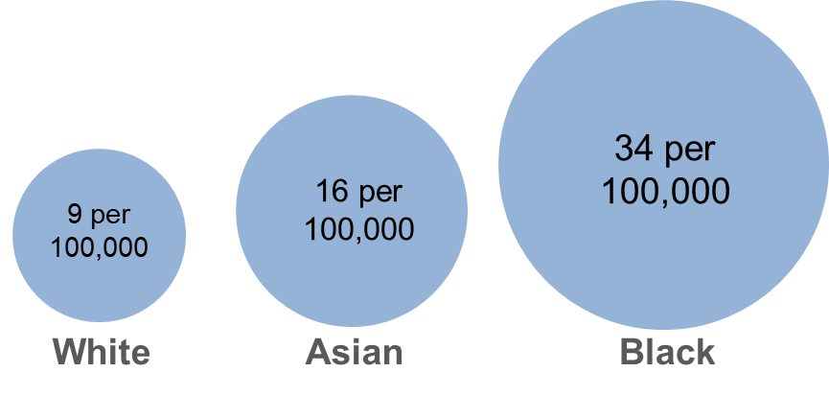
Infant and Maternal Health
UK maternal mortality during childbirth
In 2020, women in the UK were 3x more likely to die by suicide during or soon after end of pregnancy compared to 2017-19
Notes:
Infant mortality in Kent is consistently lower than the national rate, however this typically isn’t a significant difference
The following stats are for the UK,
Black women were 3.7x more likely to die than white women (34 women per 100,000 giving birth)
Asian women were 1.8x more likely to die than white women (16 women per 100,000 giving birth)
More women from deprived areas are dying and this continues to increase
In 2020, women were 3x more likely to die by suicide during or up to six weeks after the end of pregnancy compared to 2017-19 1.5 women per 100,000 giving birth
Sources:
Fingertips (Infant mortality) - https://fingertips.phe.org.uk/search/infant%20mortality#page/4/gid/1/pat/6/ati/402/are/E10000016/iid/92196/age/2/sex/4/cat/-1/ctp/-1/yrr/3/cid/4/tbm/1
MBRRACE report - MBRRACE-UK_Missing_Voices_2022_-_Infographic_v10.pdf (ox.ac.uk)

Slide 8
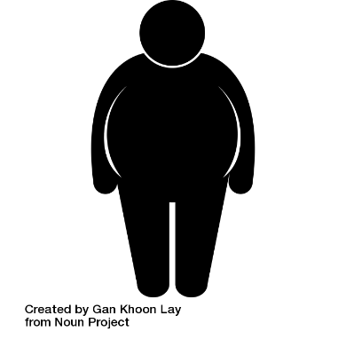
Childhood Obesity
The prevalence of excess weight in Thanet’s Year R Children decreased slightly from 2019/20 - 2021/22 from 25.8% to 24.3%
Obesity also decreased slightly from 11.3% to 10.5%
Severe obesity increased from 2.5% to 3.5%
Change from 2019/20 to 2021/22 (Year R)
Excess Weight
-1.5%
Obesity
-0.8%
Severe Obesity
+1%
x2
Kent (Year R)
In contrast, between the 2019/20 and 2021/22 school years, the proportion of obese and excess weight-carrying Year 6 children in Thanet both increased slightly, whilst the number of severely obese children decreased
Least deprived
6.4% Obese
Most Deprived
12.9% Obese
Notes:
The prevalence of excess weight in Thanet’s Year R Children decreased slightly from 2019/20 - 2021/22 from 25.8% to 24.3%
Obesity also decreased slightly from 11.3% to 10.5%
Severe obesity increased from 2.5% to 3.5%
None of these changes were statistically significant
(Most of these values are higher than Kent averages)
Kent averages for Year R (2021/22):
Excess weight: 21.3%
Obesity: 9.4%
Severe obesity: 2.6%
Children in Year R living in the most deprived areas of Kent were twice as likely to be obese compared to children leaving in the least deprived areas.
Whilst 12.9% of children were considered obese in the most deprived areas, just 6.4% were considered obese in the least deprived areas (by deprivation quintiles).
In contrast, between the 2019/20 and 2021/22 school years, the proportion of obese and excess weight-carrying Year 6 children in Thanet both increased slightly whilst the number of severely obese children decreased.
Excess weight (36.7% to 37%), Obese (23.2% to 24.1%), Severely Obese (6.2% to 5.7%).
Kent year 6 excess weight average (2021/22): 35.8%
Kent year 6 obesity average (2021/22): 22.1%
Kent year 6 severe obesity average (2021/22): 5.1%
Sources: NCMP 2021/22
NCMP 2019/20

Slide 9




Educational Attainment and Pupil Absence
41% disadvantaged Key Stage 2 pupils met the expected standard in reading, writing and maths (RWM) in Thanet, 2021/22
62% non-disadvantaged pupils met this standard
Kent
Free School Meals
Persistent and Severe Absence by Ethnicity
54% of pupils in Thanet achieved the expected standard in RWM in 2021/22, down 7% since 2018/19
Least Absent
Chinese
All Black ethnic groups
Most Absent
Irish Traveller
Roma Gypsy
x2 as likely to be persistently absent
x4 as likely to be severely absent
Notes:
40% / 66% in Kent, 43% / 66% in England
In Kent there was a general trend of increased attainment from 2011 – 2019, then no recording during the pandemic, and the latest figures show reduced attainment.
Learning loss for disadvantaged pupils has been consistently greater than for pupils overall and, as a result, the gap in attainment has grown since 2019. The disadvantage gap index (a measure of the difference in attainment between disadvantaged and other pupils) at the end of primary school was 3.23 in 2022, compared with 2.91 in 2019. Left unaddressed, lost learning may lead to increased disadvantage and significant missing future earnings for those affected.
The following data describes Kent (not Thanet);
Absences of all kinds (including authorised) have increased post-COVID
This slide focuses on the children worst effected, persistently (10% or more of sessions missed) and severely (50% or more of sessions missed) absent children
Trends are similar between Kent and England
The overall percentage of persistent absentees in Kent increased in 2021/22 by 10.9% from 2020/21 from 13.2% to 24.1%
The overall percentage of severe absentees in Kent increased in 2021/22 by 0.6% from 2020/21 from 1.2% to 1.8%
Children eligible for FSM are more than twice as likely to be persistently absent than those not eligible for FSM (43.4% compared to 18.2%) and more than four times as likely to be severely absent (3.7% compared to 0.9%)
The ethnic groups with the highest proportion of persistent and severe absentees are Irish Travellers (Persistent: 76%, Severe: 9.9%) and Gypsy Roma (Persistent: 72.1%, Severe: 6.4%).
Those with the lowest proportions are Chinese (Persistent: 5.2%, Severe: 0.1%) and the total of all Black ethnic groups (Persistent: 9.3%, Severe: 0.7%).
Note: This data shouldn’t be effected by strike action, as guidance from the Department for Education states that students shouldn’t have a ‘Y’ (enforced closure) marking on their attendance, which is not classed as an absence
Sources:
https://explore-education-statistics.service.gov.uk/data-tables/permalink/5be187b3-5841-429e-5f68-08db44b1b303
https://explore-education-statistics.service.gov.uk/data-tables/fast-track/9b8318dd-bb02-4220-8249-08db1fecc641
https://explore-education-statistics.service.gov.uk/data-tables/permalink/2f088f8d-3266-4440-5f6b-08db44b1b303
https://explore-education-statistics.service.gov.uk/data-tables/permalink/ed018804-c700-4d35-7616-08db43d84656

Slide 10

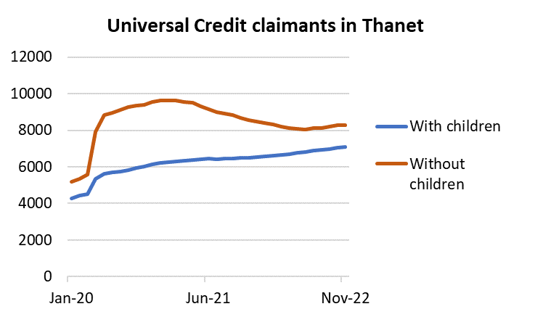

Families in Poverty
53k
12.8%
+16k children in low income families
17.6%
Children in Newington ward are 3.5x more likely to live in a low income family, than those in Kingsgate ward
2015
2022
37k
Kent
Universal Credit claimants in Thanet
Claims from those without children increased much more quickly during the pandemic, peaking in February 2021.
There was a sharp increase in claims from those with children between March 2020 and May 2020, then a gradual increase which has not slowed down since
Notes:
Children living in low-income families has increased by ~5% in Kent since 2015
Children in a low income family (relative):
Newington – 32.0%
Kingsgate – 7.9%
Source: Children in Low Income Families: local area statistics, United Kingdom, financial years ending (FYE) 2015 to 2022 (DWP)
https://www.gov.uk/government/statistics/children-in-low-income-families-local-area-statistics-2014-to-2022

Slide 11
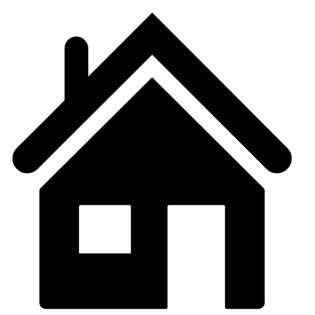

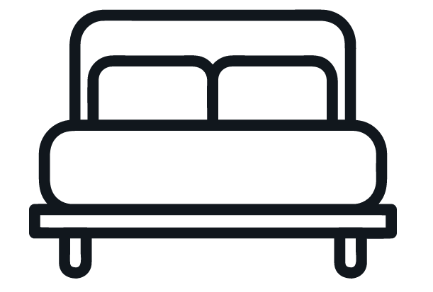
Overcrowding
12.8%
15.1%
The proportion of households deemed overcrowded by lack of overall rooms
5.9%
Thanet
Margate Central
Cliftonville East
7.2%
7.5%
8%
3.7%
… and by lack of bedrooms
Thanet
Dane Valley
Margate Central
Cliftonville West
Notes:
According to the 2021 Census, an average of 5.9% of households in Thanet have fewer rooms than required. By electoral ward, this rises to 12.8% in Margate Central and 15.1% in Cliftonville East. There were four other wards between 6-9%, with the remainder all being below the Thanet average.
In terms of bedrooms, 3.7% of households in Thanet qualify as overcrowded, rising to 7.2% in Dane Valley, 7.5% in Margate Central, and 8% in Cliftonville West. Newington closely follows Dane Valley at 6.8%, with five other wards also being slightly above the Thanet average.
Thanet sits below the England average but slightly above the Kent averages.
England averages
Rooms: 6.44%
Bedrooms: 4.37%
Kent averages
Rooms: 5.36%
Bedrooms: 3.56%
Sources: Occupancy rating for bedrooms - Office for National Statistics (ons.gov.uk)
Occupancy rating for rooms - Office for National Statistics (ons.gov.uk)

Slide 12

Respiratory Illness
Fuel Poverty
13.3% of households in Thanet were fuel poor in 2021
  9.7% in Kent and 13.1% nationally
Children living in cold homes are twice as likely to develop respiratory problems as those in warm homes.
People living in the 20% most deprived areas in Kent have approximately 4 times more emergency hospital admissions for COPD, than those in the 20% least deprived areas
Stark inequality in Kent annual COPD admissions
~430 per 100,000 population
~100 per 100,000 population
15.6%
Smoking prevalence in Thanet is on a downward trend
20% most deprived
20% least deprived
Notes:
Smoking prevalence according the GP patient survey (GPPS)
COPD admissions reduced sharply in the financial year ending 2021 due to the effect of the COVID pandemic. Admission rates increased in the following financial year but were still below pre-pandemic levels.
Fuel poverty
https://www.gov.uk/government/statistics/sub-regional-fuel-poverty-data-2023-2021-data
Smoking
https://fingertips.phe.org.uk/search/smoking#page/3/gid/1/pat/6/par/E12000008/ati/401/are/E07000110/iid/92304/age/168/sex/4/cat/-1/ctp/-1/yrr/1/cid/4/tbm/1

Slide 13
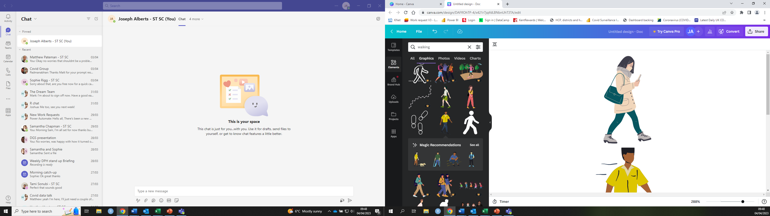
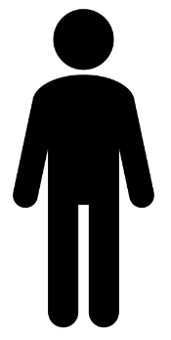
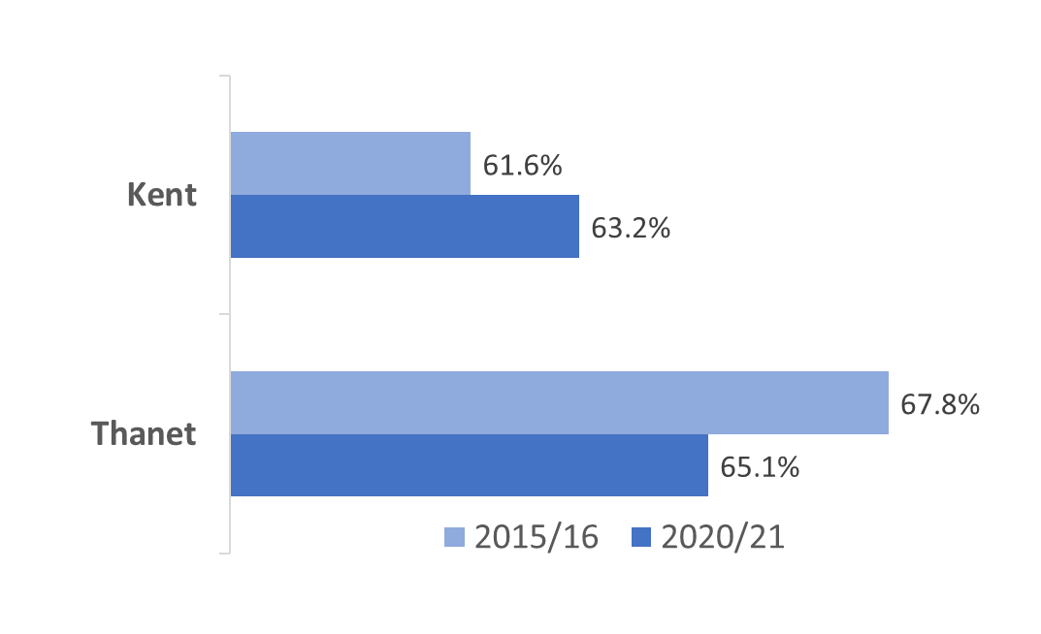

Healthy Eating and Physical Activity
COVID-19 had a noticeable effect in reducing activity levels, which declined between 2019-2021. However, Thanet maintained higher than average rates of cycling for the purpose of travel compared to all Kent districts from 2016-21.
Nationally, obesity is 10% higher in the most deprived communities (growing gap)
About 1 in 3 Thanet adults are obese
There are more overweight or obese people in Thanet, but prevalence has decreased
Thanet ranks 2nd out of 16 CIPFA nearest neighbour authorities on fruit and vegetable intake
38% of adults in Thanet eat their 5-a-day
Notes:
Nationally, prevalence of obesity is 10% higher in the most deprived communities and the gap between most and least deprived is growing
COVID-19 had a noticeable effect in reducing physical activity Kent, decreasing walking for travel by around 37% but increasing walking for leisure by 24% in years since
Between 2016-2021 cycling has decreased in Kent by 24% overall (percentage change, not percentage point difference)
According to the Active Lives Survey 2021-22, 53.4% of children and young people in Kent are not active enough (0.6% above the national average)
https://www.gov.uk/government/statistics/walking-and-cycling-statistics-england-2021
https://activekent.org/children-and-young-people/active-lives-children-young-people-survey/
Source for 1 in 3 adults obese and percentage of obesity or overweight is ONS Adult Lives Survey via Fingertips. 31.8% obese in Thanet
NB – new method for estimating fruit and veg uptake. Now survey asks ‘how many portions did you have yesterday?’ instead of ‘how many portions do you have on a typical day?’ 2021/2022

Slide 14
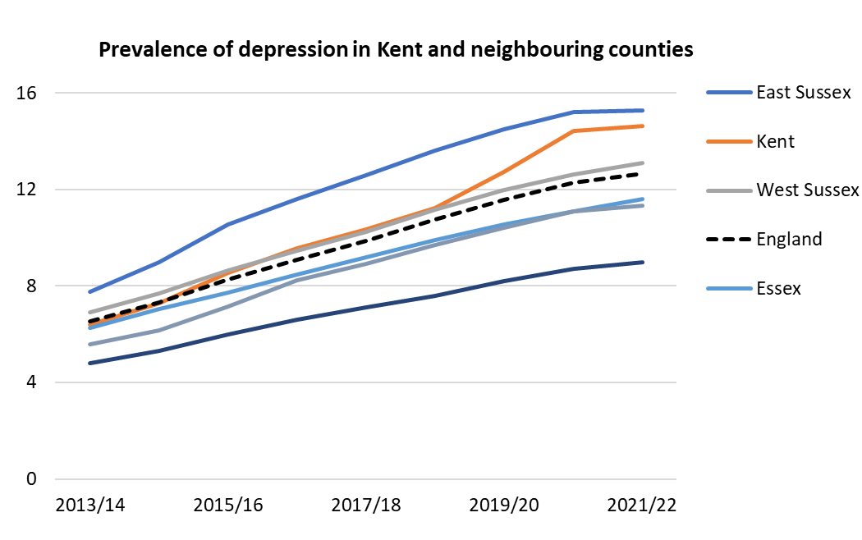
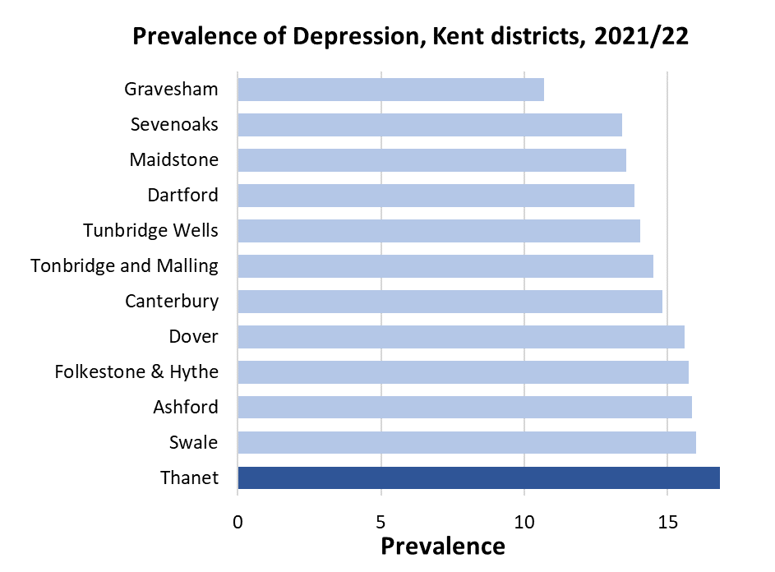
Mental Health - Depression
+130k depressed people in Kent 2013 - 2022
England and Kent have had a significant increase in prevalence of depression over the last 10 years, however prevalence in Kent has increased at a faster rate compared to England and neighbouring counties recently
Notes:
Prevalence of depression in Kent increased from 6.4% in 2013/14 to 14.6% in 2021/22. This is from QoF depression in ages 18+
updated

Slide 15
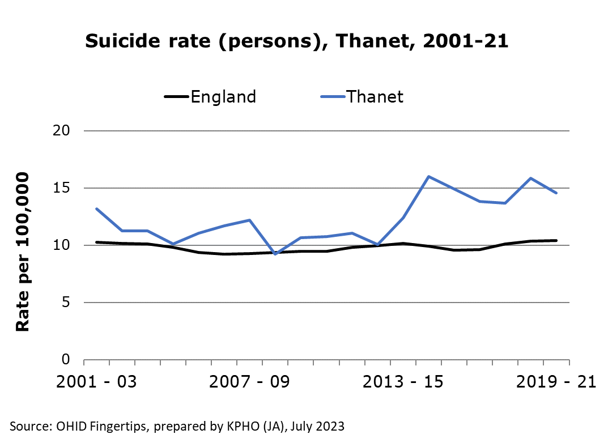

Suicide and Alcohol Admissions
The most recent data (2019-21) for suicide rates in Thanet shows them to be higher than the England average,
Thanet: 14.6 per 100,000
England: 10.4 per 100,000
Rates in Thanet have been significantly higher than England rates since 2014-16
The rate of admissions for intentional self-poisoning by alcohol exposure in 2021-22 was double in Thanet compared to the rate for England
Notes:
Suicide rates in Thanet have been significantly higher than England rates since 2014-16 (with the exception of the 2017-19 period).
Note: Although the suicide rate in Thanet is higher than the England rate prior to 2014-2016, this variation is in fact within the 95% confidence interval of the England rate. This means this variation shown is not statistically significant.
Rate of admission for intentional self-poisoning by and exposure to alcohol (2021-22)
Thanet: 66 per 100,000
England: 33.7 per 100,000
Source: OHID Fingertips

Slide 16
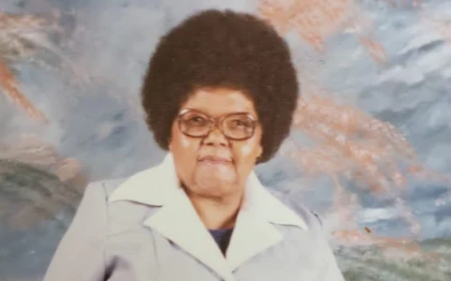
Loneliness
Across England, 45% of adults report feeling lonely
Around 30,000 of those aged 65 or over in Kent may suffer from acute loneliness
Case study of 58-year-old Sheila Seleoane from Peckham (London) who died in 2019. Her body was not discovered for two and half years
Sheila Seleoane
Notes:
It is estimated that around 10% of those aged 65 or over suffer from acute loneliness, this equates to around 30,000 people in Kent alone. The results of this isolation can be shocking.
In February 2022, the body of 58-year-old Shelia Seleoane was found at her flat in Peckham. She had been dead for two and a half years without having been discovered. Whilst her neighbours were suspicious that something bad had happened during this time, no concerned friends or family of hers had come forward. Sheila’s case also highlights a lack of coordination displayed by several organisations, mainly her housing association.
Whilst older people are especially vulnerable to the effects loneliness and tend to be at increased risk of isolation, 45% of adults report feeling occasionally lonely in England. This is linked to a myriad of adverse health effects, increasing the risk of conditions such as heart disease, stroke and obesity.
https://www.bbc.co.uk/news/uk-65055405

