Slide 1
Wider Health Determinant Indicators
Tonbridge and Malling District
Abraham George
Consultant in Public Health

Slide 2
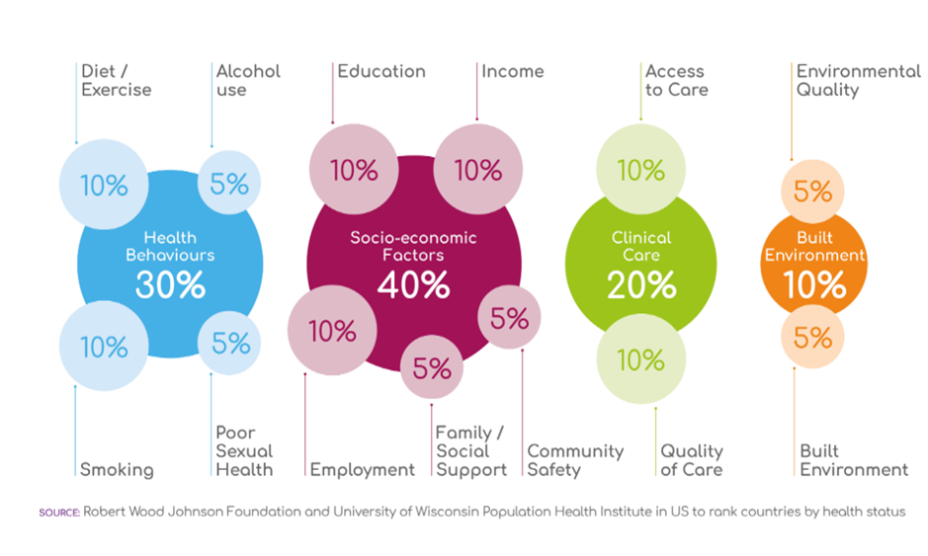
Robert Wood Johnson Model

Slide 3
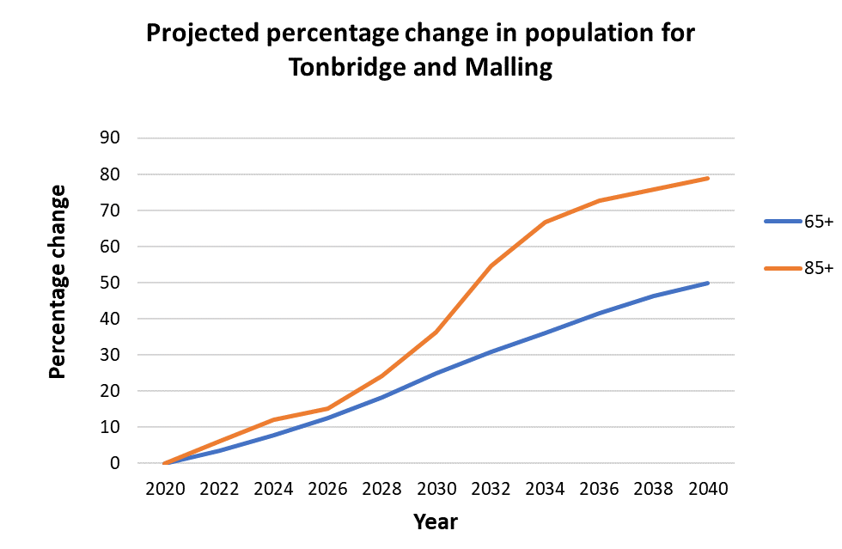
Population Projections
By 2040:
12,600 additional people aged 65+
  25,200 as of 2020
2,600 additional people aged 85+
  3,300 as of 2020
People aged 0-64 will grow by 17.6%, equating to ~18,900 people
Notes:
Updated

Slide 4
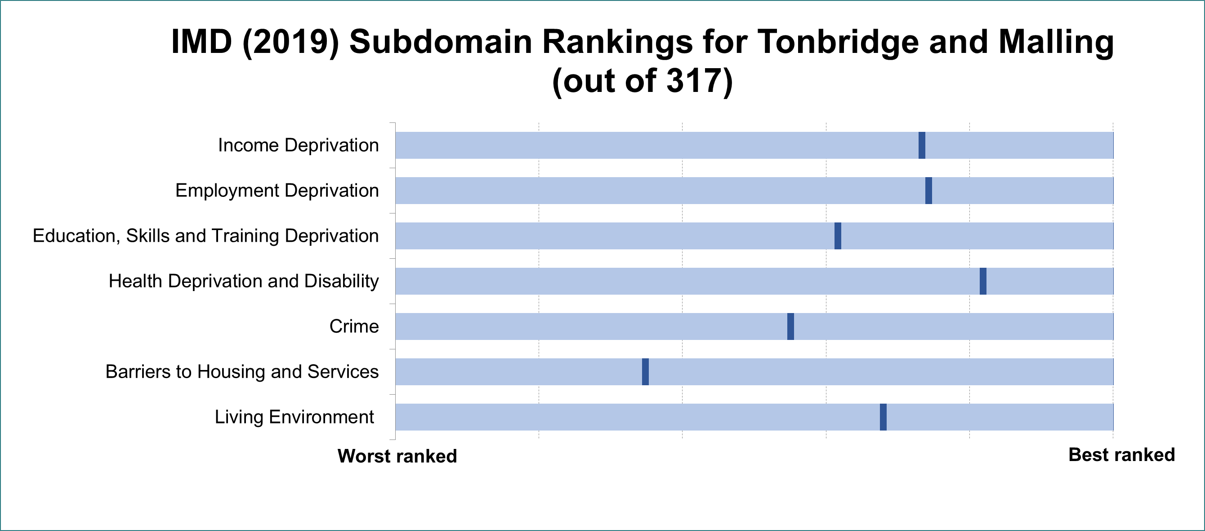
Deprivation
Tonbridge and Malling ranks 236 out of 317 local authorities overall across these seven sub-domains
Notes:
The index of multiple deprivation is a measure used to asses the level of deprivation an area sits at.
Tonbridge and Malling ranks 236 out of 317 overall. (1 is worst, 317 is best)
This is calculated from these seven sub-domains seen here.
This graph shows how Tonbridge and Malling ranks against all 317 other local authority districts in England (marked by the dark blue line)
Tonbridge and Malling performs better on income and employment deprivation, as well as Health deprivation but worse in barriers to housing.
The rankings are provided below for reference (1 is worst, 317 is best):
Income Deprivation 232
Employment Deprivation 235
Education, Skills and Training Deprivation 195
Health Deprivation and Disability 259
Crime 174
Barriers to Housing and Services 110
Living Environment 215
Data source: (File 10) https://www.gov.uk/government/statistics/english-indices-of-deprivation-2019
More on the indicators used to measure each sub-domain can be found in pages 65-70 of this technical report: https://www.gov.uk/government/publications/english-indices-of-deprivation-2019-technical-report

Slide 5
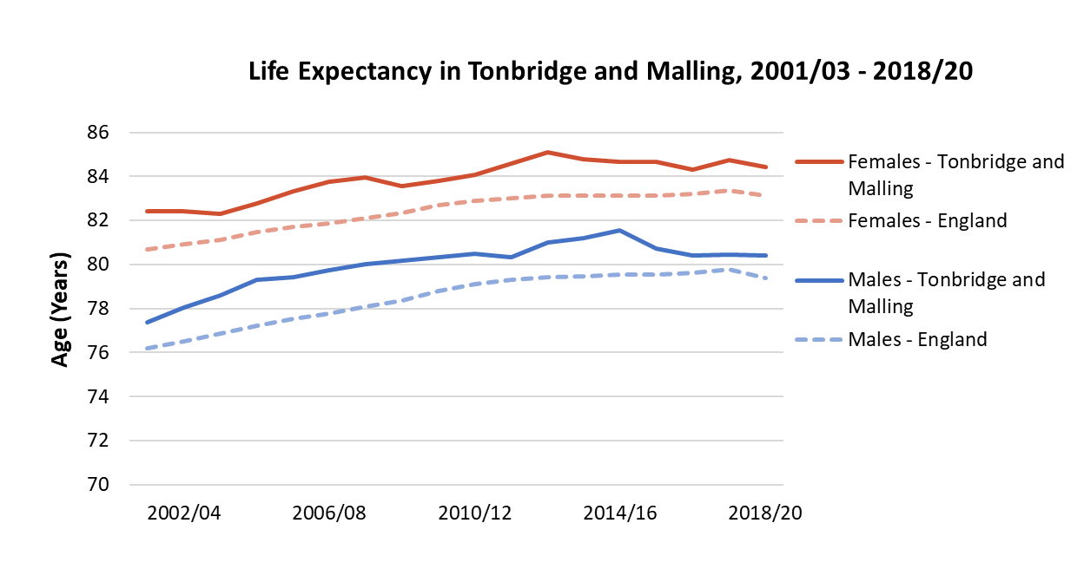
Life Expectancy
Life expectancy has plateaued, or even fallen in most recent years.
Inequality in life expectancy has fallen for males but not females
6.6 years
MALES
5.1 years
FEMALES
5.6 years
5.2 years
2010/12
Tonbridge and Malling
2018/20
Stark inequality in healthy life expectancy
10% most deprived
10% least deprived
52.2 years
70.7 years
National
Notes:
Updated
This indicator measures inequalities in life expectancy at birth. Life expectancy at birth is calculated for each deprivation decile of lower super output areas within each area and then the slope index of inequality (SII) is calculated based on these figures. The SII is a measure of the social gradient in life expectancy, i.e. how much life expectancy varies with deprivation. It takes account of health inequalities across the whole range of deprivation within each area and summarises this in a single number. This represents the range in years of life expectancy across the social gradient from most to least deprived, based on a statistical analysis of the relationship between life expectancy and deprivation across all deprivation deciles.

Slide 6
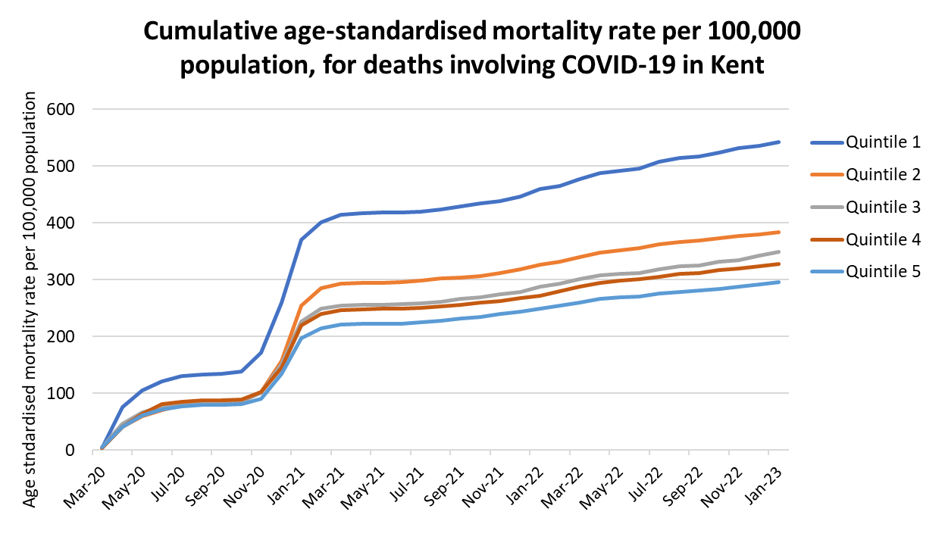
Inequalities in COVID Mortality
In Kent, mortality is 85% higher in the most deprived fifth of the population compared to the least deprived
Nationally, all Asian and Black ethnic groups have higher cumulative mortality rate than White. Pakistani and Bangladeshi group is 2.5 times higher. ‘Other Black’ group is over 3.5 times higher.
Notes:
Source: CHIME tool - CHIME - COVID-19 Health Inequalities (phe.gov.uk)
COVID Mortality rate is 85% higher in the most deprived fifth of the population in Kent compared to the least deprived.
At England level, all Asian and Black ethnic groups have higher cumulative mortality rates than White. Pakistani and Bangladeshi group is 2.5 times higher. ‘Other Black’ group is over 3.5 times higher.

Slide 7
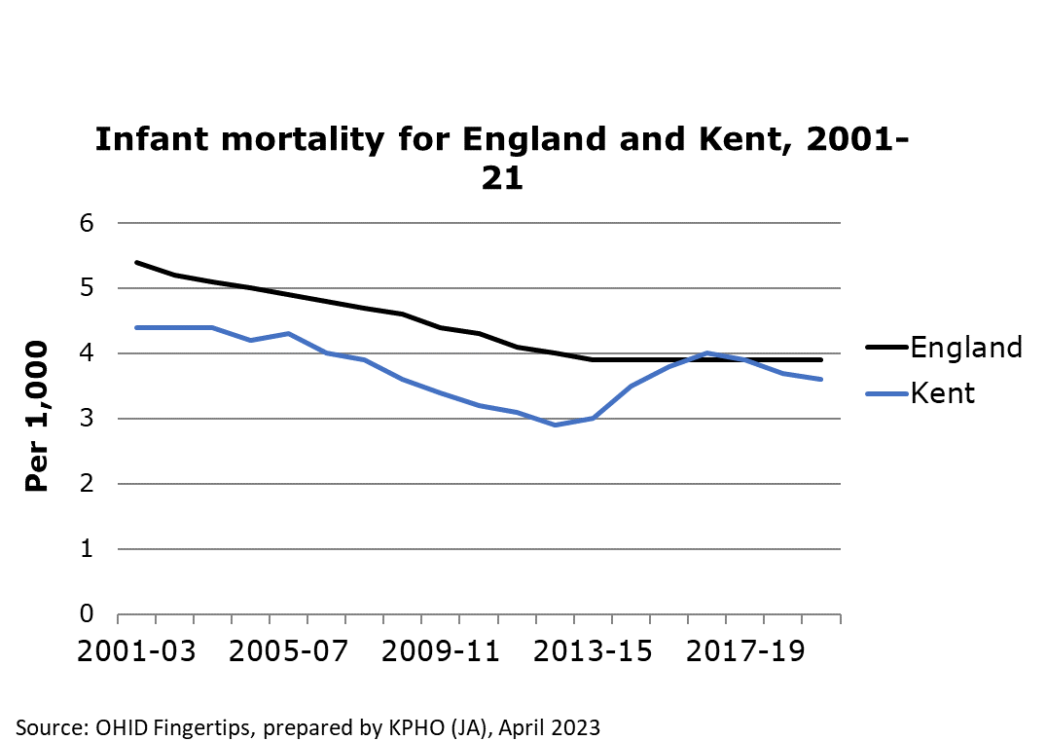
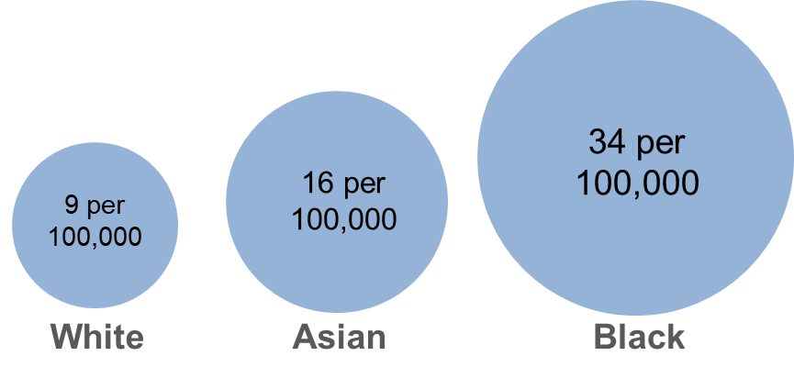
Infant and Maternal Health
UK maternal mortality during childbirth
In 2020, women in the UK were 3x more likely to die by suicide during or soon after end of pregnancy compared to 2017-19
Notes:
Infant mortality in Kent is consistently lower than the national rate, however this typically isn’t a significant difference
The following stats are for the UK,
Black women were 3.7x more likely to die than white women (34 women per 100,000 giving birth)
Asian women were 1.8x more likely to die than white women (16 women per 100,000 giving birth)
More women from deprived areas are dying and this continues to increase
In 2020, women were 3x more likely to die by suicide during or up to six weeks after the end of pregnancy compared to 2017-19 1.5 women per 100,000 giving birth
Sources:
Fingertips (Infant mortality) - https://fingertips.phe.org.uk/search/infant%20mortality#page/4/gid/1/pat/6/ati/402/are/E10000016/iid/92196/age/2/sex/4/cat/-1/ctp/-1/yrr/3/cid/4/tbm/1
MBRRACE report - MBRRACE-UK_Missing_Voices_2022_-_Infographic_v10.pdf (ox.ac.uk)

Slide 8
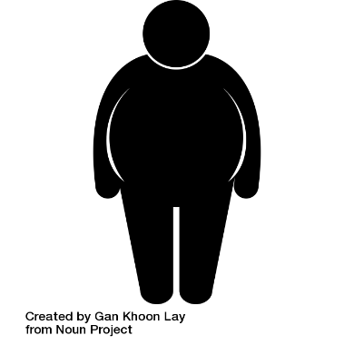
Childhood Obesity
The prevalence of excess weight in Tonbridge and Malling’s Year R Children decreased significantly from 2019/20 - 2021/22 from 24% to 20.6%
Obesity decreased slightly, from 9.6% to 9%
Severe obesity increased slightly from 1.8% to 2.4%
Change from 2019/20 to 2021/22 school year
Excess Weight
-3.4%
Obesity
-0.6%
Severe Obesity
+0.6%
x2
Kent (Year R)
In 2021/22 Tonbridge and Malling had the lowest proportion of severely obese Year 6 children out of all Kent districts at 2.6%
Least deprived
6.4% Obese
Most Deprived
12.9% Obese
Notes:
The prevalence of excess weight in Tonbridge and Malling’s Year R Children decreased significantly from 2019/20 - 2021/22 from 24% to 20.6%
Obesity decreased slightly, from 9.6% to 9%
Severe obesity increased slightly from 1.8% to 2.4%
(all these values are lower than Kent averages)
Kent averages(2021/22):
Excess weight: 21.3%
Obesity: 9.4%
Severe obesity: 2.6%
In 2021/22, Children in Year R living in the most deprived areas of Kent were twice as likely to be obese compared to children leaving in the least deprived areas.
Whilst 12.9% of children were considered obese in the most deprived areas, just 6.4% were considered obese in the least deprived areas (by deprivation quintiles).
In 2021/22 Tonbridge and Malling had the lowest proportion of severely obese Year 6 children out of all Kent districts at 2.6% (Kent average: 5.1%).
Sources: NCMP 2021/22
NCMP 2019/20

Slide 9



Educational Attainment
34% disadvantaged Key Stage 2 pupils met the expected standard in reading, writing and maths (RWM) in Tonbridge and Malling, 2021/22
67% non-disadvantaged pupils met this standard
2.91
3.23
60% of pupils in Tonbridge and Malling achieved the expected standard in RWM in 2021/22, down 11% since 2018/19
2022
2019
Nationally, the disadvantage gap index is at the highest level since 2012, suggesting that disruption to learning during the COVID-19 pandemic has had a greater impact on disadvantaged pupils.
Notes:
40% / 66% in Kent, 43% / 66% in England
In Kent there was a general trend of increased attainment from 2011 – 2019, then no recording during the pandemic, and the latest figures show reduced attainment.
Learning loss for disadvantaged pupils has been consistently greater than for pupils overall and, as a result, the gap in attainment has grown since 2019. The disadvantage gap index (a measure of the difference in attainment between disadvantaged and other pupils) at the end of primary school was 3.23 in 2022, compared with 2.91 in 2019. Left unaddressed, lost learning may lead to increased disadvantage and significant missing future earnings for those affected.
Updated

Slide 10


Pupil Absence
Kent (2021/22)
Persistent Absentees (10% or more sessions missed) almost doubled from the previous year from 13.2% to 24.1%
Severe Absentees (50% or more sessions missed) increased by half from the previous year from 1.2% to 1.8%
Persistent and Severe Absence by Ethnicity
Least Absent
Chinese
All Black ethnic groups
Most Absent
Irish Traveller
Roma Gypsy
Free School Meals
x2 as likely to be persistently absent
x4 as likely to be severely absent
Notes:
Absences of all kinds (including authorised) have increased post-COVID
This slide focusses on the children worst effected, persistently or severely absent children
Trends are similar between Kent and England
The overall percentage of persistent absentees in Kent increased in 2021/22 by 10.9% from 2020/21 from 13.2% to 24.1%
The overall percentage of severe absentees in Kent increased in 2021/22 by 0.6% from 2020/21 from 1.2% to 1.8%
The ethnic groups with the highest proportion of persistent and severe absentees are Irish Travellers (Persistent: 76%, Severe: 9.9%) and Gypsy Roma (Persistent: 72.1%, Severe: 6.4%).
Those with the lowest proportions are Chinese (Persistent: 5.2%, Severe: 0.1%) and the total of all Black ethnic groups (Persistent: 9.3%, Severe: 0.7%).
Children eligible for FSM are more than twice as likely to be persistently absent than those not eligible for FSM (43.4% compared to 18.2%) and more than four times as likely to be severely absent (3.7% compared to 0.9%)
Note: This data shouldn’t be effected by strike action, as guidance from the Department for Education states that students shouldn’t have a ‘Y’ (enforced closure) marking on their attendance, which is not classed as an absence
Sources:
https://explore-education-statistics.service.gov.uk/data-tables/permalink/5be187b3-5841-429e-5f68-08db44b1b303
https://explore-education-statistics.service.gov.uk/data-tables/fast-track/9b8318dd-bb02-4220-8249-08db1fecc641
https://explore-education-statistics.service.gov.uk/data-tables/permalink/2f088f8d-3266-4440-5f6b-08db44b1b303
https://explore-education-statistics.service.gov.uk/data-tables/permalink/ed018804-c700-4d35-7616-08db43d84656

Slide 11

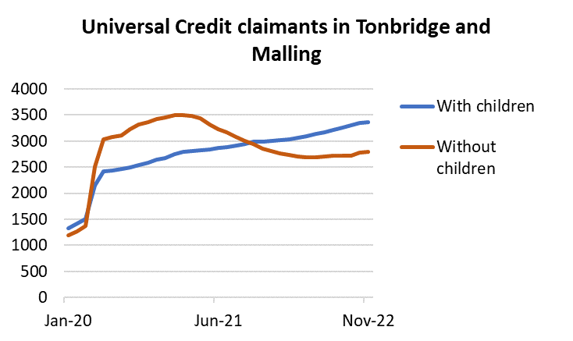

Families in Poverty
53k
12.8%
+16k children in low income families
17.6%
Children in Trench ward are more than 4x more likely to live in a low income family, than those in Hildenborough ward
2015
2022
37k
Kent
Universal Credit claimants in Tonbridge and Malling
Claims from those without children increased much more quickly during the pandemic, peaking in February 2021.
There was a sharp increase in claims from those with children between March 2020 and May 2020, then a gradual increase which has not slowed down since
Notes:
Children living in low-income families has increased by ~5% in Kent since 2015
Children in a low income family:
Trench – 23.5%
Hildenborough – 5.3%
Source: Children in Low Income Families: local area statistics, United Kingdom, financial years ending (FYE) 2015 to 2022 (DWP)
https://www.gov.uk/government/statistics/children-in-low-income-families-local-area-statistics-2014-to-2022

Slide 12
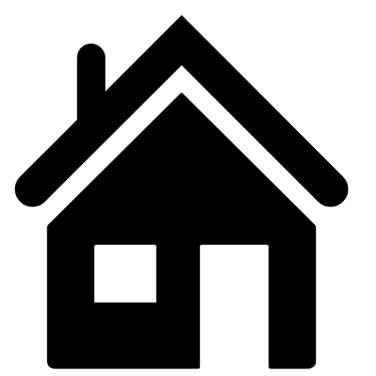

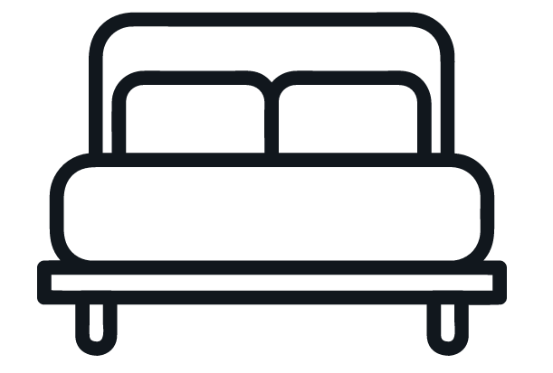
Overcrowding
7.4%
5.2%
5.6%
The proportion of households deemed overcrowded by lack of overall rooms
3.6%
Tonbridge and Malling
Vauxhall
Trench
Snodland East and Ham Hill
4.9%
5.3%
4.1%
2.5%
… and by lack of bedrooms
Tonbridge and Malling
East Malling
Trench
Snodland East and Ham Hill
Notes:
According to the 2021 Census, an average of 3.6% of households in Tonbridge and Malling have fewer rooms than required. By electoral ward, this rises to 5.2% in Vauxhall, 5.6% in Trench and 7.4% in Snodland East & Ham Hill. Medway was at 4.8% and the remainder of wards were at 4% or below.
In terms of bedrooms, 2.5% of households in Tonbridge and Malling qualify as overcrowded, rising to 4.1% in East Malling, 4.9% in Trench and 5.3% in Snodland East & Ham Hill. Higham, Judd, Medway were between 3-4%, whilst the remainder of wards were below 3%.
T&M sits below the England and Kent averages overall.
England averages
Rooms: 6.44%
Bedrooms: 4.37%
Kent averages
Rooms: 5.36%
Bedrooms: 3.56%
Sources: Occupancy rating for bedrooms - Office for National Statistics (ons.gov.uk)
Occupancy rating for rooms - Office for National Statistics (ons.gov.uk)

Slide 13

Respiratory Illness
Fuel Poverty
7.3% of households in Tonbridge and Malling were fuel poor in 2021
  9.7% in Kent and 13.1% nationally
Children living in cold homes are twice as likely to develop respiratory problems as those in warm homes.
People living in the 20% most deprived areas in Kent have approximately 4 times more emergency hospital admissions for COPD, than those in the 20% least deprived areas
Stark inequality in Kent annual COPD admissions
~430 per 100,000 population
~100 per 100,000 population
Smoking prevalence in Tonbridge and Malling decreases every year and is lowest in Kent
11.3%
20% most deprived
20% least deprived
Notes:
Smoking prevalence according the GP patient survey (GPPS)
2018/19 12.7
2019/20 11.2
2020/21 13.0
2021/22 11.4
Between 2017/18 and 2019/20 the COPD admission rates don’t vary significantly within quintiles 1 and 5, however in 2020/21 the admission rates in both quintiles falls by nearly half. In 2021/22 the rate in both groups is still slightly lower than pre-2020.
Fuel poverty
https://www.gov.uk/government/statistics/sub-regional-fuel-poverty-data-2023-2021-data
Smoking
https://fingertips.phe.org.uk/search/smoking#page/3/gid/1/pat/6/par/E12000008/ati/401/are/E07000110/iid/92304/age/168/sex/4/cat/-1/ctp/-1/yrr/1/cid/4/tbm/1

Slide 14
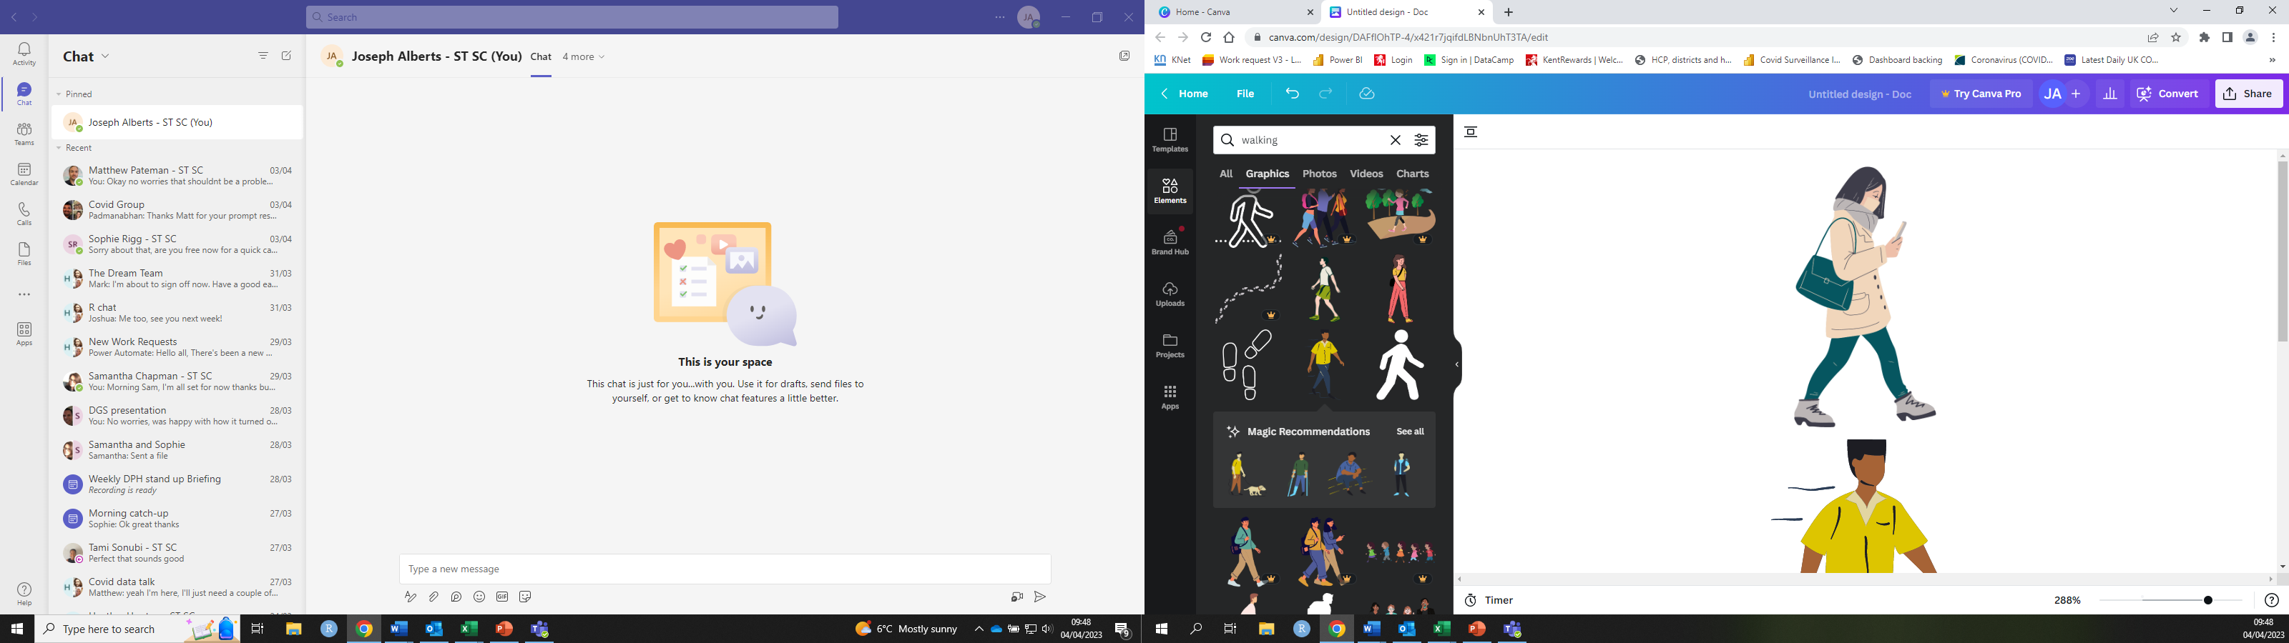
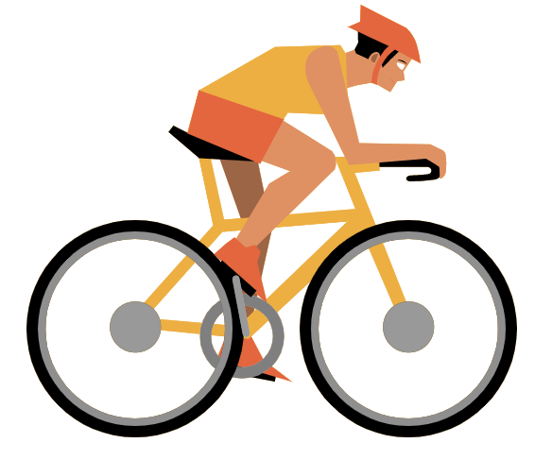
Active travel
COVID-19 had a noticeable effect in reducing activity levels, which have declined between 2019-2021
Kent consistently ranks above the England average
Tonbridge and Malling saw the largest increase in cycling for leisure from 2016-21, whilst most districts saw an overall decline
According to the Active Lives Survey 2021-22, 53.4% of children and young people in Kent are not active enough
2019
2021
Kent
Leisure
+24%
Travel
-37%
2016
Kent
-24%
2021
Notes:
https://www.gov.uk/government/statistics/walking-and-cycling-statistics-england-2021
https://activekent.org/children-and-young-people/active-lives-children-young-people-survey/
This data was used by KPHO to produce a walking/cycling report, which is still in development
COVID-19 had a noticeable effect in Kent, decreasing walking for travel by around 37% but increasing walking for leisure by 24% in years since
Between 2016-2021 cycling has decreased in Kent by 24% overall (percentage change, not percentage point)
Kent consistently ranks above the England average
Active Travel data also shows that whilst cycling for leisure between 2016-21 declined in most districts, T&M was one of a few districts to see an increase overall
According to the Active Lives Survey 2021-22, 53.4% of children and young people in Kent are not active enough (0.6% above the national average)

Slide 15

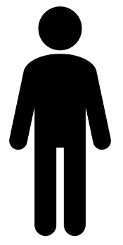
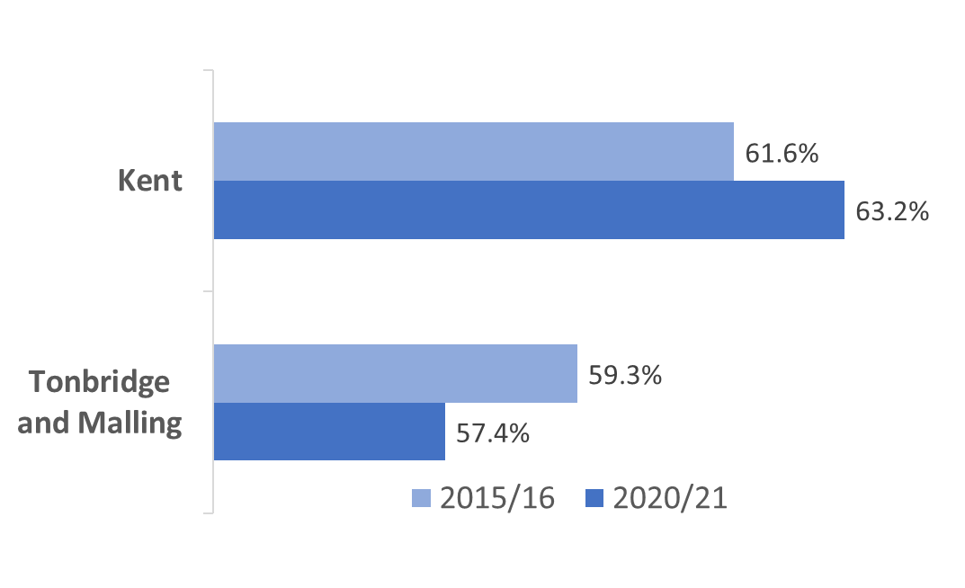
Healthy Living
Nationally, obesity is 10% higher in the most deprived communities (growing gap)
35% of adults in Tonbridge and Malling eat their 5-a-day
About 1 in 4 Tonbridge and Malling adults are obese
There are less overweight or obese people in Tonbridge and Malling, and prevalence is decreasing
Tonbridge and Malling ranks poorly on fruit and vegetable intake against CIPFA nearest neighbour local authorities (13th out of 16 nearest neighbours)
Notes:
Nationally, prevalence of obesity is 10% higher in the most deprived communities and the gap between most and least deprived is growing
Source for 1 in 4 adults obese and percentage of obesity or overweight is ONS Adult Lives Survey via Fingertips
NB – new method for estimating fruit and veg uptake. Now survey asks ‘how many portions did you have yesterday?’ instead of ‘how many portions do you have on a typical day?’

Slide 16
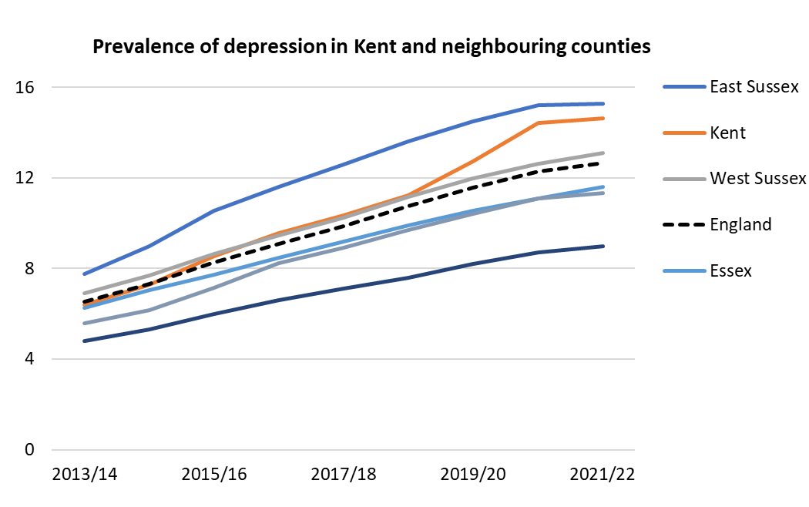
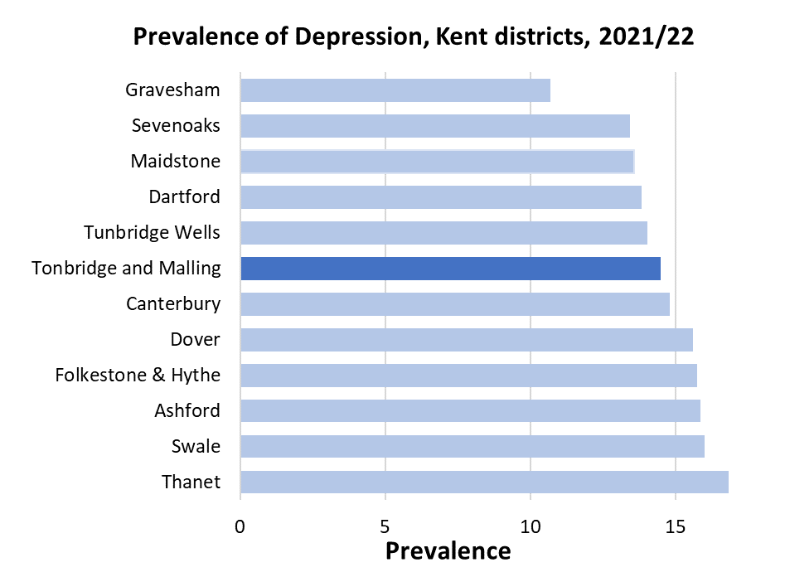
Mental Health - Depression
+130k depressed people in Kent 2013 - 2022
England and Kent have had a significant increase in prevalence of depression over the last 10 years, however prevalence in Kent has increased at a faster rate compared to England and neighbouring counties recently
Notes:
Prevalence of depression in Kent increased from 6.4% in 2013/14 to 14.6% in 2021/22. This is from QoF depression in ages 18+
updated

Slide 17
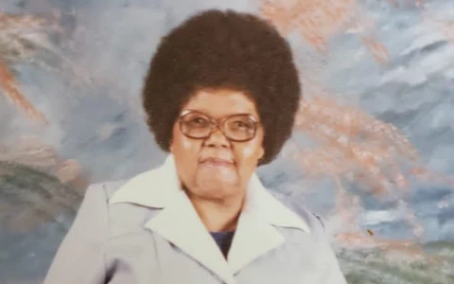
Loneliness
Across England, 45% of adults report feeling lonely
Around 30,000 of those aged 65 or over in Kent may suffer from acute loneliness
Case study of 58-year-old Sheila Seleoane from Peckham (London) who died in 2019. Her body was not discovered for two and half years
Sheila Seleoane
Notes:
It is estimated that around 10% of those aged 65 or over suffer from acute loneliness, this equates to around 30,000 people in Kent alone. The results of this isolation can be shocking.
In February 2022, the body of 58-year-old Shelia Seleoane was found at her flat in Peckham. She had been dead for two and a half years without having been discovered. Whilst her neighbours were suspicious that something bad had happened during this time, no concerned friends or family of hers had come forward. Sheila’s case also highlights a lack of coordination displayed by several organisations, mainly her housing association.
Whilst older people are especially vulnerable to the effects loneliness and tend to be at increased risk of isolation, 45% of adults report feeling occasionally lonely in England. This is linked to a myriad of adverse health effects, increasing the risk of conditions such as heart disease, stroke and obesity.
https://www.bbc.co.uk/news/uk-65055405

Slide 18
Summary
Better than Kent average for many indicators, but:
Life expectancy is plateauing, and inequality in life expectance for females is increasing
Inequalities
40% educational attainment gap (KS2)
Increase in severe obesity in Year 6 pupils (likely to be greater in more deprived groups)
Marked and sustained increase in Universal Credit claimants over the pandemic
4X more children living in poverty in most compared to least deprived wards
Twice as much overcrowding in more deprived areas

